Slide 1
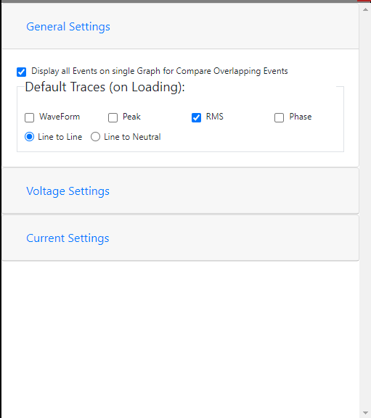
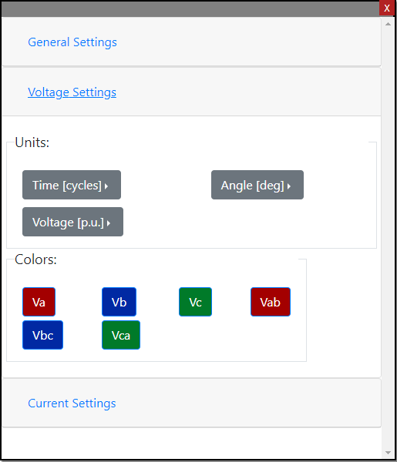
Automatic Zoom Limits
Manual Zoom Limits
Automatic Zoom Limits
Manual Zoom Limits
Time Min
Time Max

Slide 2
Use Automatic Limits
Use Manual Limits
The “Units” buttons correspond to the number of axes and the labels here should be dependent on which Settings we are editing
Use Automatic Limits
Use Manual Limits
Use Automatic Limits
Use Manual Limits
Voltage Min
Voltage Max
Use Automatic Limits
Use Manual Limits
Angle Min
Angle Max

Slide 3
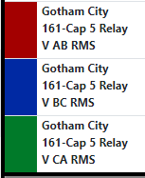
Time | Value | 500.3869629 sec 30023.22 cycles | Point 2 | Point 3
 | Delta | N/A | Point 2 | Point 3
 | Value | 0.09 V | Point 2 | Point 3
 | Delta | N/A | Point 2 | Point 3
 | Value | 0.03 V | Point 2 | Point 3
 | Delta | N/A | Point 2 | Point 3
 | Value | 0.10 V | Point 2 | Point 3
 | Delta | N/A | Point 2 | Point 3
Scrolls <=> as more points are added up to whatever default max width of the side panel
The Time Value and Delta should have the selected Time Unit on the first line and cycles on the second line, unless cycles is the selected Unit, in which case remove the first line.

Slide 4
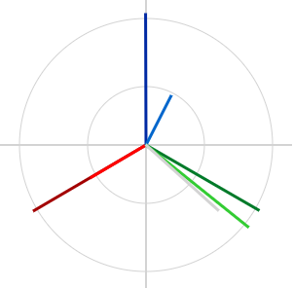
The chart needs to resize with the panel/drawer and remain a square/circle (no oblong charts!).
If more channels than fit in the table below the chart are listed or more than one Asset is selected, the table should scroll separately from the entire panel/drawer. The panel itself should not need to scroll.
The name of the Asset should be represented on the left of the channels that belong to it in the table.
 |  |  | Mag[kV] | Ang[deg]
 |  | Vab | 233.41 | -149.61
 |  | Vbc | 235.02 | 90.18
 |  | Vca | 233.48 | -30.05
 |  | Ia | 0.16 | -149.39
 |  | Ib | 0.14 | 62.95
 |  | Ic | 0.32 | -38.76
 |  | Ires | 0.24 | -42.14

Slide 5
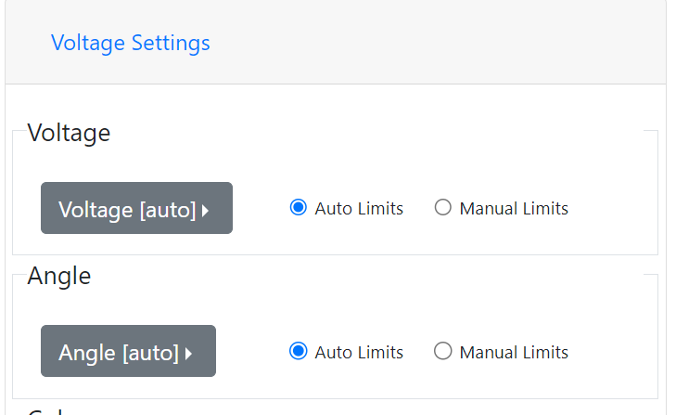
Overlapping Event 1:

