Slide 1

Introduction to GPA

Slide 2

Who We Are
GPA is a not-for-profit corporation established in 2010
Specialize in software and services for the electric utility industry
All software is open source, published under the permissive MIT license
Focus on a robust, reliable and resilient grid

Slide 3

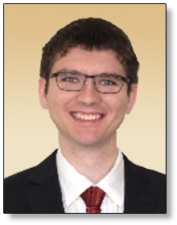

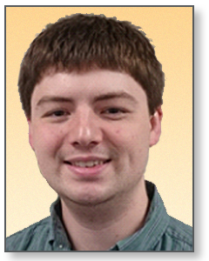
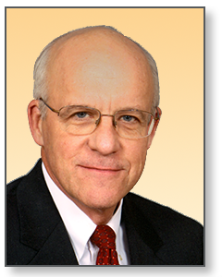
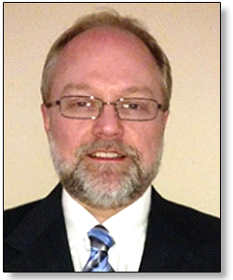
Key GPA Staff
Dr. Christoph Lackner
Operating Officer & Lead Engineer
ROLE: Operational & Engineering Leadership
Erika Wills
Senior Support Engineer
ROLE: Support & Project Leadership
Grid Protection Alliance, Inc., specializes in the development and support of innovative software solutions for the electric industry.
GPA has a track record of innovation and has led major software development projects with client utilities and the Federal Government.
In addition to custom application development, GPA offers services for installation, set-up, integration, and on-going maintenance of its open-source software.
Establishes new software development projects and assures the successful completion of established projects.
Provides engineering oversight of GPA analytic applications.
8+ years’ experience with synchrophasor data analytics and use of synchrophasor data in various applications such as state estimation, predictive maintenance, and system parameter estimation.
Specializes in the development of real-time and offline data analytics for power systems.
Recently joined GPA.
Previous experience in sales, operations and technical support.
10+ years of experience in customer support and project management.
B.S. in IT with focus on software development.
Stephen Wills
Senior Systems Analyst
ROLE: Lead Software Development
Ritchie Carroll
Senior Solutions Architect
ROLE: Systems Architect & Lead Developer
Russell Robertson
Principal
ROLE: Strategic Studies
Major contributor to GPA software solutions and provides system support and integration services to utilities.
10 years’ experience in developing .NET solutions, much of that time contributing significantly to GPA’s core code base – the Grid Solutions Framework.
Specializes in the management of data from substation devices – PMUs, DFRs, power quality meters, and relays.
Prior to joining GPA, extensive experience at the Tennessee Valley Authority in development of synchrophasor data software.
Oversees GPA software development and provides software system design and development services to utilities.
25+ years’ expertise in high-performance software system design, development, and delivery. Has led numerous large software development projects.
10 years at the Tennessee Valley Authority leading synchrophasor software development among other operational systems.
Active participant in NASPI and other industry efforts to improve synchrophasor data systems.
Establishes collaborations within the utility industry to support the development and maintenance of open-source software.
Founded GPA’s open-source software and consulting-service business.
Expertise in grid operations, IT/OT architecture, information management, and control systems.

Slide 4








GPA General Facts
Headquartered in Chattanooga, TN
Founded in 2010
Focus on open-source software
<10 employees
Clients include U.S. and international utilities

Slide 5
Open-Source
Almost all code developed by GPA is open-source
Actively involved with the standards of associations such as IEEE
Work with Linux Foundation and other open-source communities
Publishes almost all code on GitHub
Employees are involved with various open-source projects outside of work

Slide 6
Providing the Layer between Data and Engineers
We do not develop any measurement devices
Applications are both front-end (e.g., engineering desk, web applications, control room) and backend (e.g., data storage, retrieval, and processing)
Not a classical Big Data business
  We do not provide data analysis services
  Develop applications hosted by clients
Focus on security and reliability
  Grid operations depend on our software; reliable 24x7 operation is required
  Applications are in highly secured networks at utilities

Slide 7








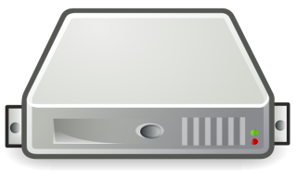







openXDA Suite of Tools
Field Devices
Control Center Infrastructure
External Access
Engineering Desktops
OR
Configuration Tools
Our applications are involved in all stages of the data lifecycle
DFR
Relay
OR
PQM

Slide 8
Internship Available
Software Engineer Intern
  Primarily front-end bug fixing
  No experience with electric power systems required
  Part-time, flexible hours
  Competitive salaries
  Small company = large impact and opportunity!

