Slide 1

GPA PQ Tools for Automated Fault Analysis for faster Line Crew Response Times

Slide 2










GPA PQ Tools
Data
Collection
Data
Analysis
Data
Visualization
PQ Interval
Data

Slide 3




Where does the Data come From
GPA PQ Tools focus on Power Quality Data
  PQ Meters
    ION Devices
  DFRs
    APP
    Mehatech
    USI
  Relays
    SEL
    GE
  Revenue Meters
    Schneider
    Jemstar
GPA Tools are vendor agnostic
Process data from standard files
  PQDIF
  COMTRADE
Working with vendors to process other formats
  SEL cev Files
  Schneider ION Files

Slide 4

Automated Fault Analysis
Trip Coil energization Analysis*
  Requires TCE monitor
  Determine Breaker characteristics for Asset Health
Single Ended Fault Location
  Estimate distance to fault based on 1 end monitored
Double Ended Fault Location
  Estimate distance to fault based on both ends being monitored
Event Classification
  Classify event as Sag, Swell, Fault, breaker operation, interruption etc
Event Characterization
  Type of Fault, size of Swell/Sag etc
IEEE 1547 Reporting*
  Determines if event violates IEEE 1547
Breaker Operations & SOE
  Correlate events with breaker operations (SCADA) and SOE information
CapBankHealth Analytic*
  Identify health issues on monitored cap Banks
  Include Fuse and relay health indicators
Lightning Data Correlation*
  Identify relevant Lightning strikes around an event
Fault Cause Identification*
  Identify most likely cause of a Fault
* Some Analytics are only available in the Enterprise Edition.

Slide 5
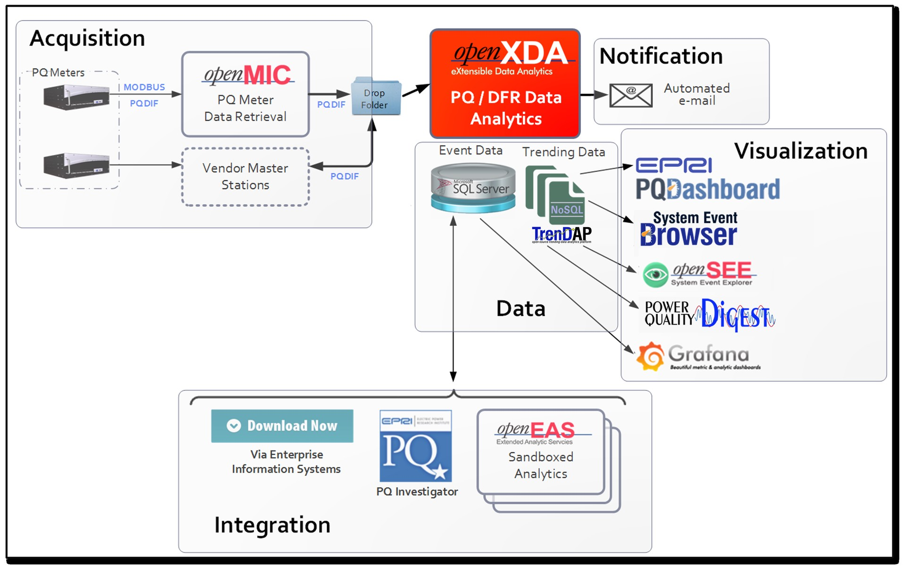
Infrastructure for Automated Fault Analysis

Slide 6
Current Line Crew Response to a Fault
Line Crews respond to Faults on the lines
Location of faults are not exactly known
  Crews drive the lines to identify faulted locations
Cause may not be known
  Equipment for repair may not be on truck
Review of detailed incident data may take days
  Collecting DFR records
  Analyzing records

Slide 7
Improved Line Crew Response
openXDA can provide
  timely notification to Line Crew
  estimated fault location
  closest structure based on GIS information
  GIS overview to determine best point of access
  Most likely cause of fault
  Additional information such as line type or special characteristics
Line Crews can respond faster and more targeted

Slide 8
Real Improvements
Large Transmission Utility with 1000+ DFRs
DFR data is collected within 3-4 minutes of event
System processes events within 5 minutes
Targeted notifications are send out within 6 minutes
  Text messages with basic information
  Email messages with GIS information, closest structure and most likely cause
Line crews are still dispatched manually
  Often Crews are ready and have information before dispatch

Slide 9
Example Notification - Summary
From: powerquality@gpa.org <powerquality@gpa.org>
Sent: Thursday, July 14, 2022 10:51 PM
To: Power Quality <PowerQuality@gpa.org>
Subject: Fault detected on Chattanooga 161kV Line 1 (L1234)
Station: | Chattanooga (S4321) | Birmingham AL (S8765)
DFR: | GPA APP DFR (APP) | GPA APP DFR 2 (APP)
File: | 5146.dat | 1256.dat
Breaker: | B1 | B2
Fault Type: | BN | BN
Inception Time: | 21:22:27.6365620 | 21:22:27.6365235
Fault Duration: | 85.208 msec (5.11 cycles) | 56.771 msec (3.41 cycles)
Fault Current: | 8581.1 Amps (RMS) | 8785.0 Amps (RMS)
Distance Method: | Reactance | Takagi
Single-ended Distance: | Structure # 23 (4.591 miles from Chattanooga) | Structure # 26 (2.960 miles from Birmingham)
Double-ended Distance: | Structure # 25 (5.345 miles from Chattanooga) | Structure # 26 (2.978 miles from Birmingham)
Double-ended Angle: | 0.078° | -0.139°
Click for fault report: | 7440641 | 7440826

Slide 10
Example Notification – Fault Causes
 | Probability of Fault Cause
DFR: | GPA APP DFR (APP) | GPA APP DFR 2 (APP)
Tree: | Low (Rf = 1.36) | Low (Rf = 2.93)
Lightning: | No lightning found | No lightning found
Insulation Flashover: | Low (75.12° from peak) | Low (79.06° from peak)
Arrester Failure: | Low (0.00) | Low (0.00)
Conductor Slap / Debris Midspan: | No (applies only to multi-phase faults) | No (applies only to multi-phase faults)
Broken Conductor: | Low (0.94) | Low (0.92)
Line Parameters: | Value: | Per Mile:
Length (Mi) | 8.28 | 1.0
Pos-Seq Imp Z1 (Ohm) (LLL,LLLG,LL,LLG) | 6.1073∠85.8624° 0.4407+j6.0914 | 0.7376∠85.8624° 0.0532+j0.7376
Zero-Seq Imp Z0 (Ohm) | 21.471∠75.2423° 5.4693+j20.7627 | 2.5931∠75.2423° 0.6605+j2.5076
Loop Imp ZS (Ohm) (LG) | 11.184∠79.0894° 2.1169+j10.9819 | 1.3507∠79.0894° 0.2557+j1.3263

Slide 11
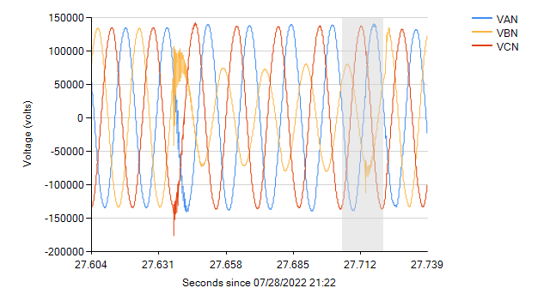
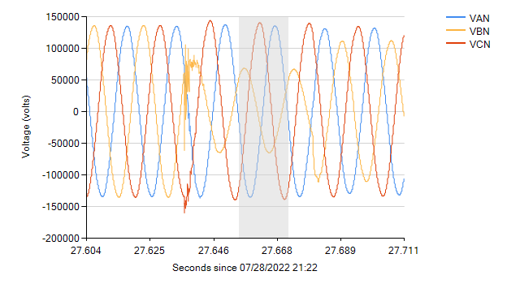
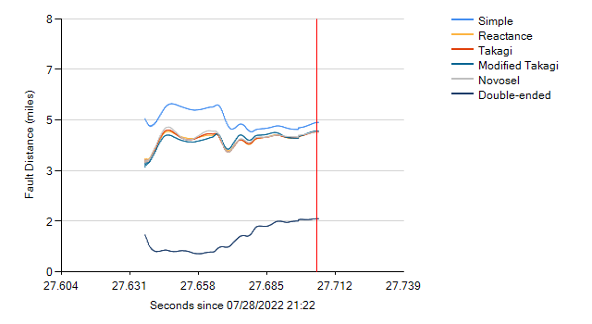
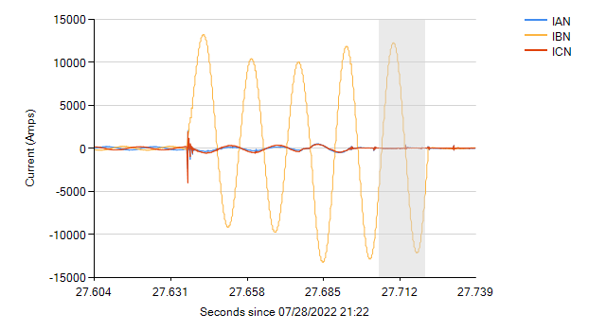
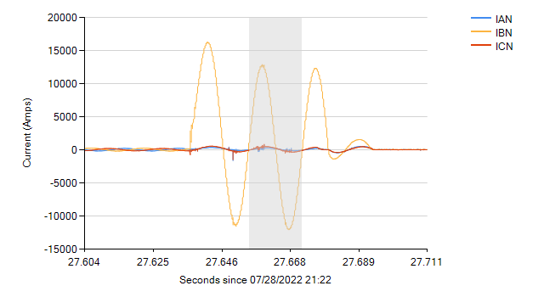
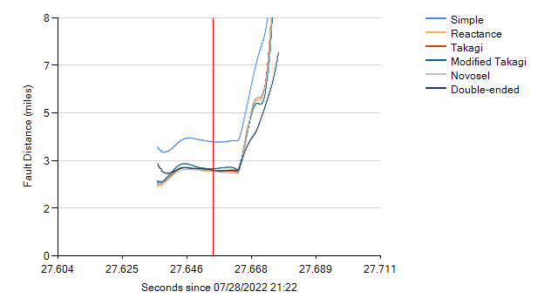
Example Notification - Data
Chattanooga - Voltage
Birmingham - Voltage
Birmingham – Fault Distance
Chattanooga - Current
Birmingham - Current
Birmingham – Fault Distance

Slide 12
Notification Details
Targeted Notifications
  openXDA allows notifications based on specific events on specific assets
  Personnel assigned to a Transmission Line can be notified of any issues wit that Line
  Summary notifications are available for engineers where no ommidiate action is required
Self Subscription
  Users can manage their own subscription
  Tie in with cooperate AD for email and phone
Regulatory Restrictions Available
  Notifications can be restricted to require approval

Slide 13
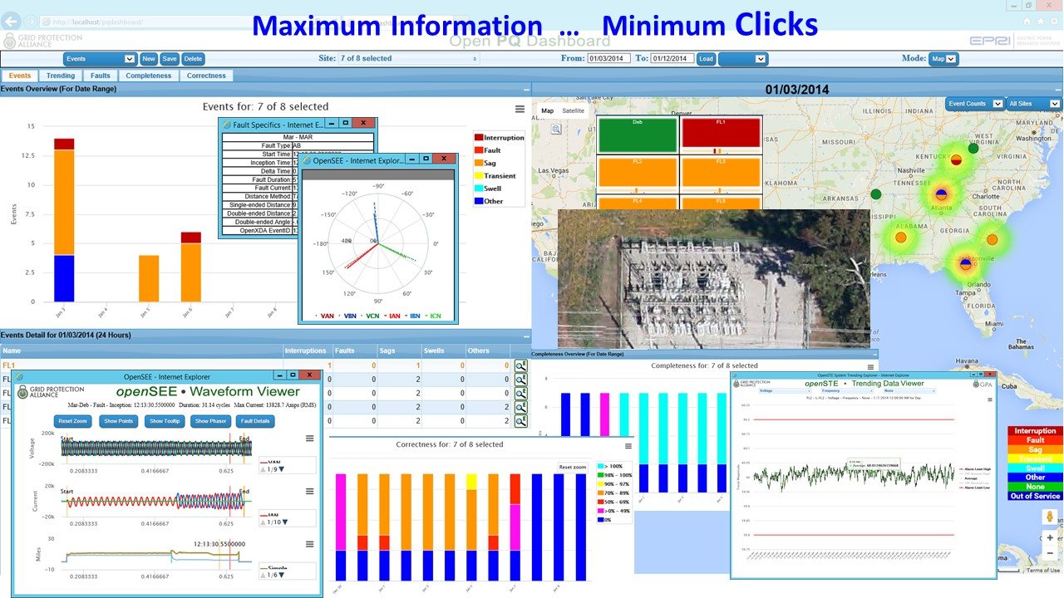
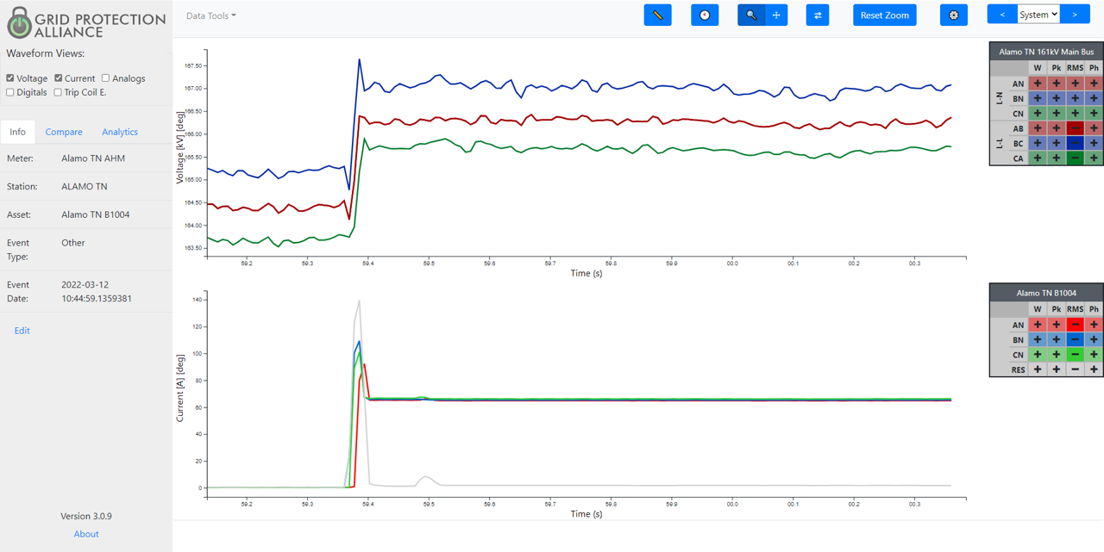
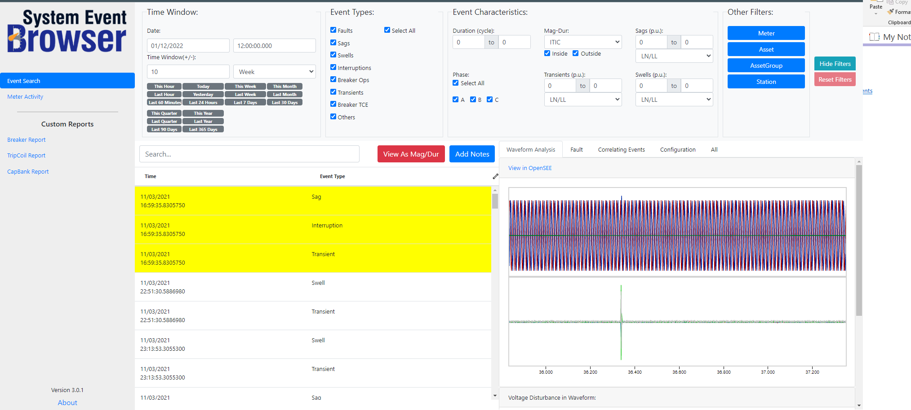
Other Applications

Slide 14
Thank you

