Slide 1
GPA Introduction

Slide 2

Who We Are
GPA is a not-for-profit corporation established in 2010
Specialize in software and services for the electric utility industry
All software is open source, published under the permissive MIT license
Focus on a robust, reliable and resilient grid

Slide 3

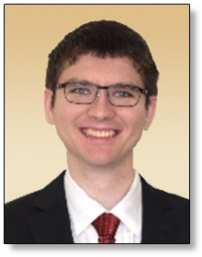

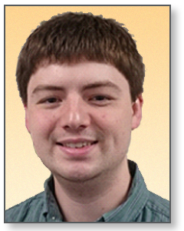
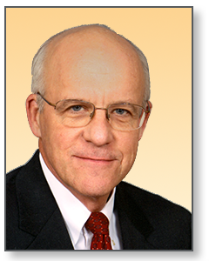
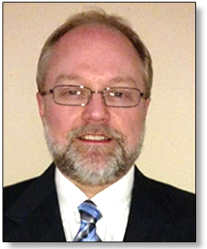

Introduction Key GPA Staff
Dr. Christoph Lackner
Operating Officer & Lead Engineer
ROLE: Operational & Engineering Leadership
Erika Wills
Senior Support Engineer
ROLE: Support & Project Leadership
Grid Protection Alliance, Inc., specializes in the development and support of innovative software solutions for the electric industry.
GPA has a track record of innovation and has led major software development projects with client utilities and the Federal Government.
In addition to custom application development, GPA offers services for installation, set-up, integration, and on-going maintenance of its open-source software.
Establishes new software development projects and assures the successful completion of established projects.
Provides engineering oversight of GPA analytic applications.
8+ years’ experience with synchrophasor data analytics and use of synchrophasor data in various applications such as state estimation, predictive maintenance, and system parameter estimation.
Specializes in the development of real-time and offline data analytics for power systems.
Oversees customer support and project progress.
Establishes training curricula and software documentation.
Previous experience in sales, operations and technical support
10+ years of experience in customer support and project management.
Stephen Wills
Senior Systems Analyst
ROLE: Lead Software Development
Ritchie Carroll
Senior Solutions Architect
ROLE: Systems Architect & Lead Developer
Russell Robertson
Principal
ROLE: Strategic Studies
Major contributor to GPA software solutions and provides system support and integration services to utilities.
10 years’ experience in developing .NET solutions, much of that time contributing significantly to GPA’s core code base – the Grid Solutions Framework.
Specializes in the management of data from substation devices – PMUs, DFRs, power quality meters, and relays.
Prior to joining GPA, extensive experience at the Tennessee Valley Authority in development of synchrophasor data software.
Oversees GPA software development and provides software system design and development services to utilities.
25+ years’ expertise in high-performance software system design, development, and delivery. Has led numerous large software development projects.
10 years at the Tennessee Valley Authority leading synchrophasor software development among other operational systems.
Active participant in NASPI and other industry efforts to improve synchrophasor data systems.
Establishes collaborations within the utility industry to support the development and maintenance of open-source software.
Founded GPA’s open-source software and consulting-service business.
Expertise in grid operations, IT/OT architecture, information management, and control systems.

Slide 4








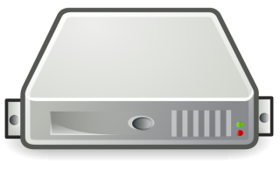







openXDA Suite of Tools
Field Devices
Control Center Infrastructure
External Access
Engineering Desktops
OR
Configuration Tools
Our applications are involved in all stages of the data lifecycle.
DFR
Relay
OR
PQM

Slide 5
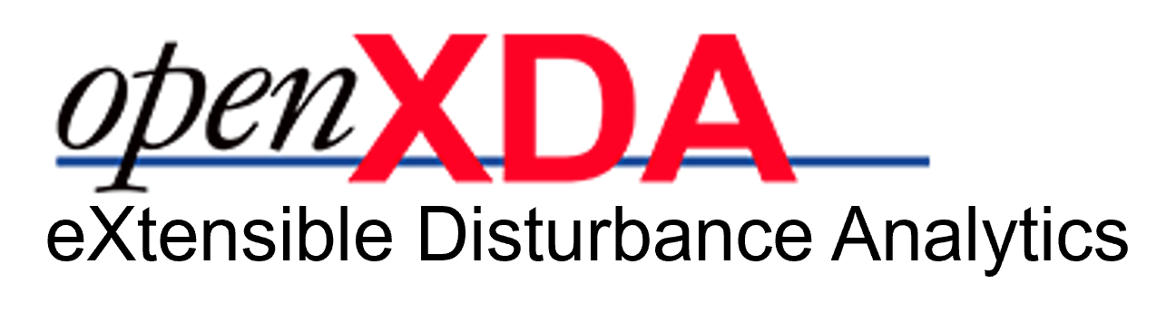
The openXDA application automatically discovers, parses, analyzes and saves both raw data and analytic results from data captured from field devices. openXDA runs as a back-office service watching for new event or interval data files. After analyzing the data in these files, openXDA produces emails and raises alarms based on meter data quality and/or the nature of the system event that triggered the substation device.
The interval data processing pipeline includes:
Collecting daily statistics
Triggering configured alarm thresholds as appropriate
Collecting data completeness information
Collecting data quality information, including identifying latched values and engineering reasonability checks
The event waveform data processing pipeline includes:
Event identification
Event cause probability identification
Event classification
Sag/Swell analysis
Identification of related events recorded by other devices
Other relevant event analysis

Slide 6
PQ Visualization
System Overview
Waveform of Focus
View the results of openXDA’s analysis in stats tables, charts, and waveforms.
From wide area down to single waveform focus.
Rebranding of SEBrowser to PQBrowser as its functionality expands.

Slide 7

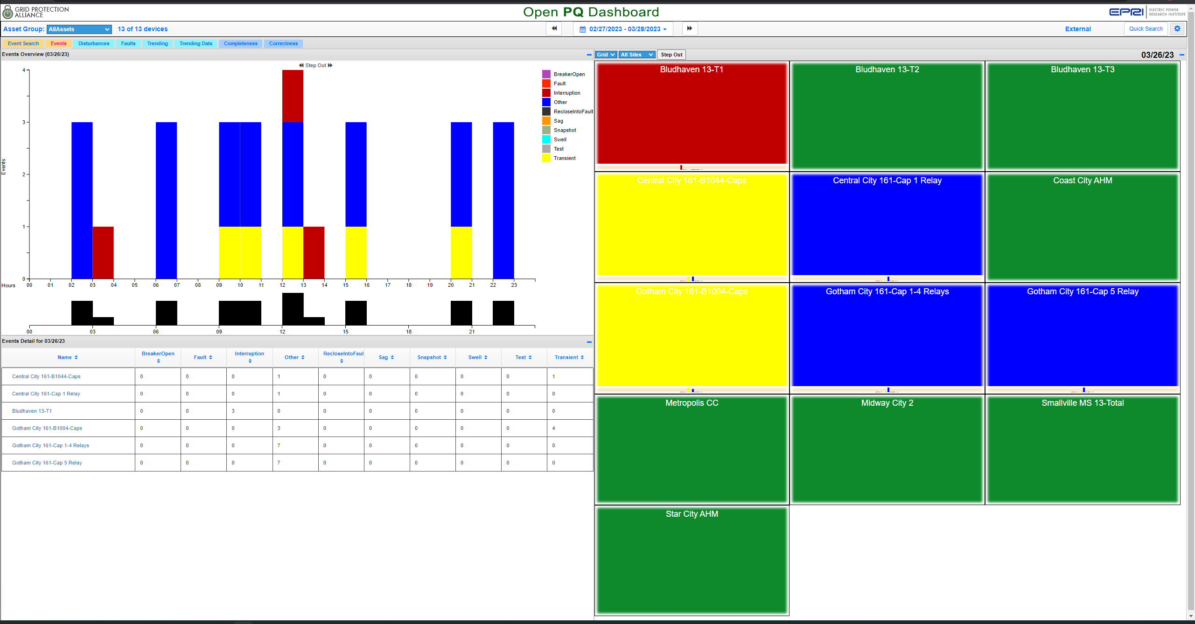
View various types of events, trending alarms and data, and data heath metrics across your entire PQ system.
Includes a map feature to view how a single event affects your wide-area grid.

Slide 8

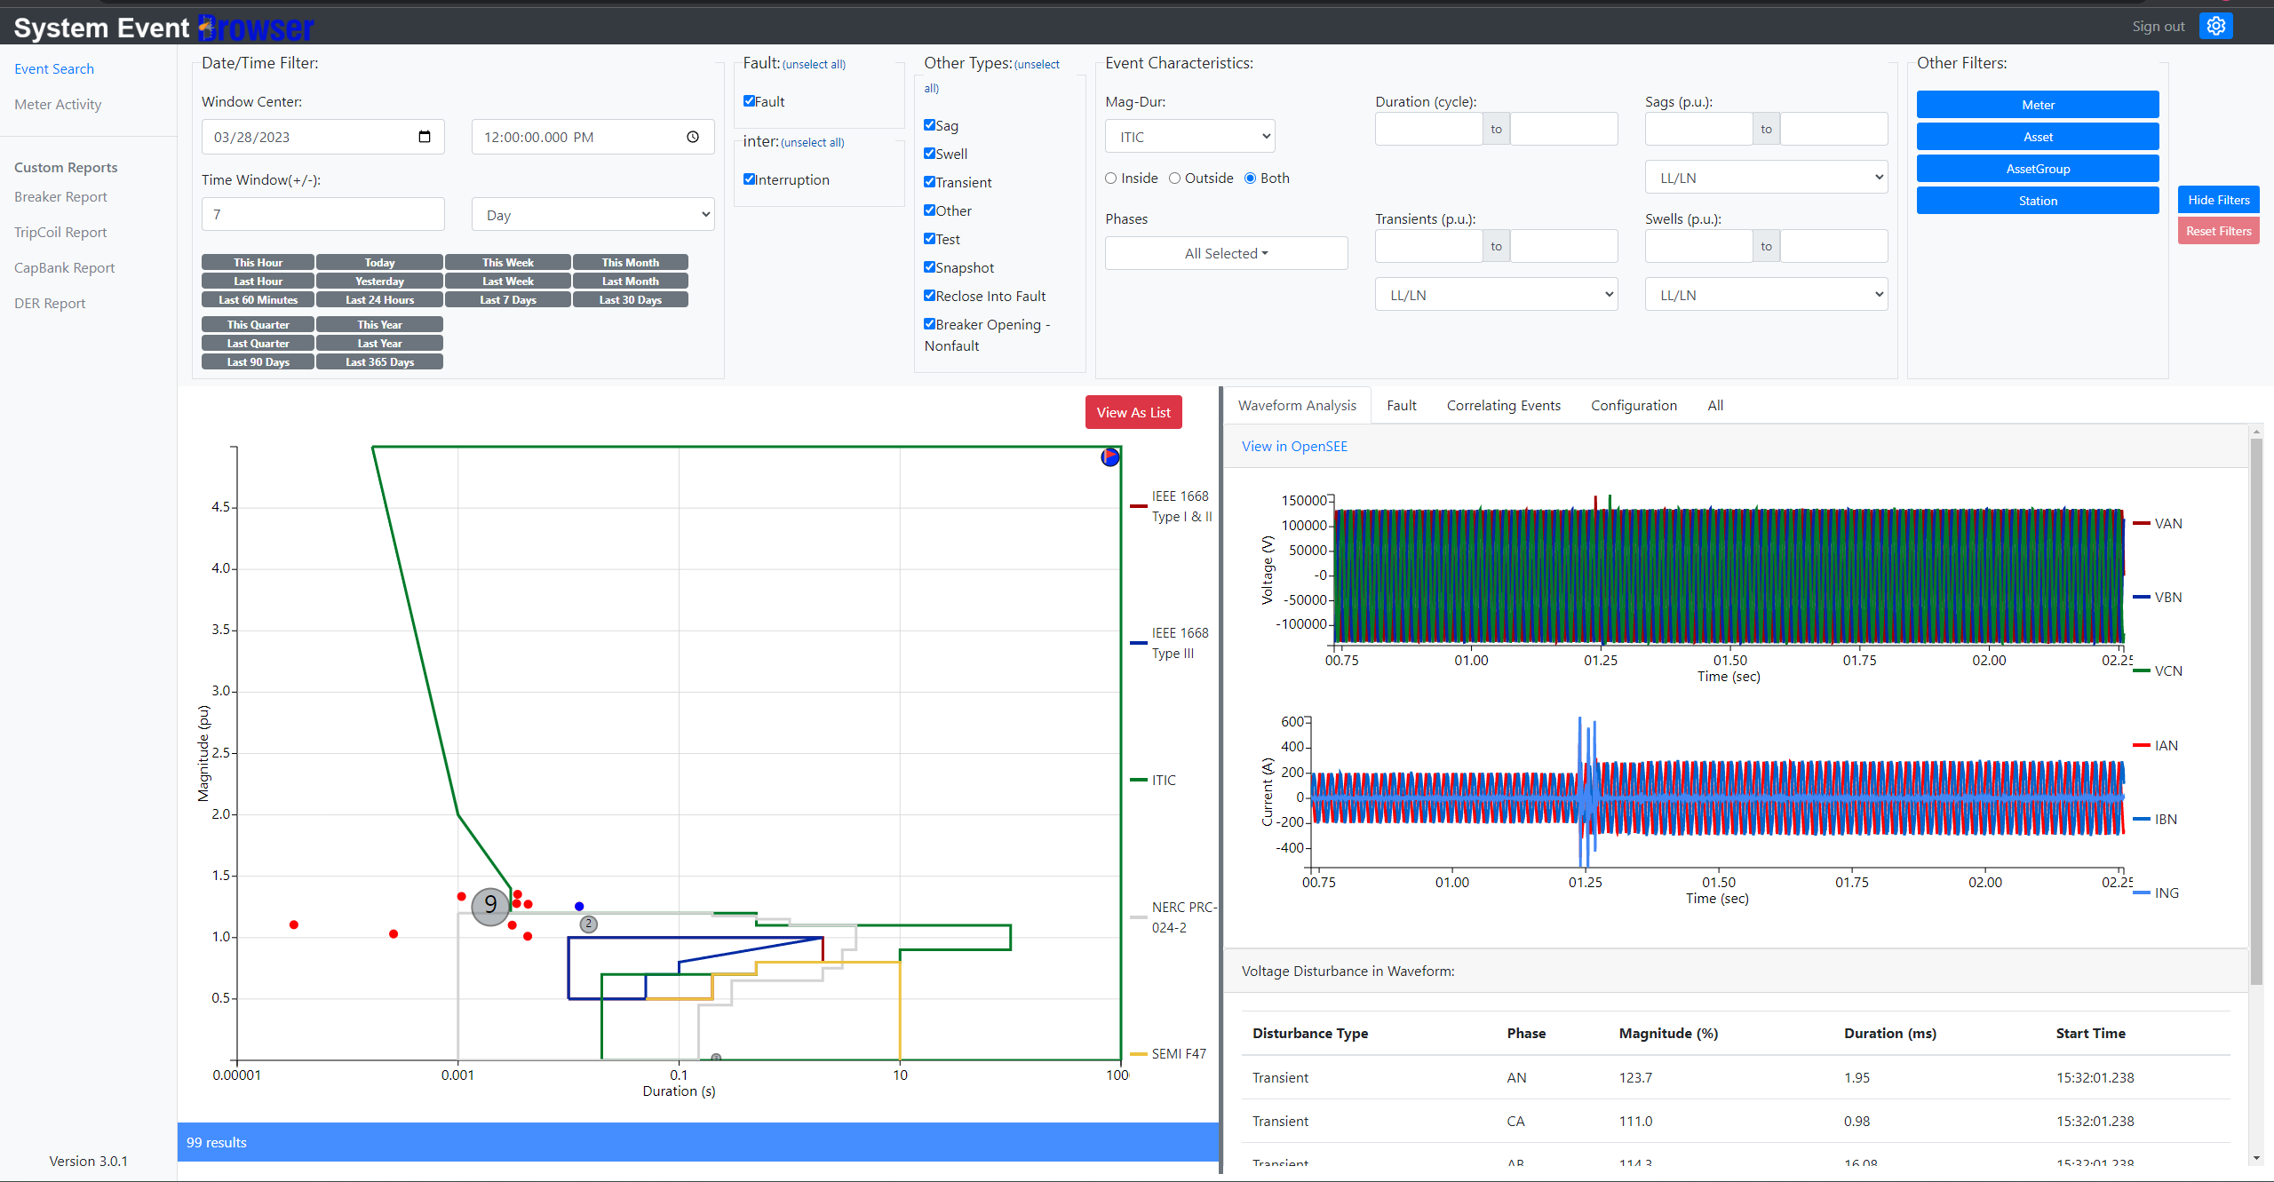
Search and drill into specific events with an assortment of available configurable widgets and reports.
The built-in Magnitude-Duration Chart shows all the applicable events in your search plotted with both standard and user-definable curves.

Slide 9
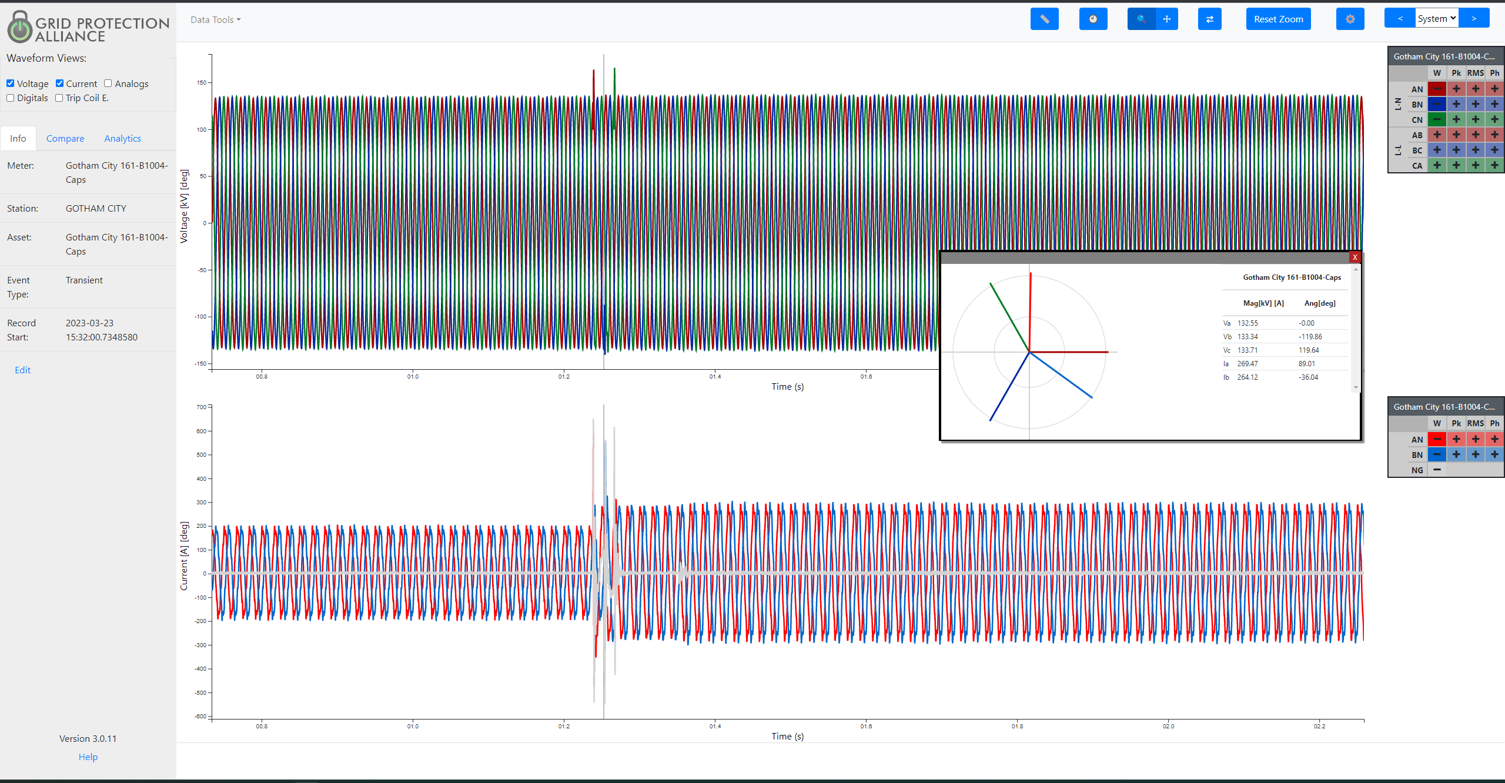
View a waveform-of-focus with tools to show detail and share it with others with a URL formatted to show exactly what the user saw, including zoom levels and analytics.
Compare time-correlated events and run a variety of ad-hoc analytics with ease.

Slide 10

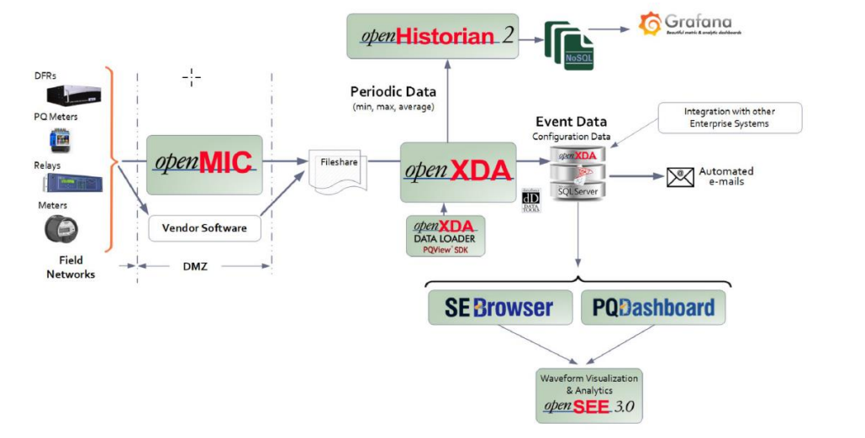
SFTP Server for openMIC; Fileshare for XDA

Slide 11
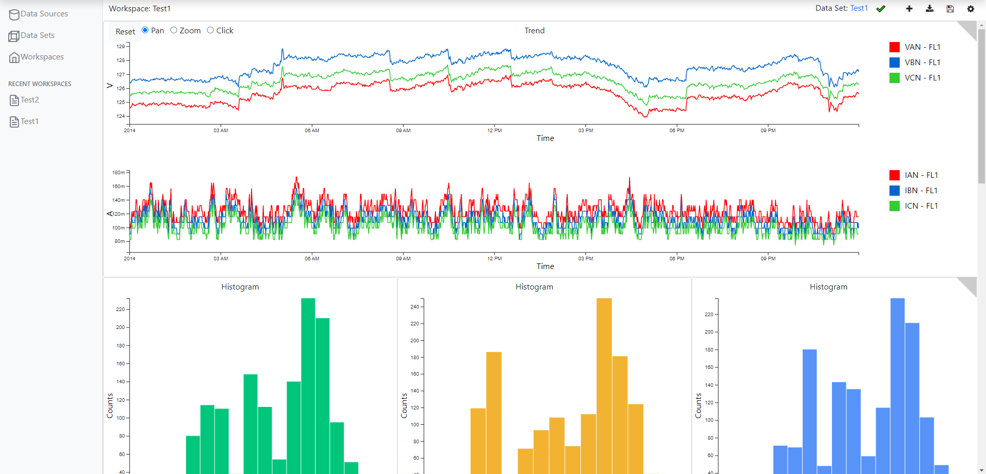
Custom workspaces to view interval and time-series data analytics using a variety of widgets.
TrenDAP is in-development through a partnership with EPRI and member utilities.

