Slide 1

Southeast User’s Group 2023 – Training Session

Slide 2






Agenda
9:30 | Welcome and Introductions
9:35 | System Center
10:45 | Break
11:00 | PQ Dashboard
12:30 | Lunch
1:00 | SE Browser
2:30 | Break
2:45 | openSEE
 | PQDigest Demonstration (if time allows)
4:30 | Adjourn

Slide 3

Configuration tool for openXDA and the associated suite of tools
Asset, Substation, and Asset Group Configuration
Value Lists
New Meter Wizard
Additional Fields
Meter Maintenance/Test Mode
Data Files
Remote openXDA Instances

Slide 4
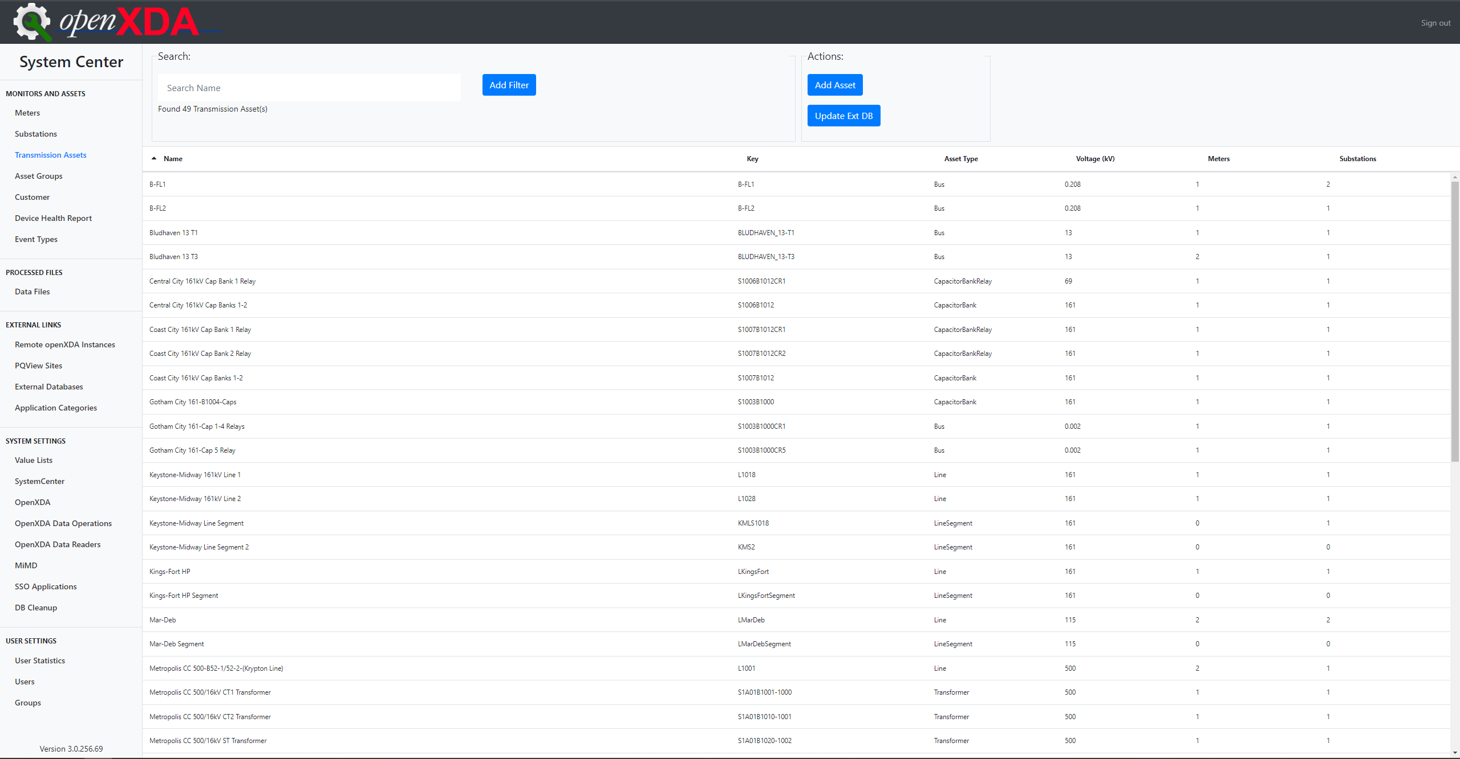
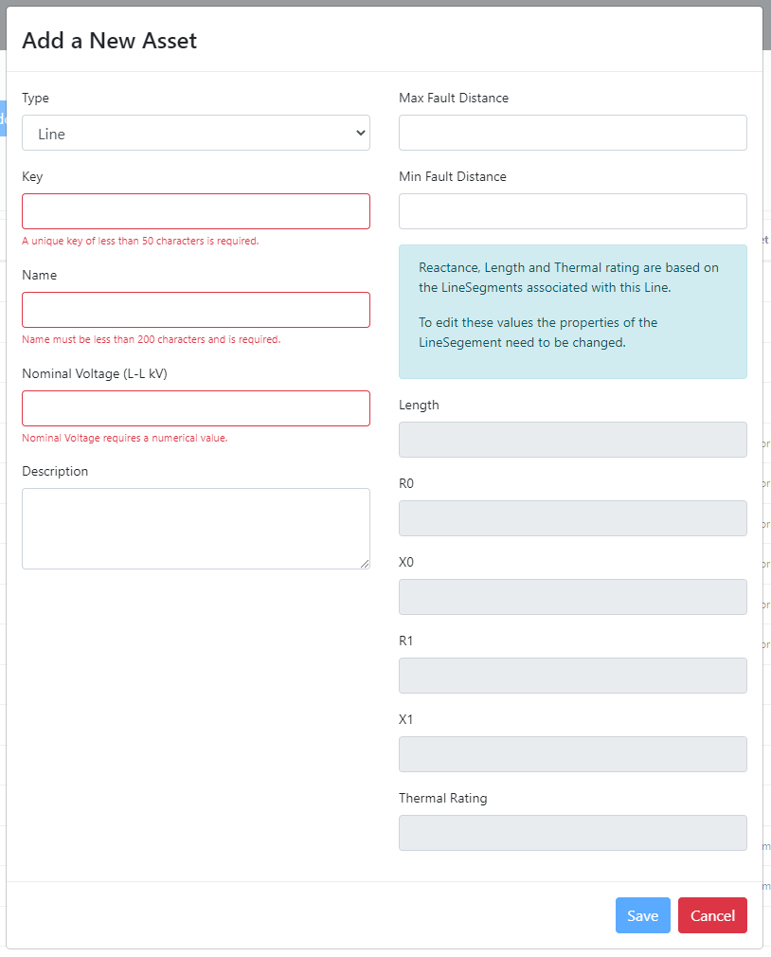
Transmission Assets
openXDA has moved to an Asset-centric Model in version 3.0
Asset types:
  Breaker
  Bus
  CapBank
  CapBank Relay
  DER
  Line
  Transformer
Fields are dependent on the selected Asset Type.

Slide 5
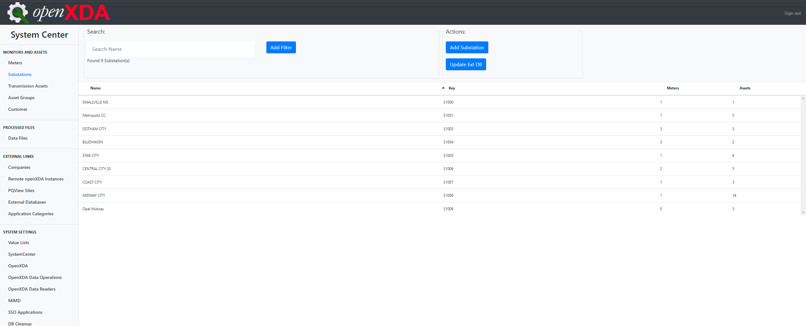
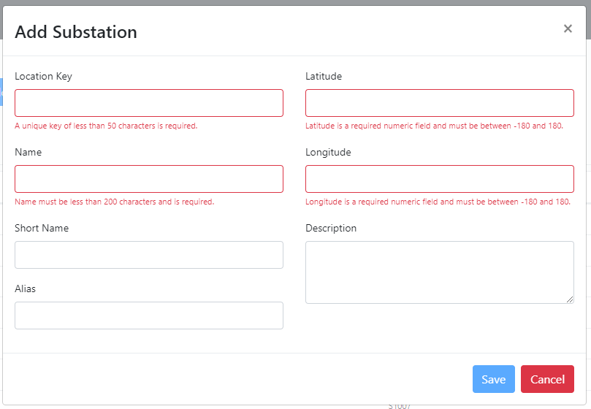
Substations

Slide 6
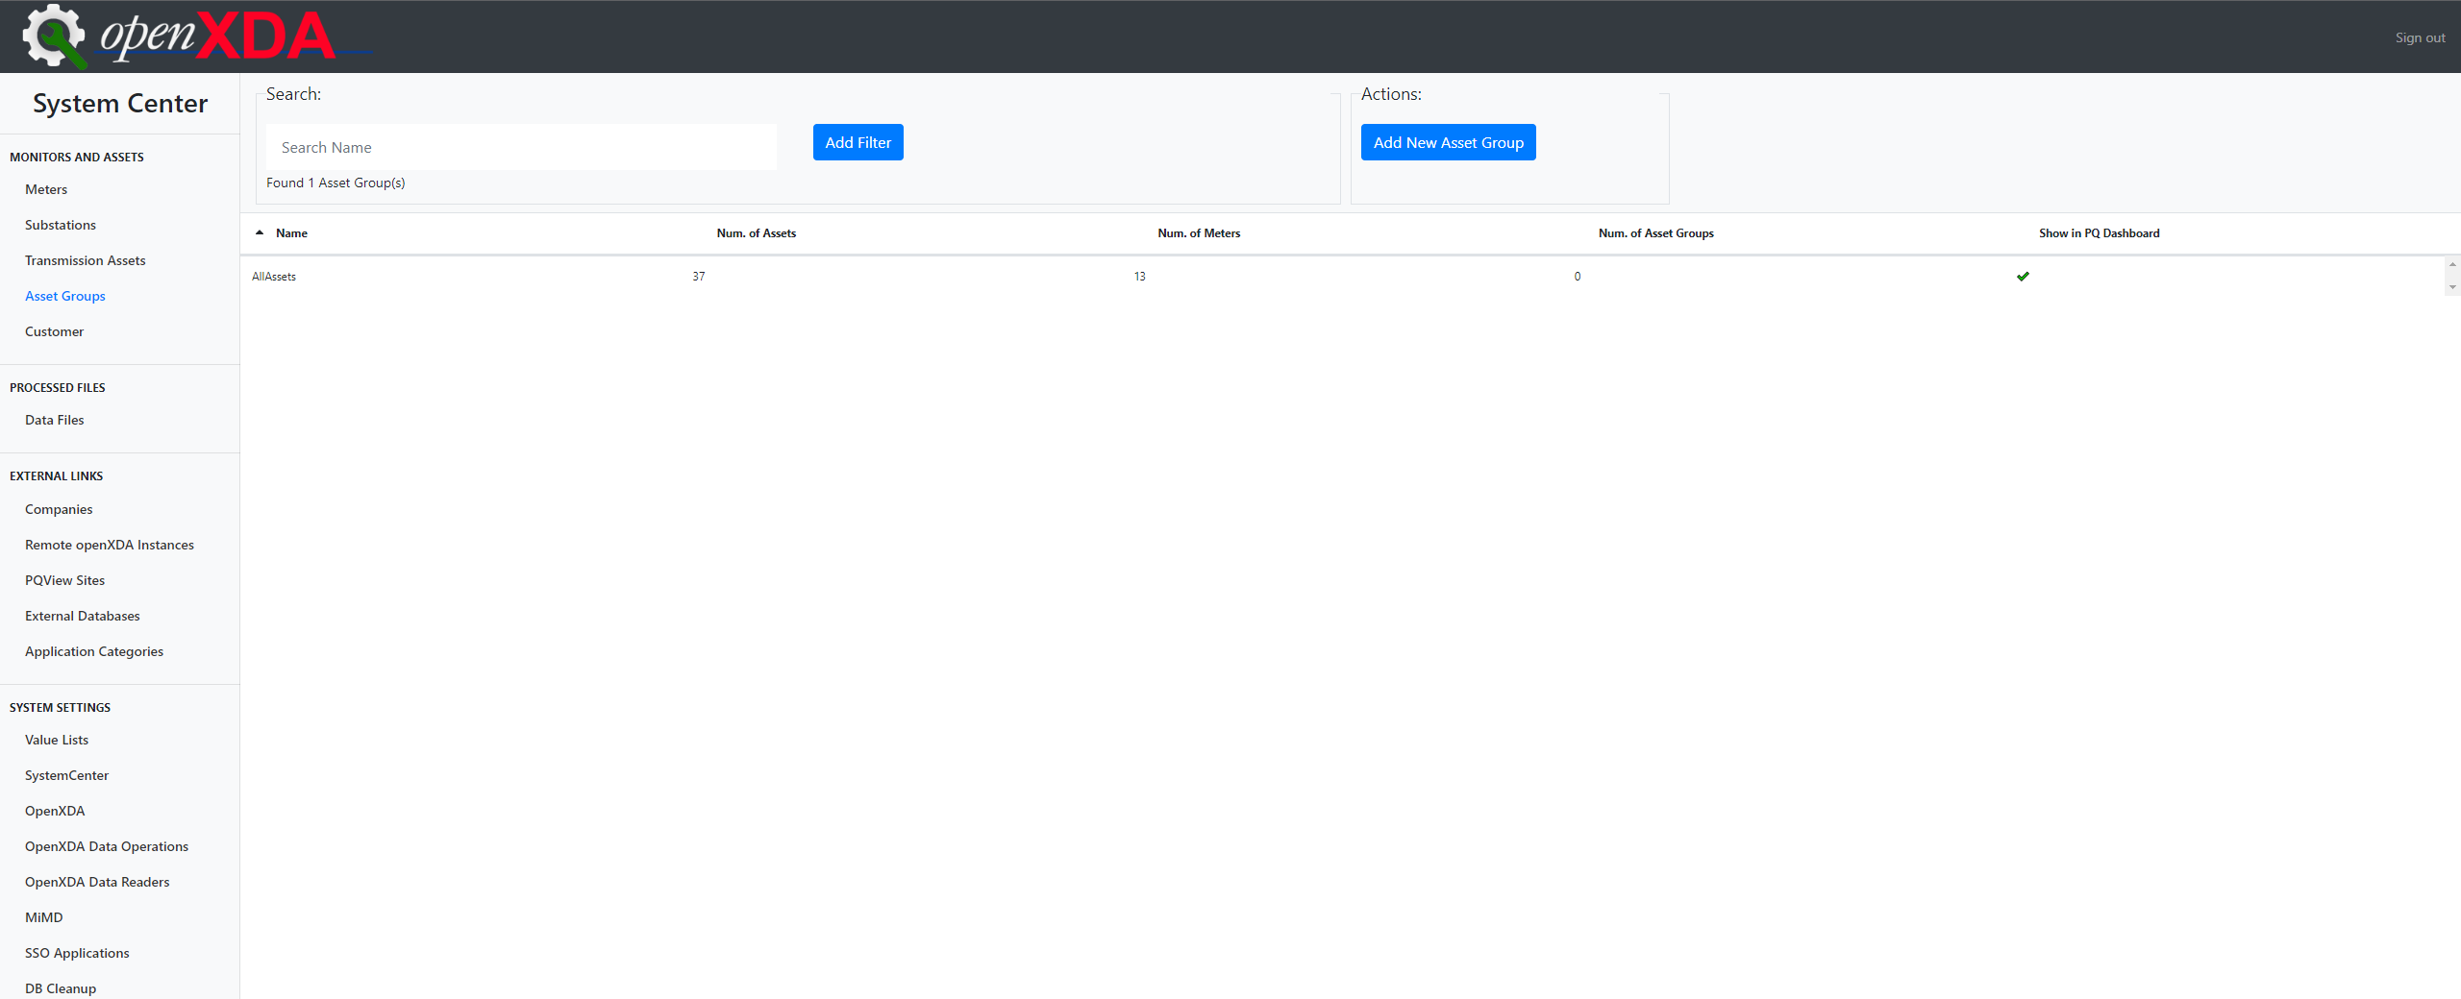
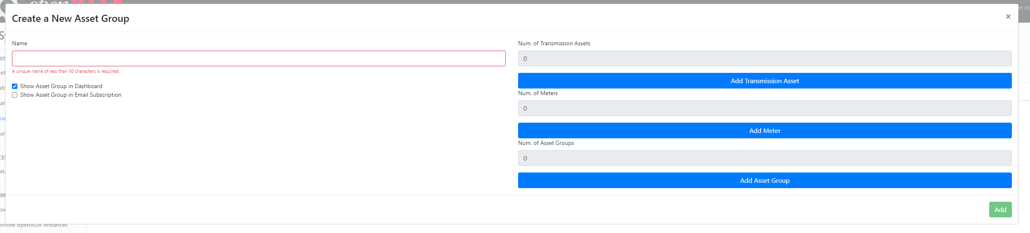
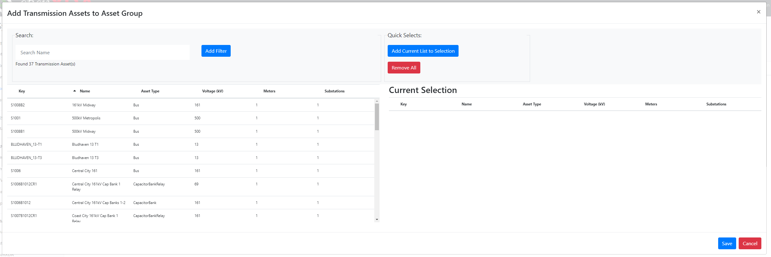
Asset Groups
Asset Groups allow grouping of assets, meters, and other asset groups to “filter” in PQ Dashboard and Email Subscriptions

Slide 7
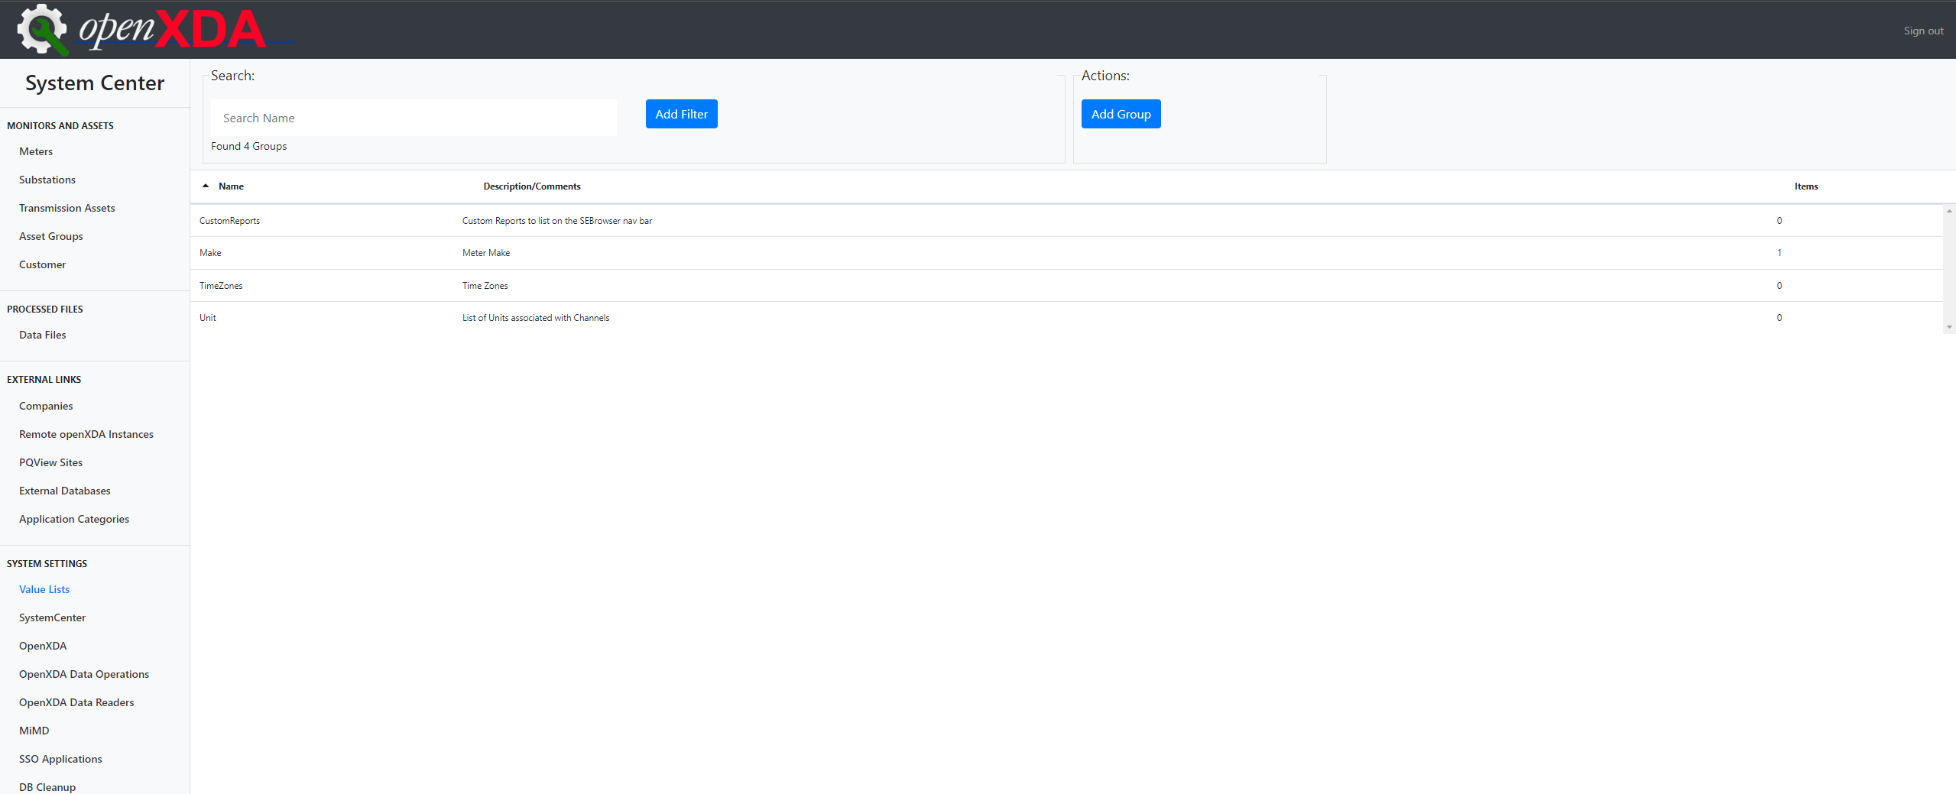
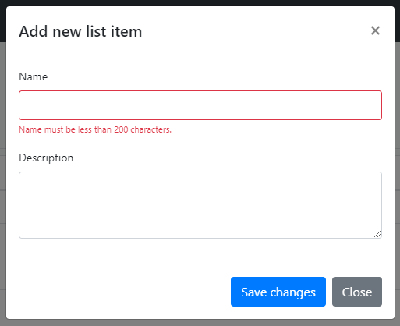
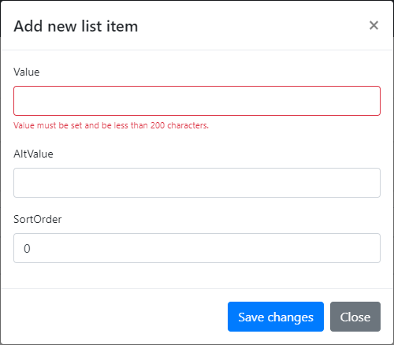
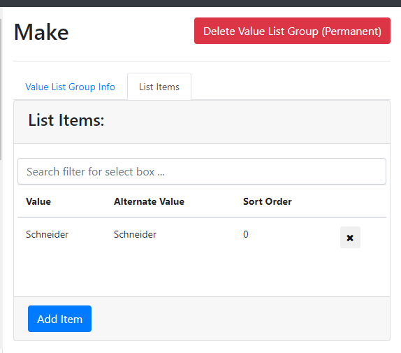
Value Lists
Value Lists are used to configure a variety of options throughout openXDA.

Slide 8
Value Lists are highly customizable; however, some have specific purposes.
Value Lists of Note:
CustomReports – configures which Custom Reports are available in SE Browser.
Unit – a list of units associated with Channels.
TimeZones – time zones associated with Meters.
  The Alternate Value of List Items in this Value List Group must match a Windows time zone.
Make – a list of makes associated with Meters.
Model – a list of models associated with Meters.

Slide 9
New Meter Wizard
Progress is saved and can be picked back up if interrupted.
Updated to walk through each step necessary for the configuration of a meter, including its substation and assets.
  Fewer clicks necessary to configure the entire meter start to finish.
Primary Configuration:
General info
Substation
Event Channels
Trend Channels
Assets
Asset Connection
Optional Configuration:
Additional Fields
External Databases
Asset Groups and Customers
Additional Fields (for assets added during NMW)
Asset Groups and Customers (for assets added during NMW)
Line Segment Wizard (for lines added during NMW)

Slide 10
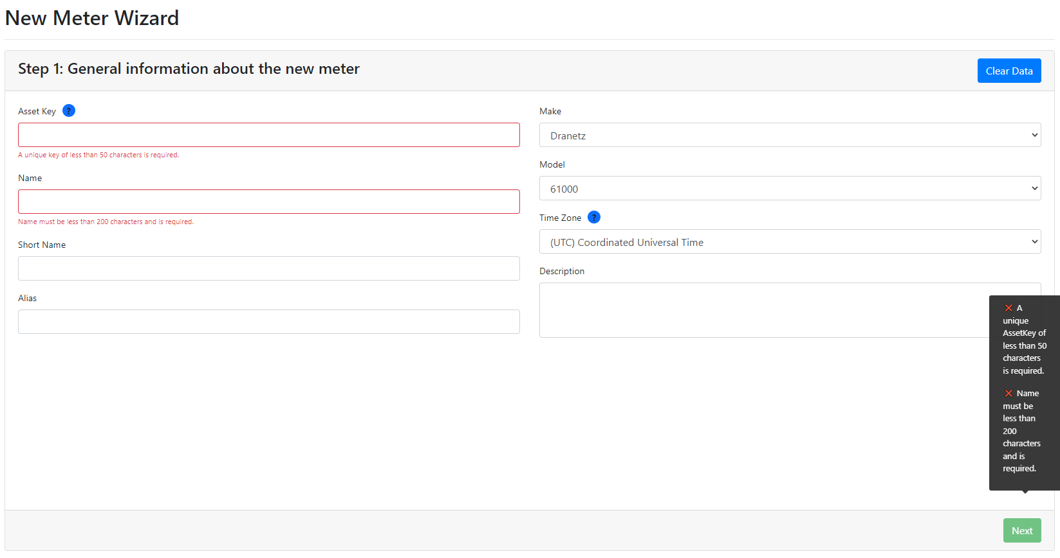
Clear Data erases all progress in the Wizard and brings the user back to Step 1
Make, Model, and Time Zone are dropdowns, the content of which are pulled from Value Lists
Tooltips show errors that prevent progression and warnings to remind the user of optional steps

Slide 11
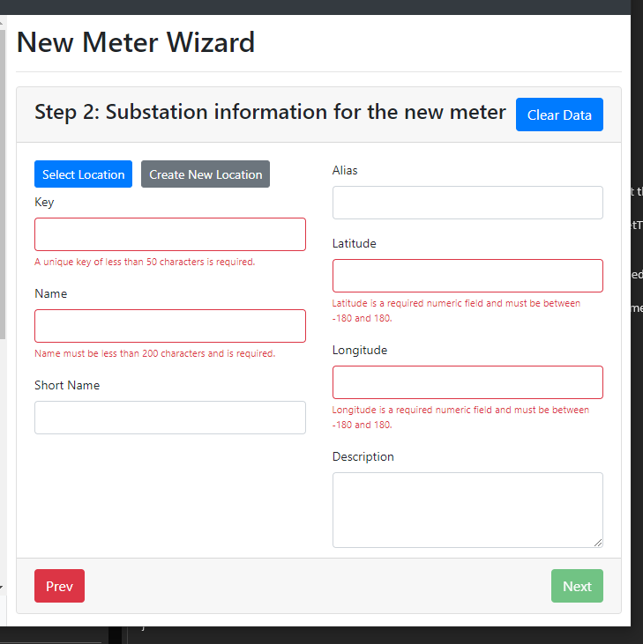
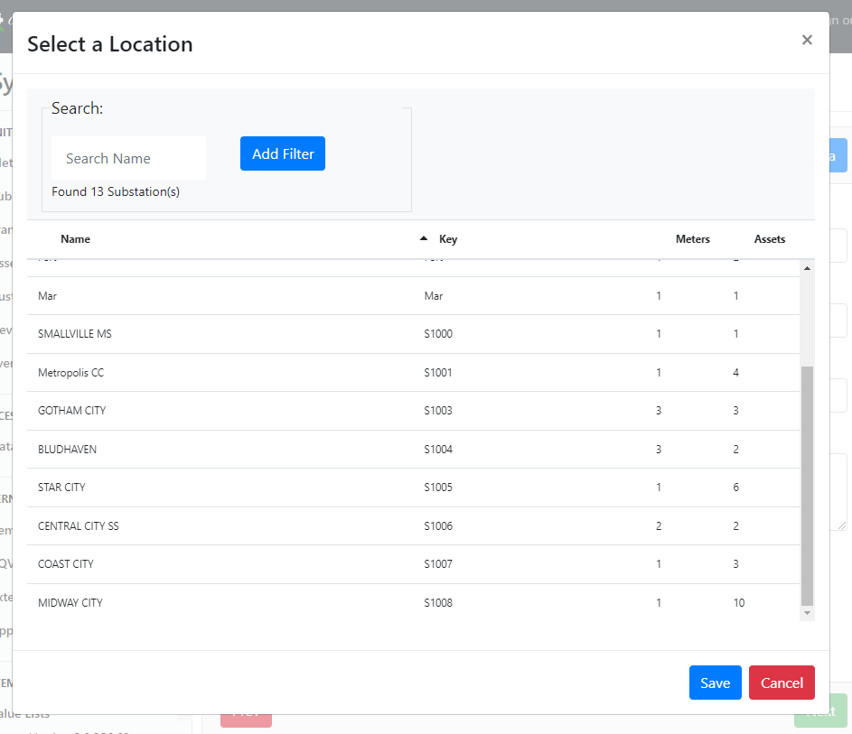
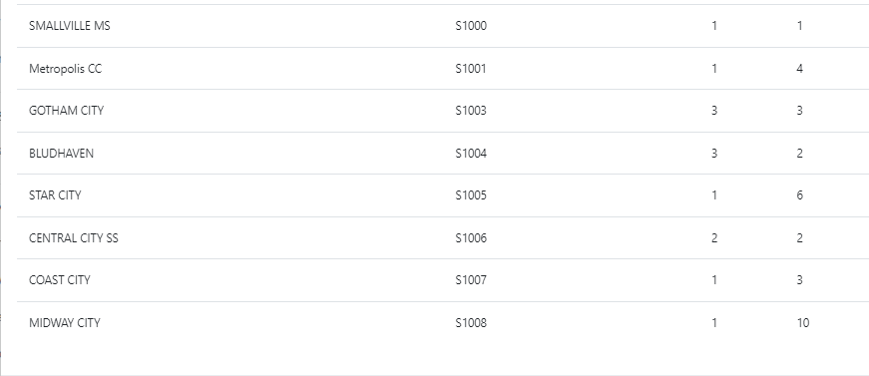
Clear a selected Substation
Next saves entered info as a new Substation

Slide 12
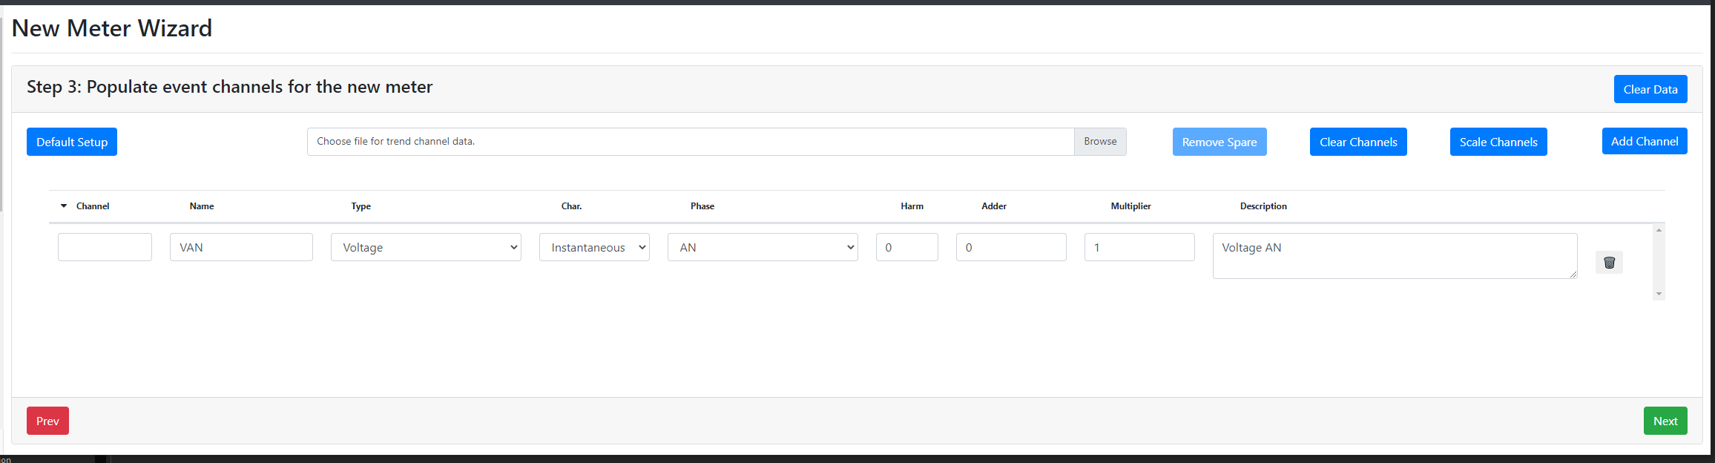
All steps after Step 2 can be skipped
Adds a default channel configuration composed of Voltage and Current channels.
These buttons become enabled as appropriate channels are added.
Remove Spare removes channels labeled as Spare.
Clear Channels removes all added channels.
Scale Channels allows entry of PT and CT ratios for multiplier calculation.
Adds a single channel (default configuration seen below).
The table loads blank, this is the default when Add Channel is used
Delete a single added channel by clicking the trashcan icon on the right.
Step 4: Populate trend channels for the new meter appears nearly identical, but trend channels can only be added using a pqd file.

Slide 13
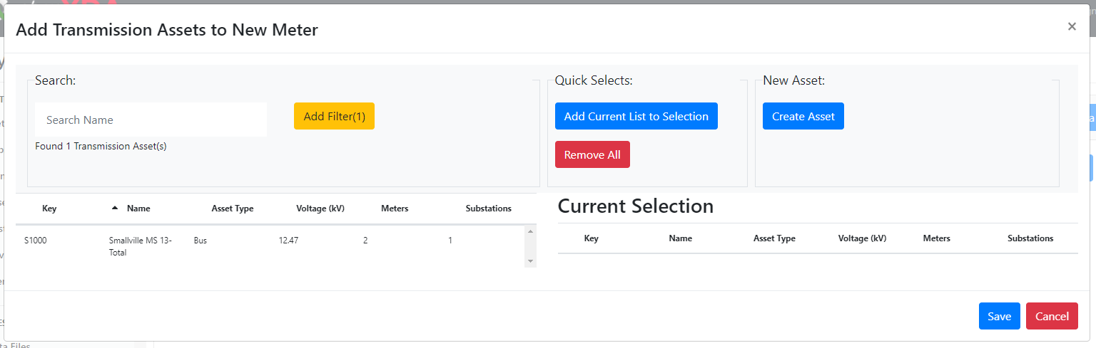
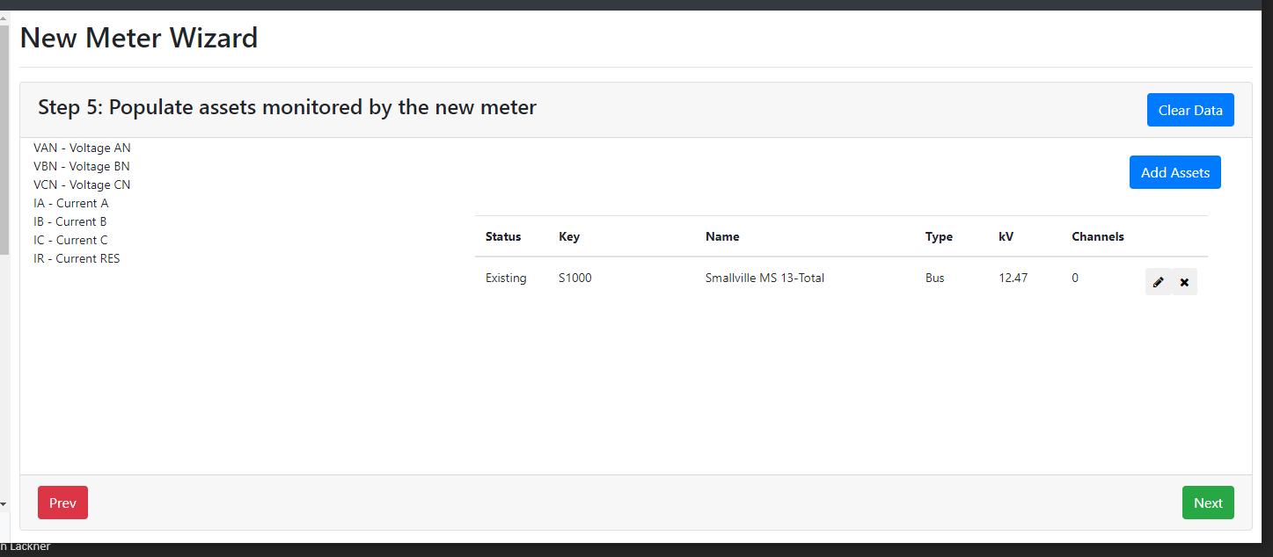
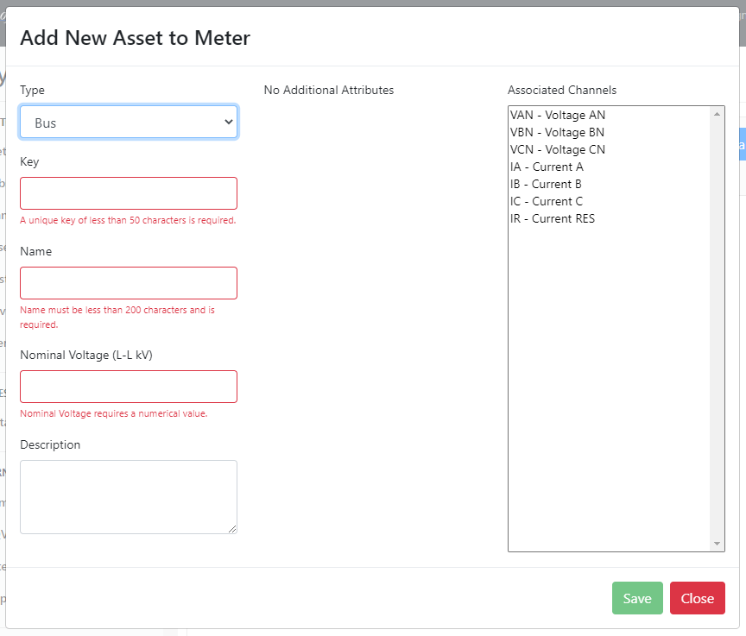
Add all assets from the filtered list on the left to the Current Selection list.
The Add Assets popup opens immediately to facilitate adding assets to the new meter.
Close the popup.
Only channels that have not yet been assigned appear here.
Assets are automatically filtered by Substation
Channels that have already been assigned to an asset are indicated by strikethrough.
If no assets have been added, this button reads Create Meter, which saves the meter to the database, and the Wizard can be exited.

Slide 14
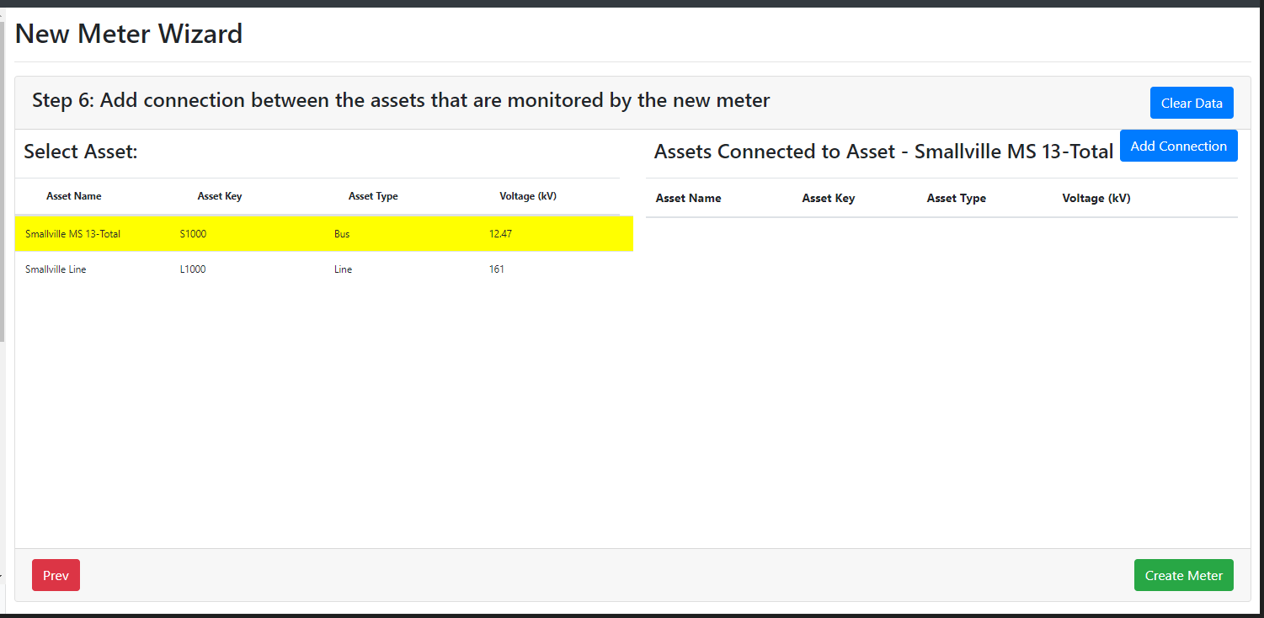
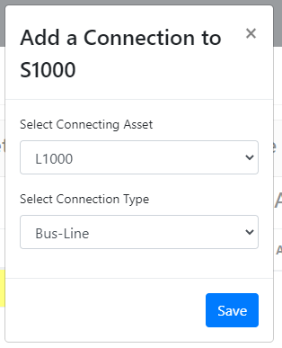
Saves the meter (and any new substation or assets) to the database and continues to optional configuration steps.

Slide 15
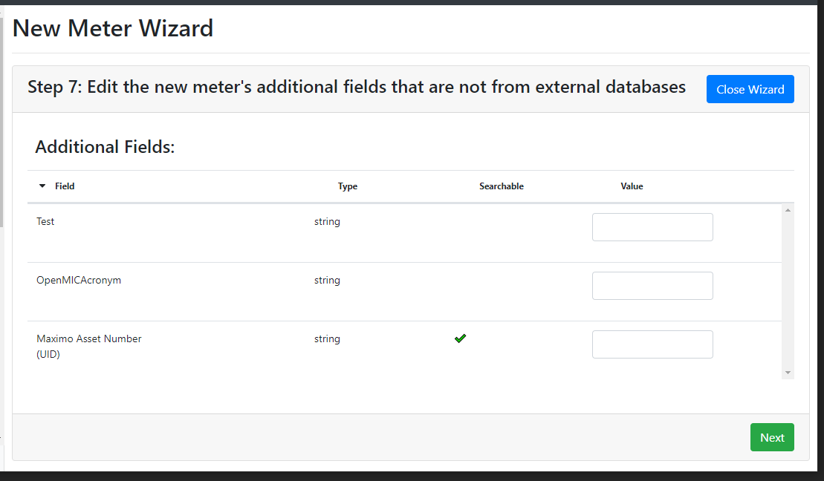
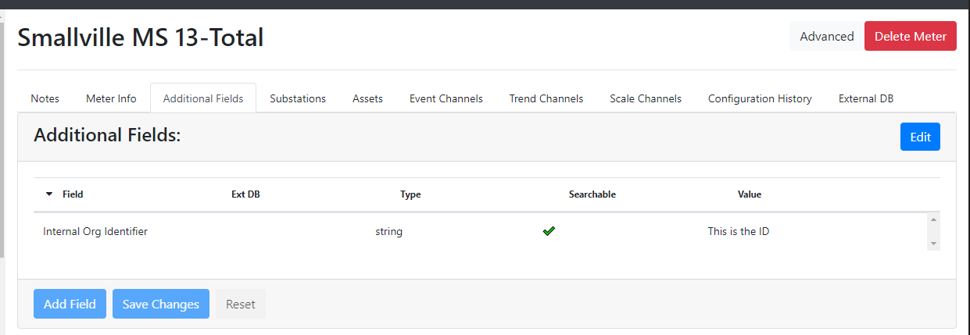
Optional Configuration Steps
Clear Data becomes Close Wizard and directs the user back to the Meters main page
Once this button has been clicked, the user cannot return to the Wizard
Asset steps (11 and 12) only offered if a new asset was added in step 5
Line Segment step (13) only offered if a new line was added in step 5
See slide 9 for the complete list and order of Optional Configuration Steps

Slide 16
Additional Fields
Available for Meters, Substations, Transmission Assets, Customers, and Users.
Assign custom values to individual entries that can be used in System Center searches or to pull data from external databases.
Value Lists can be used as a Type to preset the available Values for a given Additional Field.

Slide 17
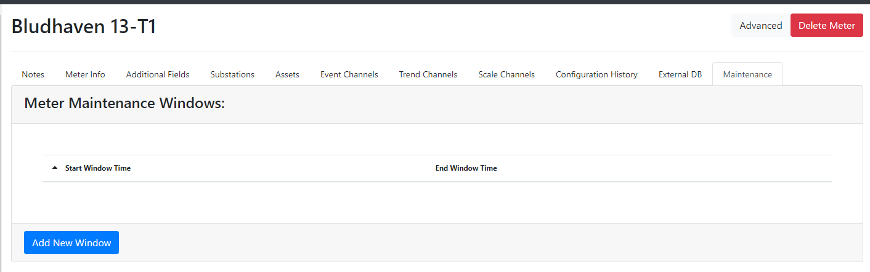
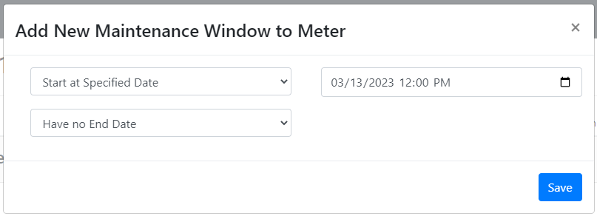
Maintenance/Test Mode
Meters can be placed in “Maintenance” or “Test” Mode to mark any incoming events as “Test” type

Slide 18
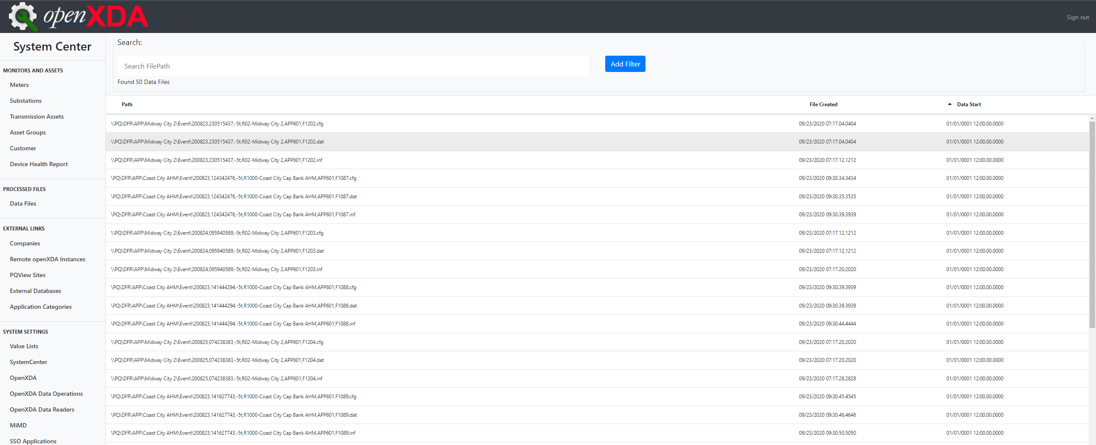
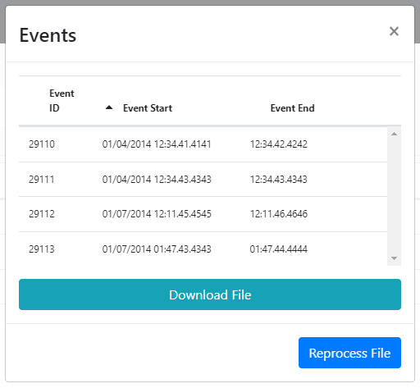
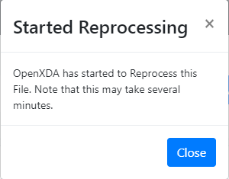
Data Files

Slide 19
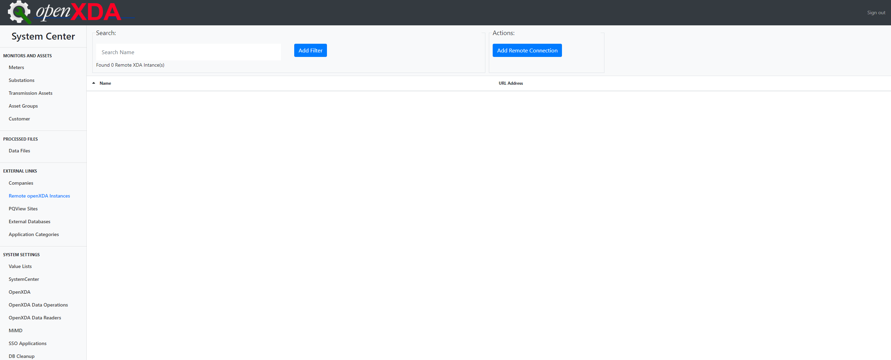
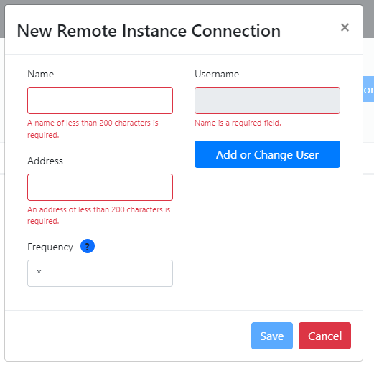
Remote openXDA Instances

Slide 20
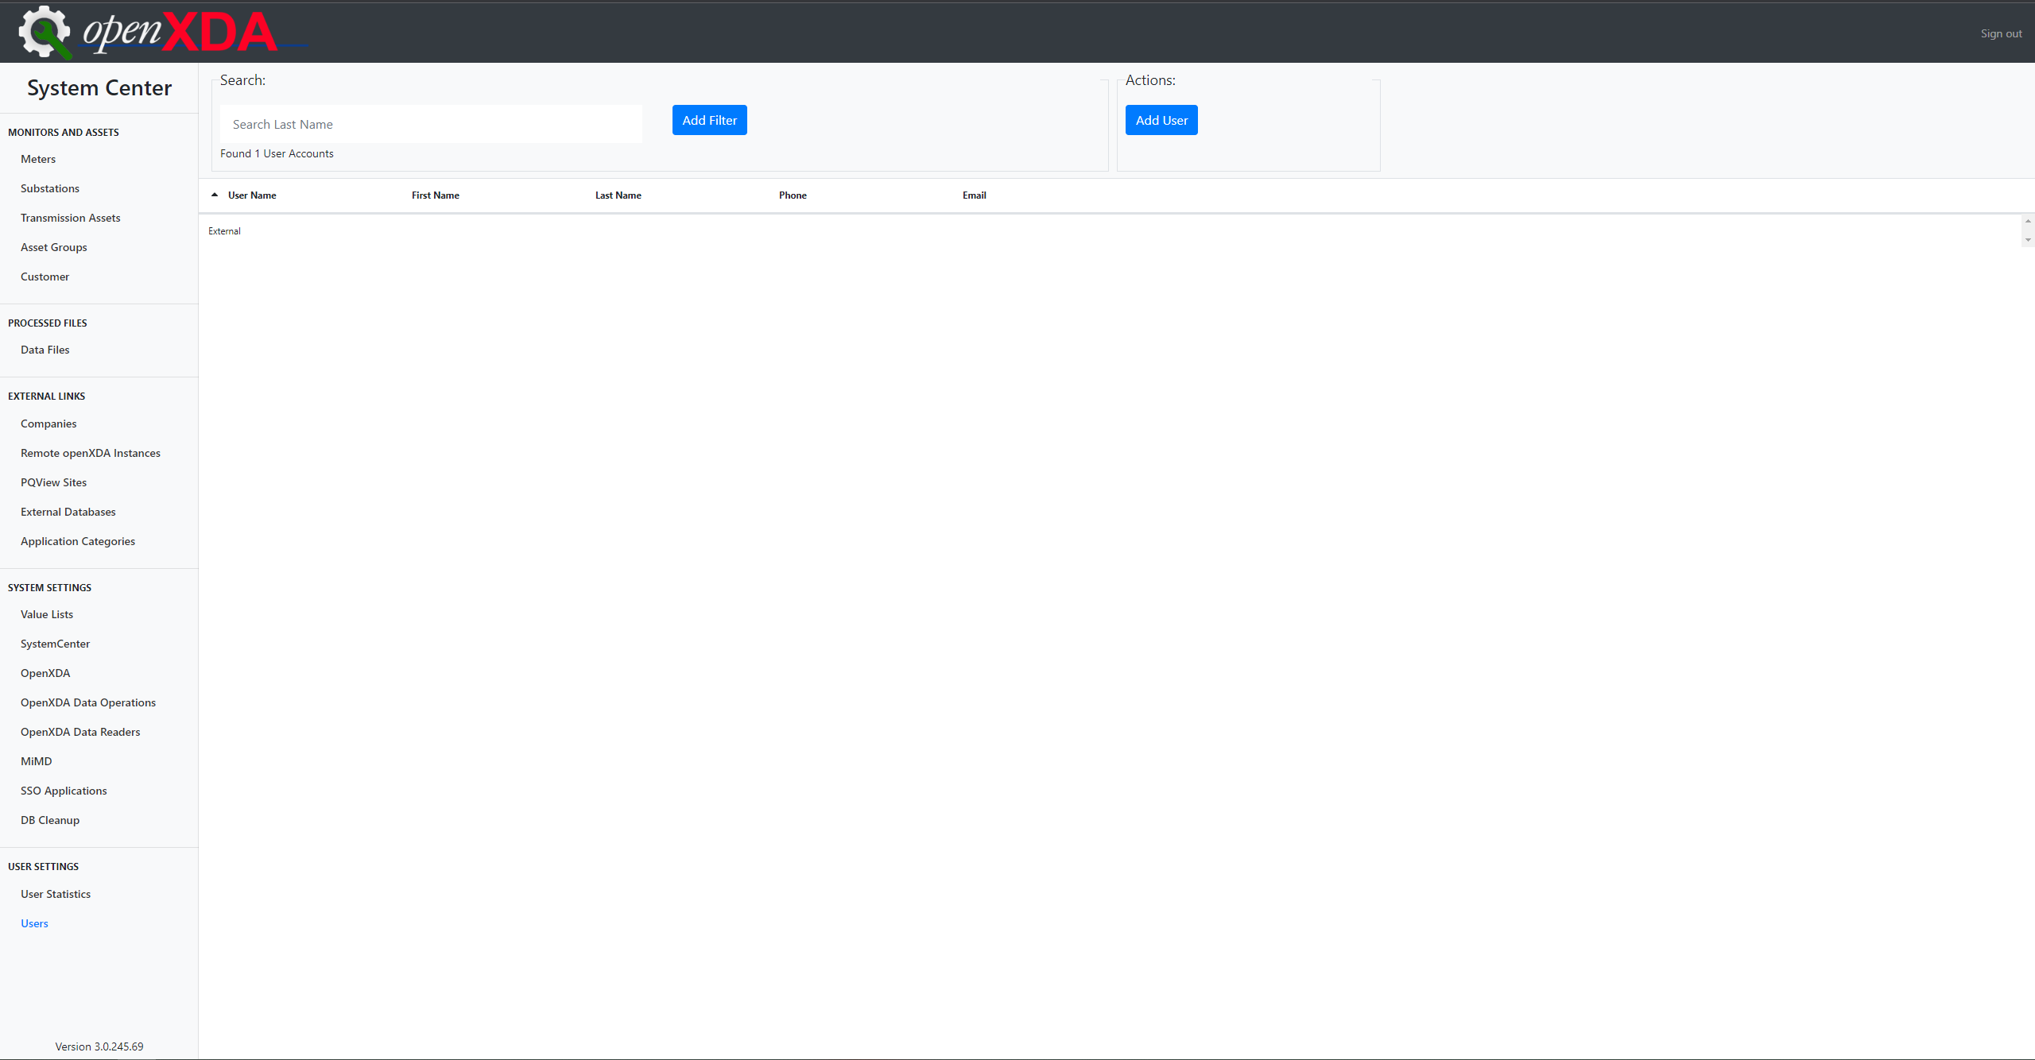
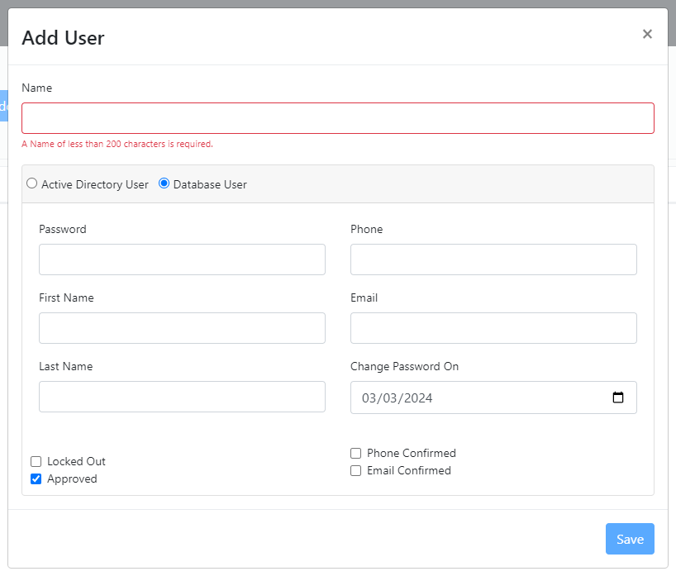
A database user is required to allow access to the remote instance.
Name (Username) and Password are the only required fields for Database Users. Be sure Approved is checked and Change Password On is appropriately set.

Slide 21
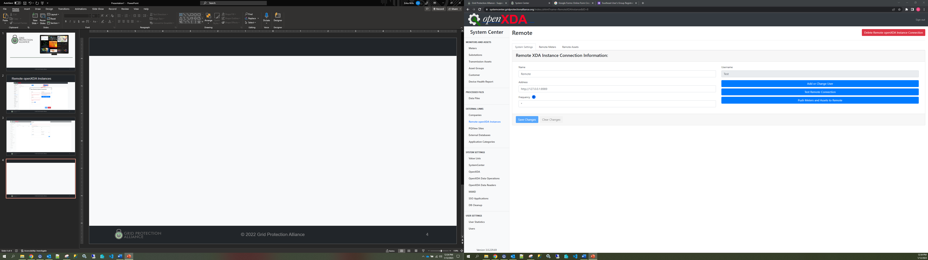
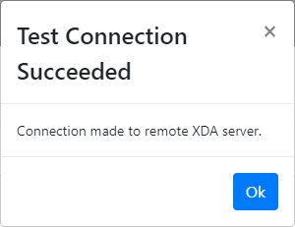
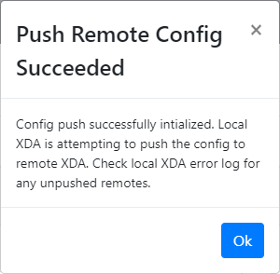
Once a connection has been established, Meter and Asset configuration and data can be pushed to the remote instance in the Remote Meters and Remote Assets tabs.

Slide 22



Visualization
System Overview
Waveform of Focus
View the results of openXDA’s analysis in stats tables, charts, and waveforms.
From wide area down to single waveform focus.
Rebranding of SE Browser to PQ Browser as its functionality expands.

Slide 23

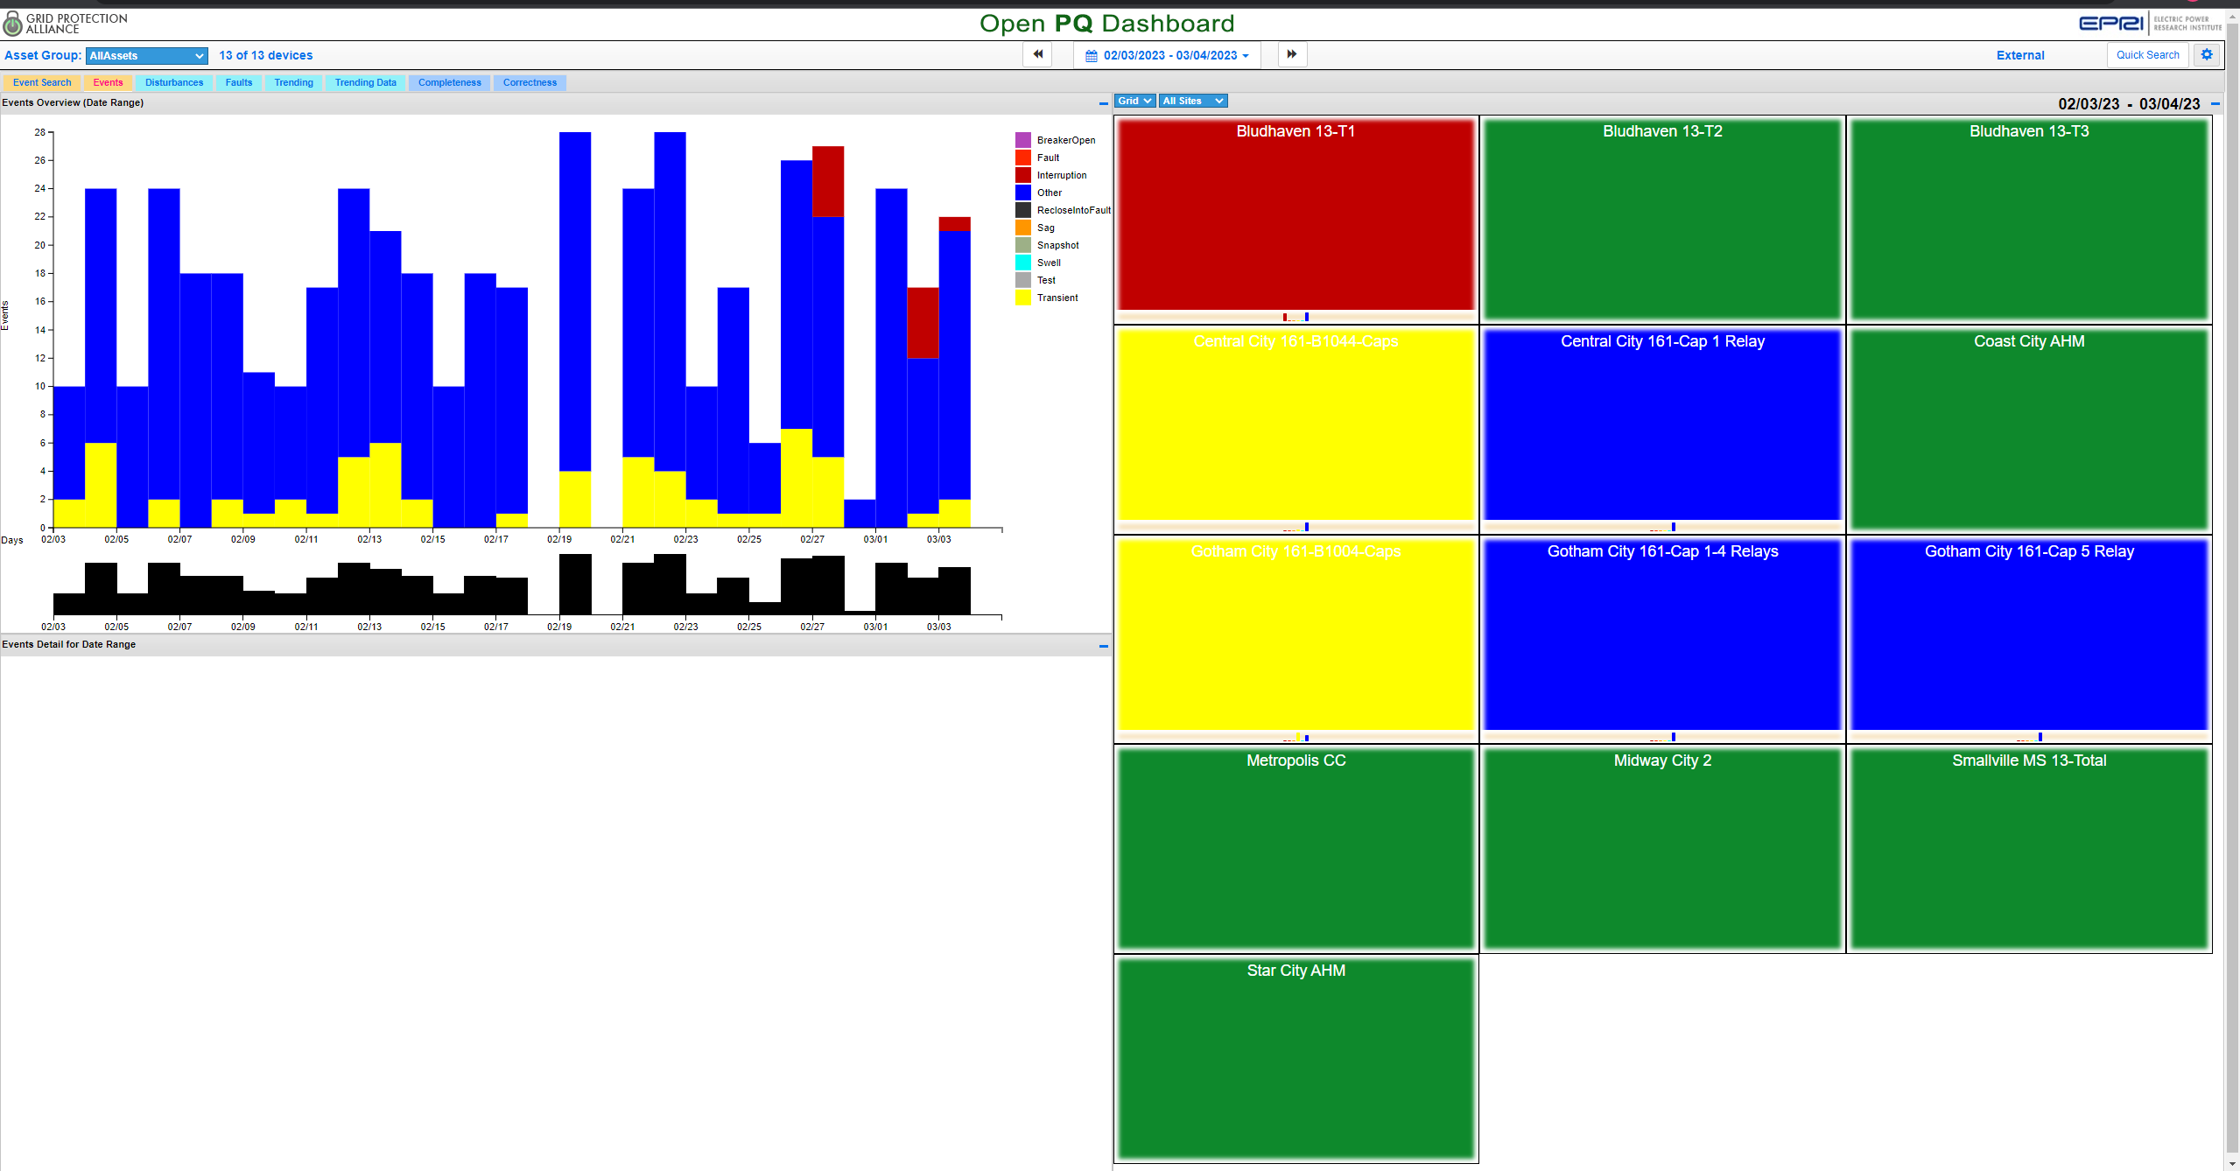
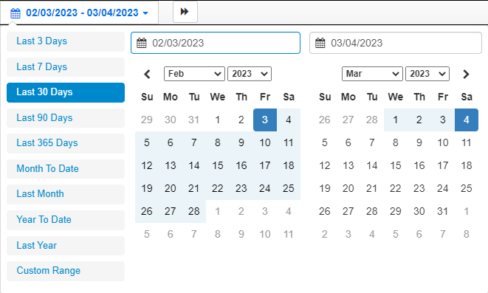

Select an Asset Group to filter the meters being viewed
Default time range is Last 30 Days and the date picker always shows 2 consecutive months, regardless of selection

Slide 24
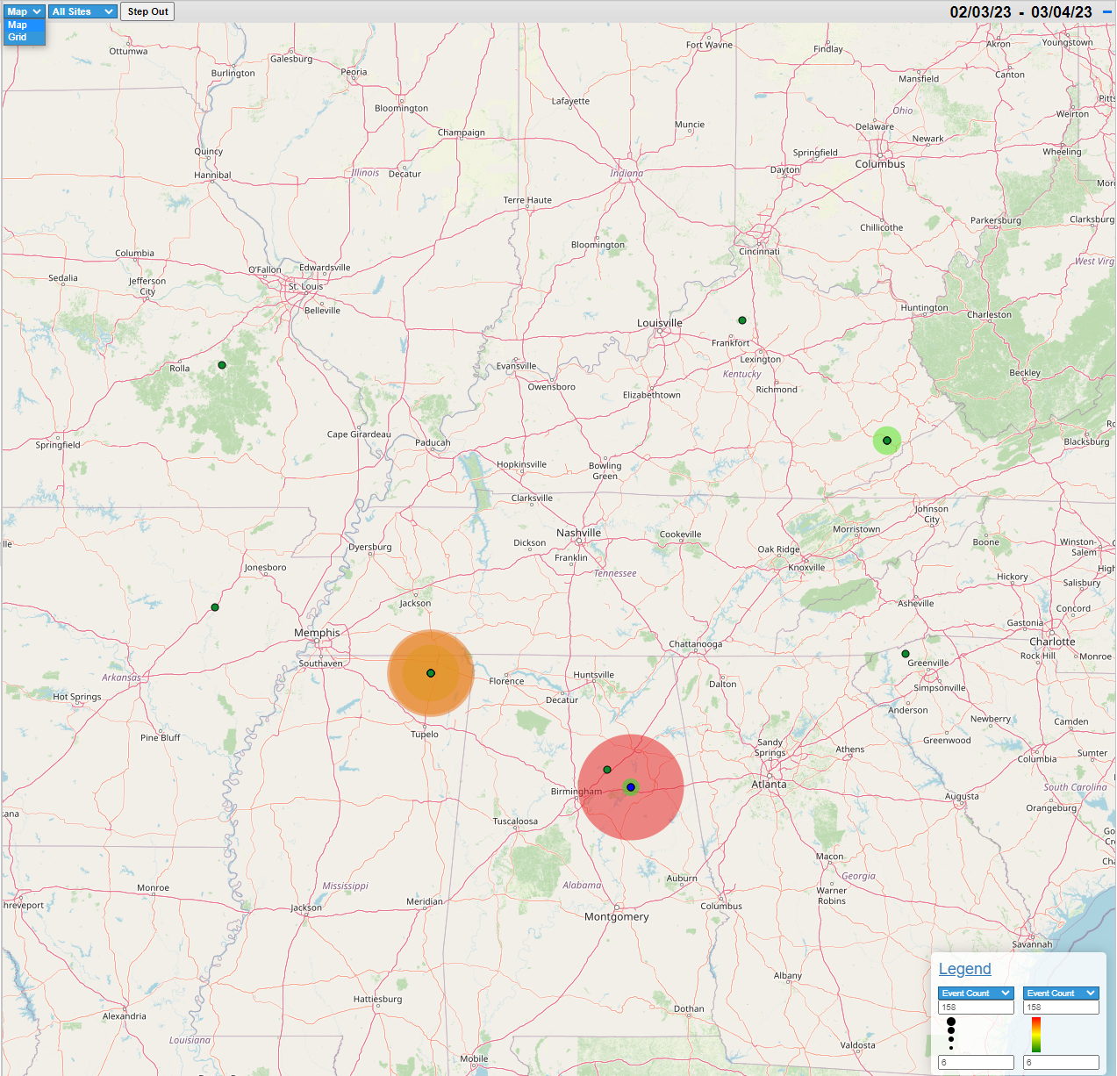
Use the dropdown above the Grid to change to the Map view.
The “auras” around the substation locations are configured using the Legend at the bottom right of the Map. Min and Max auto fills based on available data when a data type is selected.
Available data types:
Event Count
Sag Count
Swell Count
Interruption Count
Sag Minimum
Swell Maximum
Maximum Voltage RMS
Minimum Voltage RMS
Average Voltage RMS
Maximum Voltage THD
Minimum Voltage THD
Maximum Short Term Flicker
Minimum Short Term Flicker
Average Short Term Flicker
If the selected Asset Group is part of another Asset Group, the option to Step Out in the hierarchy is available on both the Grid and Map view.
The dots on the map represent substations, based on the Longitude and Latitude configured in System Center.

Slide 25
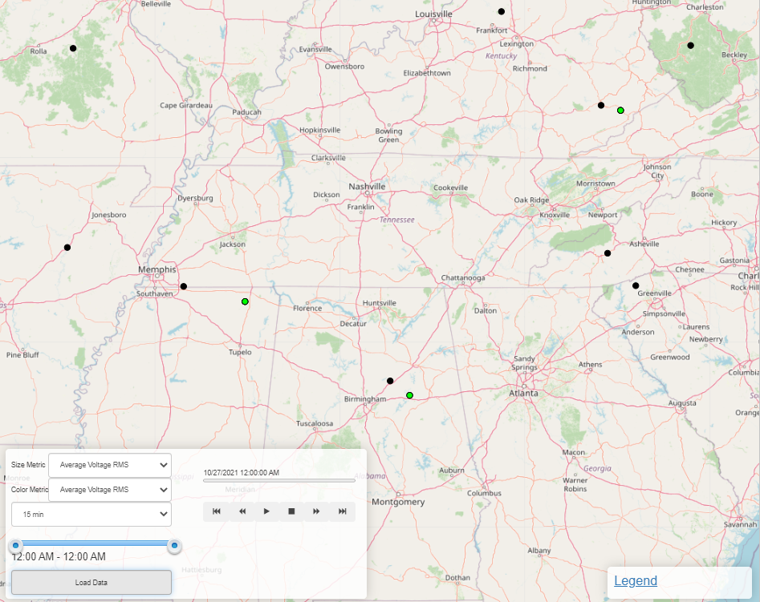
Map Animations
When the Trending Data tab is selected, the animation feature can be used by selecting a day from the bar chart on the left.
Size and Color Metric functions the same as the Legend, though limited to Min, Max and Average of Voltage RMS, Voltage THD, and Short Term Flicker.
Select an appropriate interval from the dropdown.
  1, 5, 10, 15, 20, 30, and 60 min intervals available.
Select the time range to be viewed using the sliders.
Click Load Data for the animation controls to become available.
The trending data can now be “stepped through” or played as an animation to view the effects across your system.

Slide 26

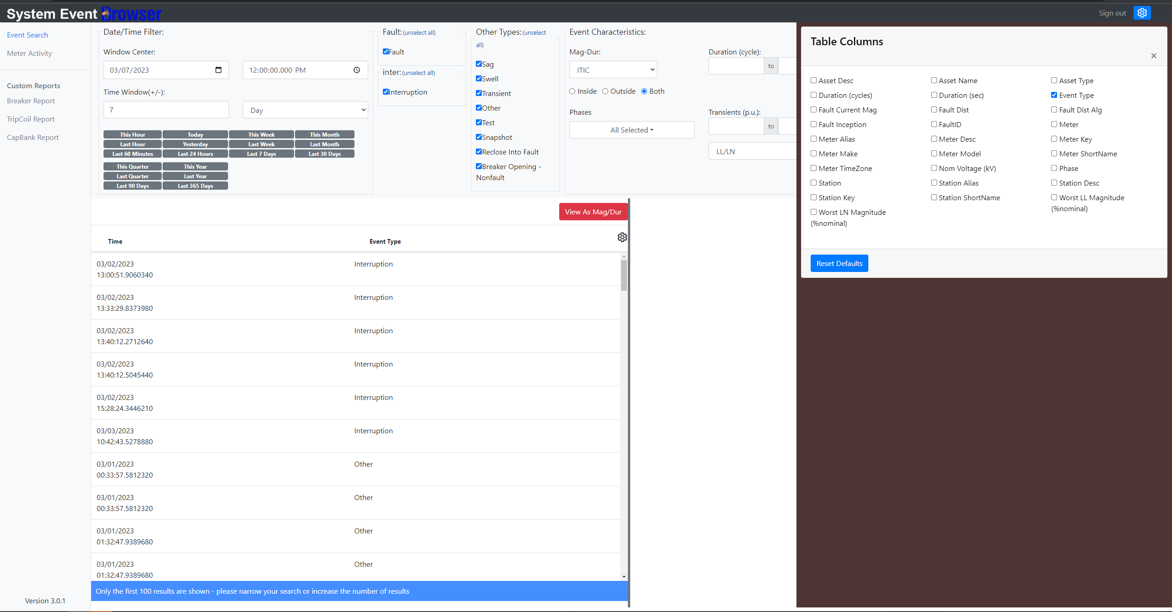
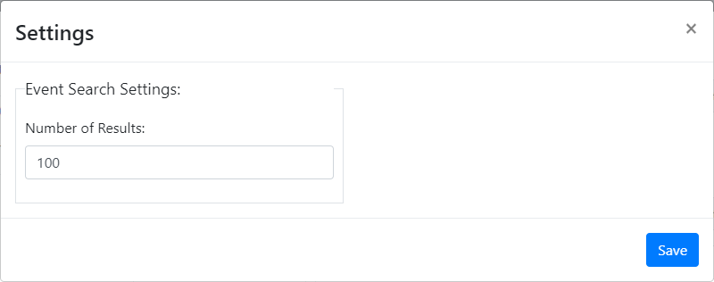
To change the number of results shown, use the gear at the top right.
Note: larger numbers of results can negatively influence load times.
Use the CustomReports Value List in System Center to configure viewable reports.
Both the Number of Results and Table Columns settings persist between sessions and are local to the workstation.
To change the visible results table columns, use this gear. Time is the only column that cannot be disabled.
Drag bar (highlighted in yellow for demonstration) side-to-side to resize results table and event preview pane up to a 75/25 split on either side.

Slide 27

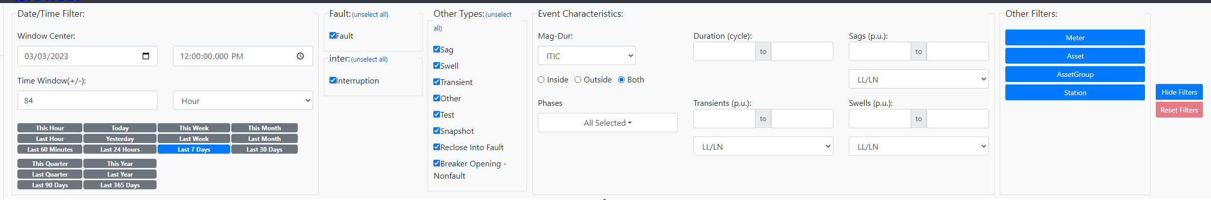
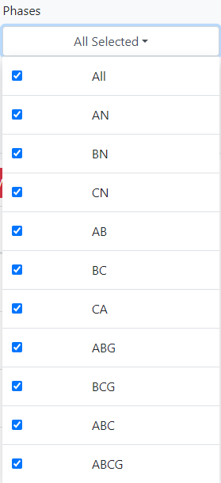
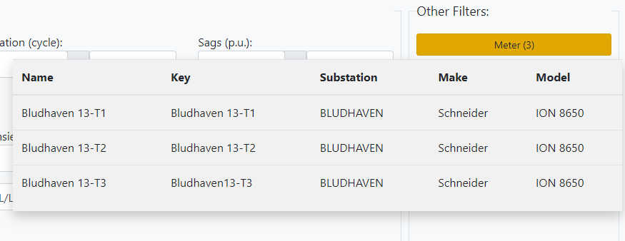
Event Characteristics
Filter by where the events sit on a given Mag-Dur curve.
Filter by Phase.
Filter by Duration in cycles.
Filter by Line to Line or Line to Neutral Magnitude (per unit).
  These filters become unavailable if their associated event type is filtered out.
Hide/Reset Filters
To give more room to your search results and event preview, the Hide Filters button will hide the entire filter bar, showing only the selected time window. If a filter other than time has been applied, the button will turn yellow.
Reset Filters will reset all applied filters except time window.
Date/Time Filter
The selected date and time is the center point for the window. The Time Window(+/-) field does not accept decimals.
Quick picks (below) highlight in blue when selected.
Event Type Filter
Available Event Types and their organization into categories are configurable in System Center under Event Types.
Other Filters
Filter by Meter, Asset, Asset Group, and/or Substation.
When a filter of the given type is selected, the associated button will turn yellow and show a count of the number of selections in the filter.
Mousing over the button shows the selections (up to 10).

Slide 28
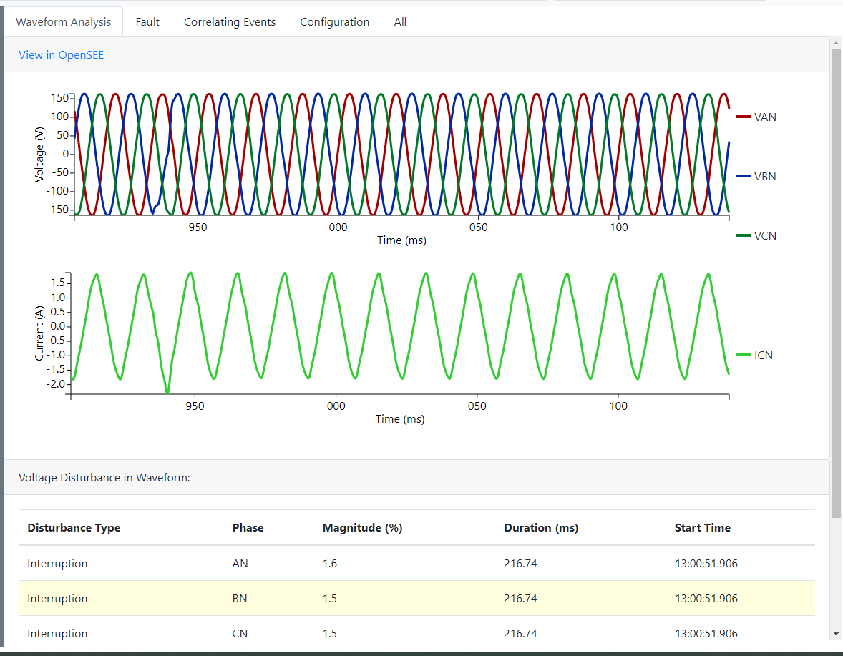
Event Preview Pane
When an event from the results list is selected, the Event Preview Pane is populated to the right.
View details about the event and asset.
Available widgets/cards are configurable (currently through the database, UI coming soon).
Ability to configure tabs coming soon.

Slide 29
Available Widgets/Cards
Widget Name | Description | Current Tab Location(s) | Default?
Waveform Preview | Shows the waveform preview(s) and View in openSEE link. | Waveform Analysis & All | Yes
Interruption Report | PQI interruption report | Configuration & All | No
Fault Evolution Summary | Shows the Evolution, Inception, and Duration of a fault | Waveform Analysis & All | No
Voltage Disturbance in Waveform | Shows the voltage disturbances in the waveform, highlights the worst disturbance | Waveform Analysis & All | Yes
Correlated Sags | Shows time-correlated sags | Correlating Events & All | Yes
Line Parameters | Shows the line parameters | Fault & All | No
File Info | Shows the file path for the file containing the event, a link to System Center Configuration History, and Channel Mappings | Configuration & All | No
Asset History | Shows asset lifetime stats and event history | Fault & All | Yes
Breaker Performance | TCE performance during the selected event | All | No
Historic Breaker Performance | History of selected TCE parameters | All | No
EPRI CapBank Analytic | CapBank analytic for the selected event | All | No
Notes | Shows notes for the event | Configuration & All | Yes
Additional widgets/cards may be available and not listed due to being developed for tools used at specific utilities. Contact GPA for more information or to develop a custom widget/card.

Slide 30
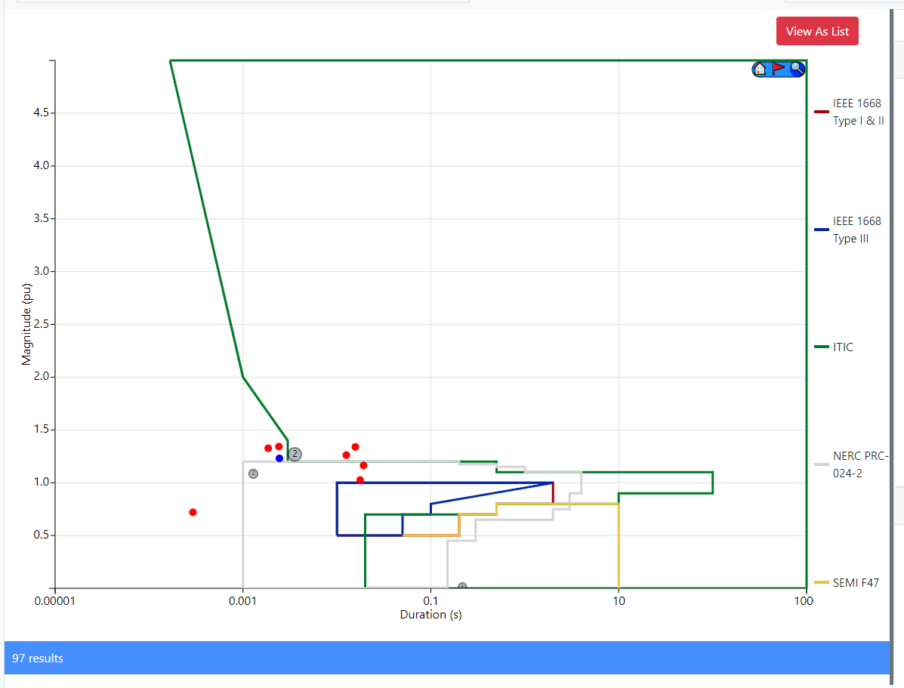
Mag/Dur Chart
If an event was selected from the table, it will appear blue on the Mag/Dur Chart.
Click View As Mag/Dur to view the results list on a Mag/Dur Chart. Click View As List to return to the table.
Click the magnifying glass to expand the tools.
Home – reset zoom
Flag – select an event for viewing in the Event Preview Pane or zoom into a cluster of events
Magnifying Glass – enable zoom, both mouse wheel and click and drag
Click the curve name to enable/disable the curve on the plot. Additional Mag/Dur curves are configurable in the openXDA database.
If multiple events have similar magnitude and duration, they are combined on the chart into a single dot with the number signifying the number of events in that cluster. Zoom in (mouse wheel or click and drag while ) or use the flag tool (top right) to view the individual events.

Slide 31
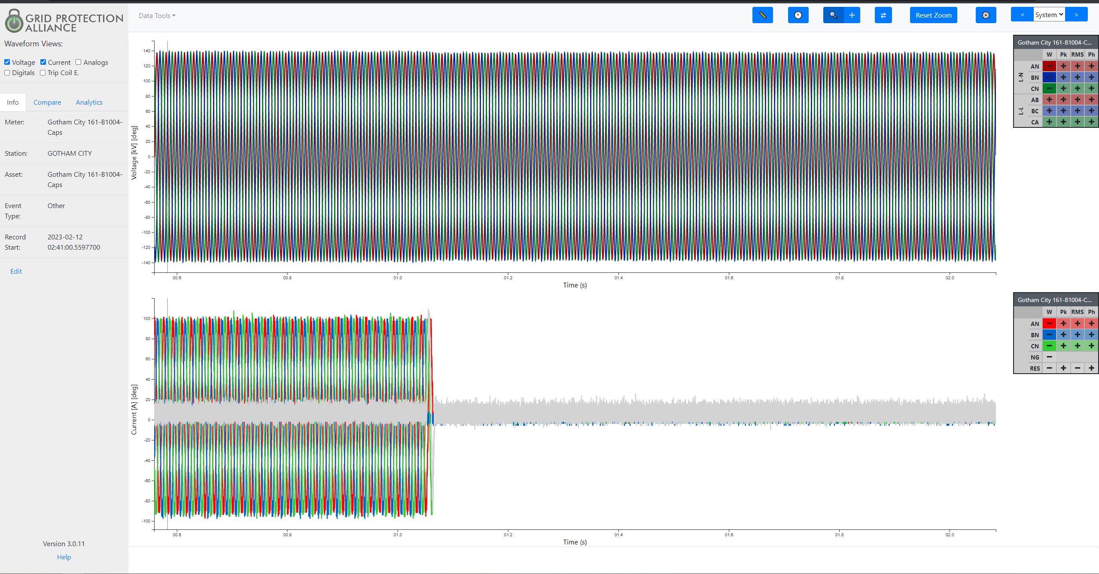
Select the Waveform(s) to plot. Each Waveform is drawn on its own chart.
Select Trace(s) to draw.
Information on the webapp functions.

Slide 32
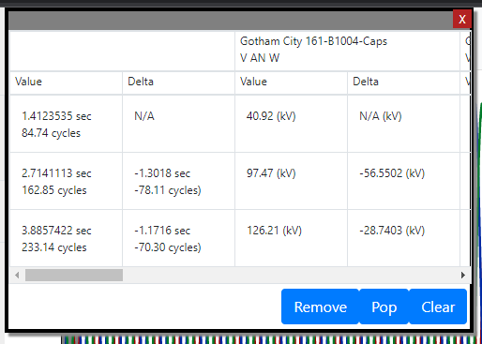
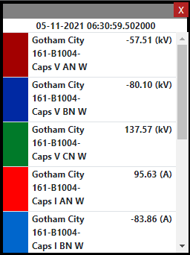
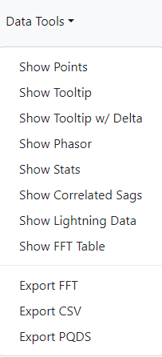






Data Tools are popups that can be moved around the page to give access to the data with the flexibility to be moved out of the way.
Show FFT Table and Export FFT only available when viewing the FFT Analytic
Export FFT and Export CSV export the applicable data as a CSV file.
Export PQDS exports as EPRI’s PQDS standard file type.

Slide 33





Pan (click and drag on chart)
Zoom/Pan Orientation
Select the reference axis for Zoom or Pan; Rectangle is both.
Zoom and Pan along the Time axis affects all charts with Time as the x axis
Navigate through System Events
Move to Previous/Next event chronologically (if available) for each selection type. System is all possible; Station, Meter, and Asset selection is based on the event currently being viewed.
Show Tooltip (Data Tool)
Show Phasor (Data Tool)
Zoom (click and drag on chart)
FFT (click and drag the gray bar on the plot to select cycles)
Reset Zoom/Pan (applies to all charts)
Settings
General Settings configures settings for the whole webapp (local to the workstation).
Units and Colors can be configured for each waveform or analytic currently being viewed.
Note: some settings may also apply to certain analytics.

Slide 34

Compare tab
Ensure the Setting Display all events on single Graph for Compare Overlapping Events is unchecked before selecting this tab. This feature is still in development and can cause the application to lock up.
Shows the assets with correlating events. Select one or more to plot these for comparison.
Each waveform for the selected event(s) is drawn on a separate chart, with the time axis matching that of the original regardless of the duration of the event selected to compare.

Slide 35

Analytics
Use the dropdown to select the desired analytic. These are computed, not pulled from the device.
Each analytic is drawn on a separate chart below the event waveform(s). Don’t forget to select your traces appropriately!

