Slide 1
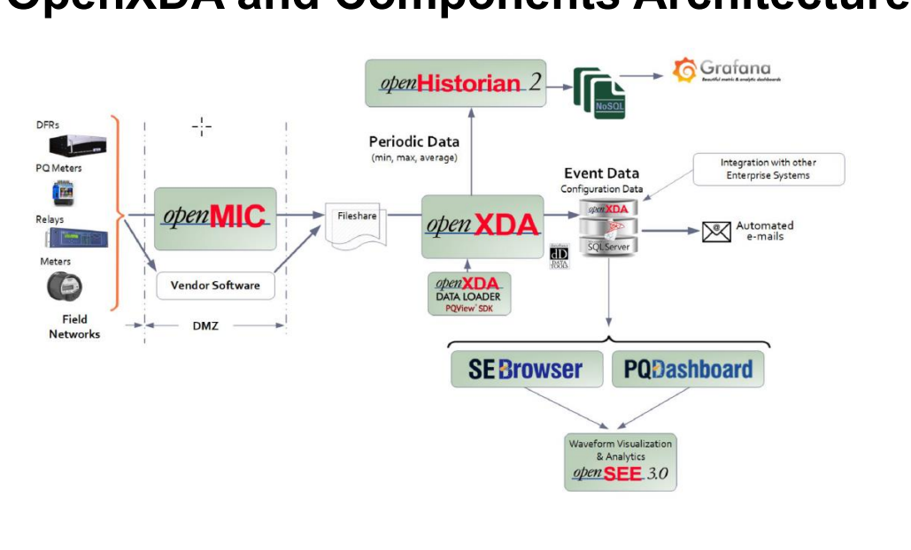
OpenMIC Standard Setup

Slide 2
OpenMIC Current TVA/SRP Setup
Unsecure, 3rd party?
Windows File Transfer

Slide 3
OpenMIC Proposed SFTP Setup
Windows File Transfer (opt)
SFTP
SFTP Server for openMIC; Fileshare for XDA

Slide 4
Proposed Joint Project
Changes will resolve:
  SRP copy across boundary to XDA
  TVA duplicate file share across boundary for file access
IT/Cyber Security will need to confirm SFTP is the right protocol
GPA estimates ~60 hours for resolution (~12k)

