Slide 1
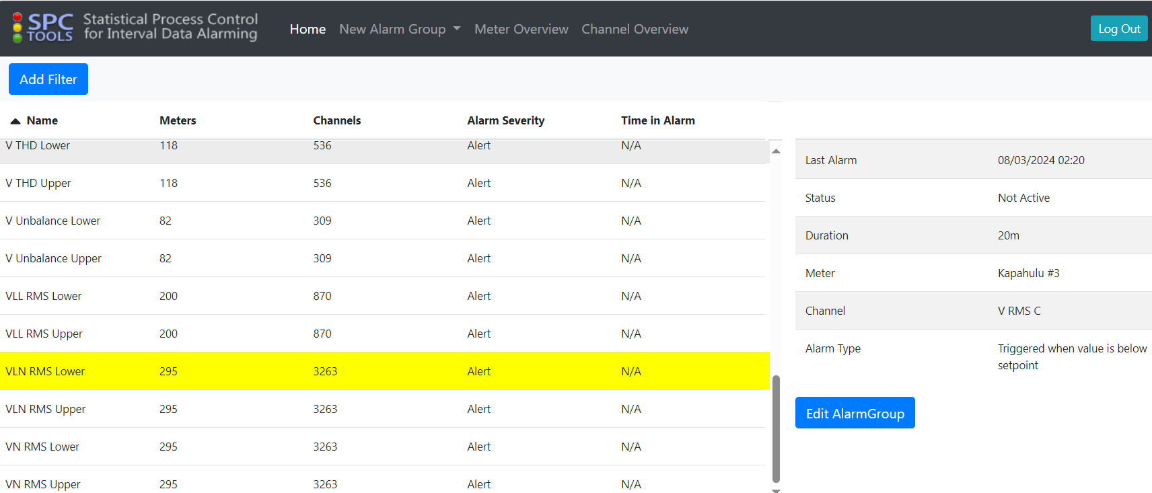
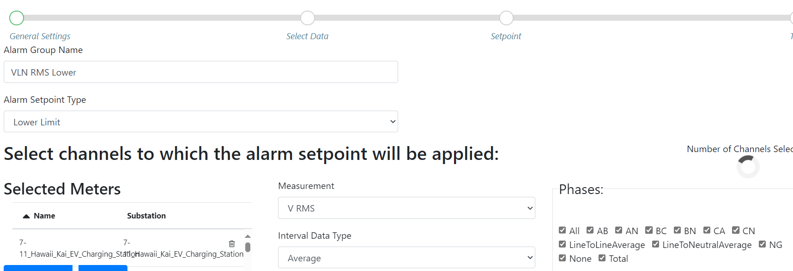
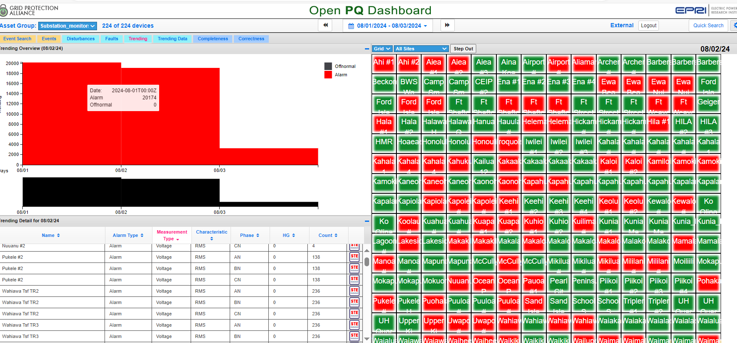
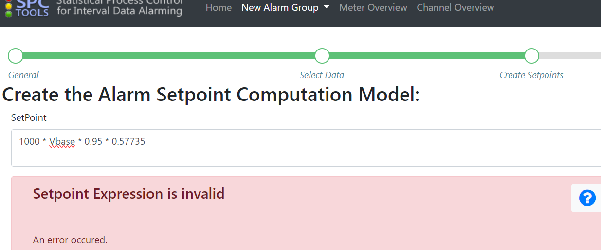
Fix few monitors having Out of L-N Limit Alarms – SPC Tools
Need to choose ALL to be able to use “Vbase” formula below that will update all monitors, but now started to get this error so can’t fix the remaining few monitors.
Note: when choosing All also causes some other alarms like for None and moves NG upper limit L-N voltage level.

Slide 2
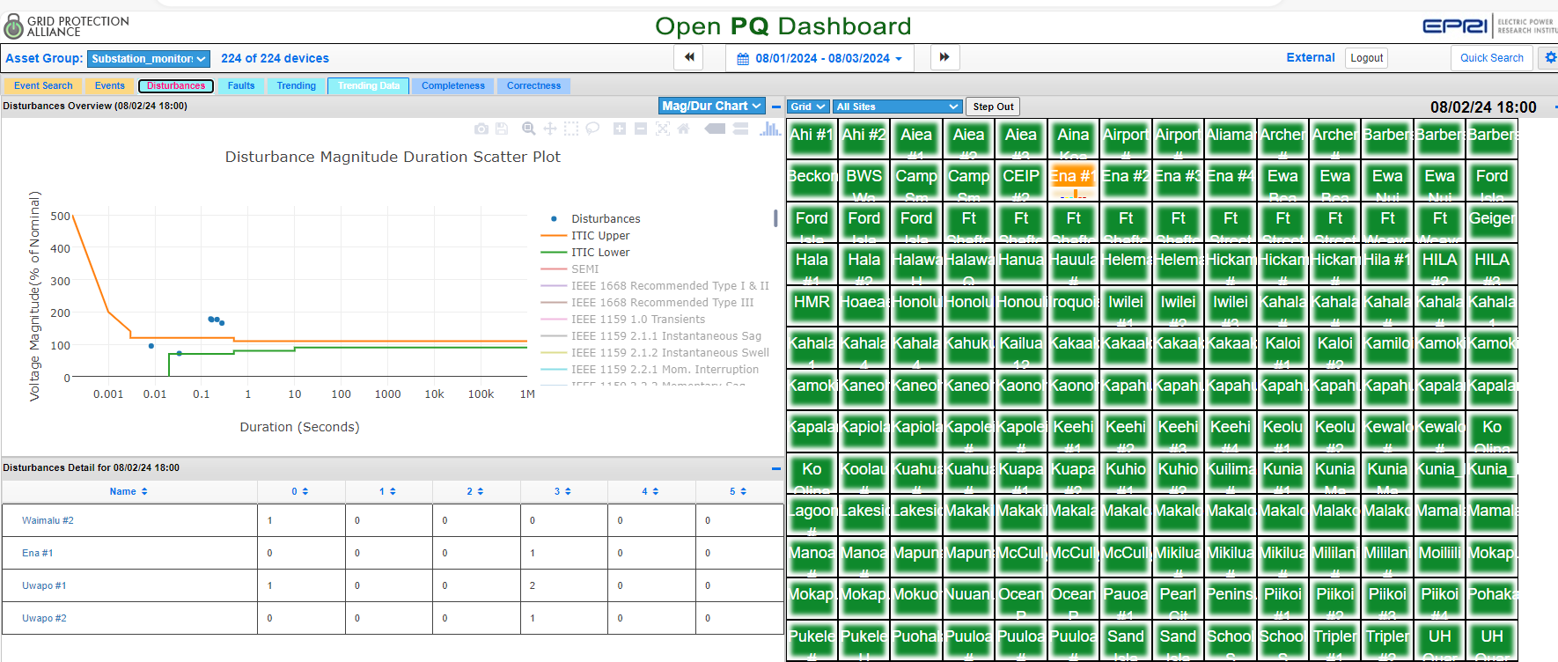
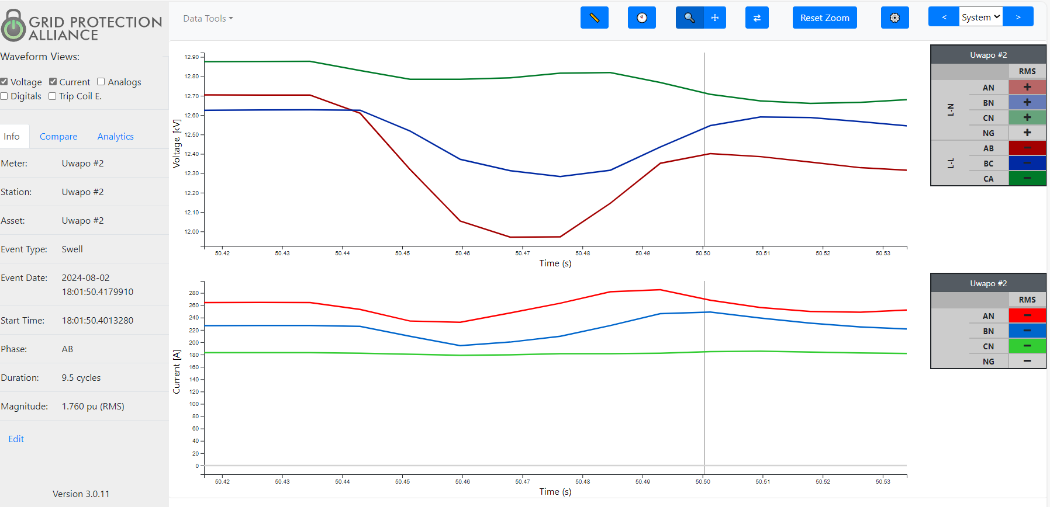
Fix Substation monitors “Swell” Events
Swell event but showing sag profiles for SEE
Question: Would reprocessing files correct this issue after updating Vbase for some?

Slide 3
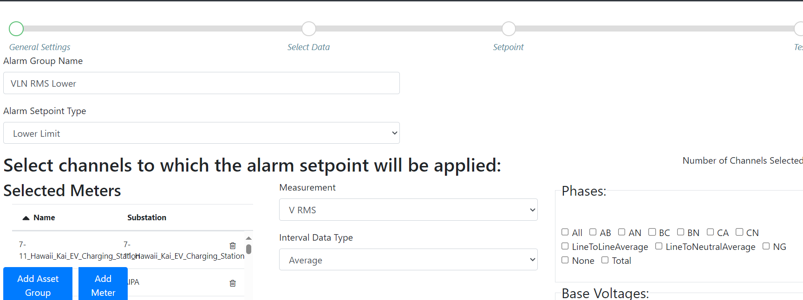
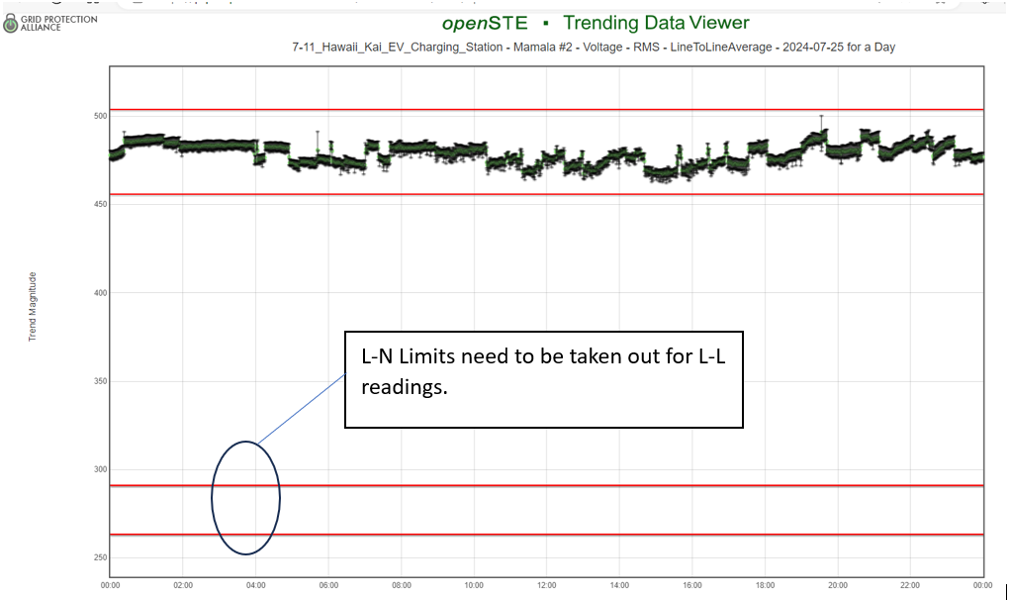
Bring back VLL Upper and Lower Limit monitoring – had to remove all VLL because L-N limits were being triggered causing numerous alarms.
It appears that when having to select ALL for changing limits for VLN limits it also includes “LineToLineAverage” so causing for VLN limits to show up on chart and triggering these alarms. We had to Delete these VLL parameters in System Center to avoid these numerous alarms. Can LineToLineAverage be taken out of Phases box? If LineToLineAverage can be taken out, how can we reload the VLL parameters that were removed due to this issue?

Slide 4
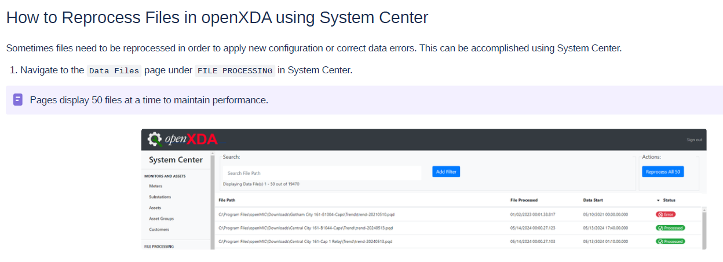
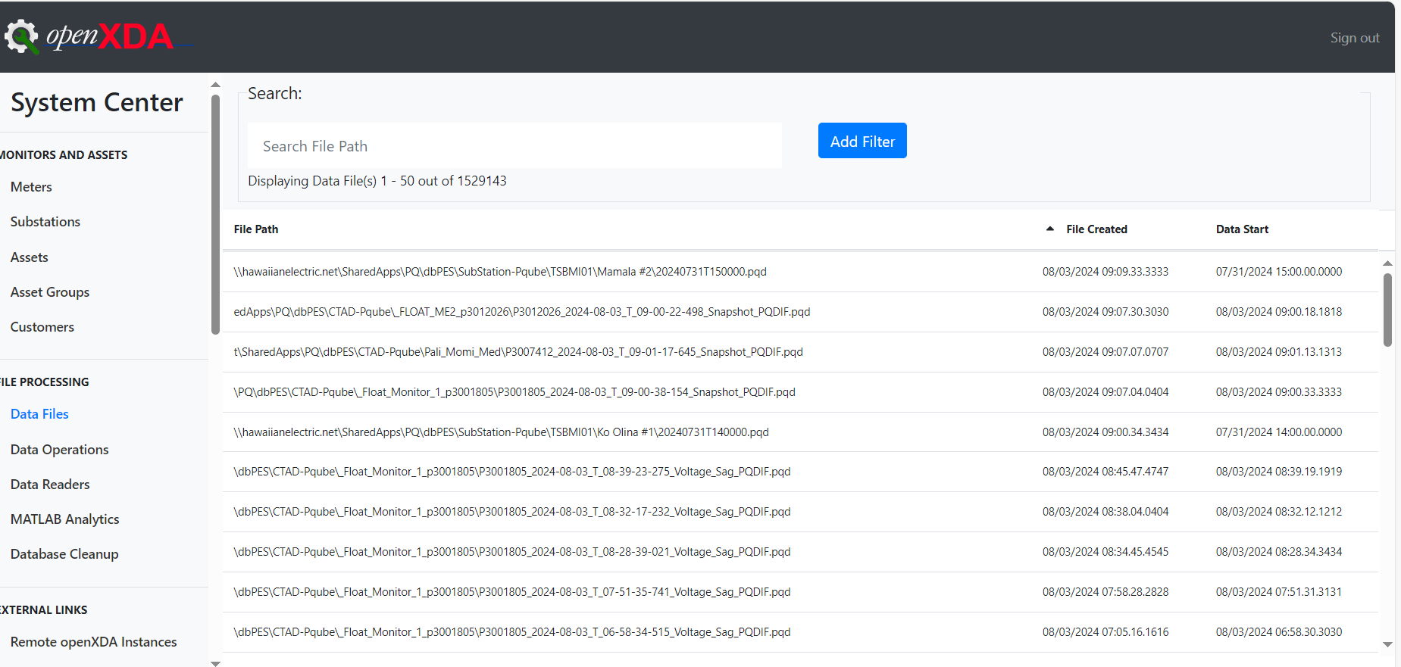
Reprocessing Flies – Instructions showing Status of monitors but ours doesn’t show

