Slide 1


Entergy Grafana Training – July 2023

Slide 2
Filter Expressions
All Filter Expressions begin with FILTER and include WHERE
  FILTER <TableName> WHERE <Expression>
FILTER selects the table to be filtered
  TOP <number>
WHERE selects the filter conditions
  Operators (=, LIKE, etc.)
  AND & OR

Slide 3
Before Running Functions

Slide 4
Grafana Functions for OH
Average
Minimum
Maximum
Total
Range
Count
Distinct
AbsoluteValue
Add
Subtract
Multiply
Divide
Modulo
Round
Floor
Ceiling
Truncate
StandardDeviation
Median
Mode
Top
Bottom
Random
First
Last
Percentile
Difference
TimeDifference
Derivative
TimeIntegration
Interval
IncludeRange
ExcludeRange
FilterNaN
UnwrapAngle
WrapAngle
Label
Evaluate

Slide 5
Deferred enumeration
Distinct
AbsoluteValue
Add
Subtract
Multiply
Divide
Modulo
Round
Floor
Ceiling
Truncate
Difference
TimeDifference
Derivative
Interval
IncludeRange
ExcludeRange
FilterNaN
Label
Evaluate
Immediate enumeration
Average
Minimum
Maximum
Total
Range
Count
TimeIntegration
Immediate in-memory array load
StandardDeviation
Median
Mode
Top
Bottom
Random
First
Last
Percentile
UnwrapAngle
WrapAngle

Slide 6
Special Commands
DropEmptySeries
IncludePeaks
Imports={expr}

Slide 7
Group Operations - Set vs. Slice
The following prefixes can be added to Series Functions to perform the transformation in aggregate.
Set
  “Horizontal”
  Example:
    SetAverage(FILTER ActiveMeasurements WHERE SignalType=‘FREQ’)
Slice
  “Vertical”
  Example:
    SliceSum(0.0333, FILTER ActiveMeasurements WHERE SignalType=‘IPHM’)
Series 1: 8, 23, 25, 29, 34, 39, 47, 57, 61, 75
Series 2: 15, 19, 21, 46, 50, 56, 58, 64, 73, 88
Series 3: 4, 10, 12, 23, 35, 42, 62, 71, 91, 92
Series 1: 8, 23, 25, 29, 34, 39, 47, 57, 61, 75
Series 2: 15, 19, 21, 46, 50, 56, 58, 64, 73, 88
Series 3: 4, 10, 12, 23, 35, 42, 62, 71, 91, 92

Slide 8
Grafana Plugins
Plugins can be for Data sources, Apps, or Panels.
Data source plugins communicate with external sources of data and return it in a Grafana-consumable format.
  Example: openHistorian
Panel plugins provide new ways to visualize data in your dashboards.
  Example: Geomap
App plugins blend data source and panel plugins into a bundled experience.
  Example: Grafana OnCall

Slide 9
Deploying Plugins on Entergy System
As the Entergy openHistorian server does not have internet access, “special” steps need to be taken to deploy new Plugins.
Find the desired Plugin on https://grafana.com/grafana/plugins/
Follow directions to download as a zip file
Copy the files to the ./plugins/ directory on the server
Restart Grafana
Plugins often have these steps listed on their websites for easy reference!

Slide 10
Grafana Dashboards
A Dashboard in Grafana is a collection of visualizations, aka Panels.
Dashboards can be saved and even imported and exported for future and shared use.

Slide 11
Before Creating a New Dashboard
ANSWER:
The goal of the dashboard – what story is it going to tell/question is it going to answer?
  How do we currently access/view this data? What is needed to make better use of the data?
What is our dashboard strategy?
  Write it down! Having a strategy reduces future questions about design choice and maintains consistency for users of all your dashboards.

Slide 12
During and After Dashboard Creation
ASK YOURSELF:
Can I tell what each panel represents?
  Is this intuitive, or require some thinking?
Who will be using this dashboard?
  What data and visualizations will be of use to my end user?
  Will my target user be able to understand as well as I do?
Collaborate!
  Request feedback whenever possible to help answer the above questions.

Slide 13
Panels
Panels are the visual representation of the data.
Available Panels are only limited by downloaded Plugins and ability to connect to the required data source.

Slide 14
Variables

Slide 15
Annotations
Add notes to Grafana visualizations using the native tool.

Slide 16
Review with Geomap

Slide 17
ConfigurationEntity Table
Defines the Tables that Grafana can access
SourceName – the name of the Table in the database
RuntimeName – the name to display in Grafana
Description – only optional field, describes the data contained in the Table
LoadOrder – the order in which the Table contents are listed in Grafana
Enabled – whether or not to show in Grafana

Slide 18
Grafana Managed Alerts
Set thresholds using the Grafana-native alerts.

Slide 19
Important Tables for Grafana
For trending points in Grafana, table should include PointTag field – other tables useful for dropdown lists:
ActiveMeasurements
ActionAdapters
Alarms
InputAdapters
InputStreamDevices
Statistics

Slide 20
Grafana Table Name | DB Table/View Name | Table or View? | Description
ActionAdapters | IaonActionAdapter | View | Defines IActionAdapter definitions for a PDC node
ActiveMeasurements | GrafanaActiveMeasurements | View | Defines active system measurements for a PDC node
Alarms | Alarm | Table | Defines alarms that monitor the values of measurements
CompressionSettings | NodeCompressionSetting | View | Defines information about measurement compression settings
FilterAdapters | IaonFilterAdapter | View | Defines IFilterAdapter definitions for a PDC node
InputAdapters | IaonInputAdapter | View | Defines IInputAdapter definitions for a PDC node
InputStreamDevices | RuntimeInputStreamDevice | View | Defines input stream devices associated with a concentrator
MeasurementGroupMeasurements | MeasurementGroupMeasurement | Table | Defines the measurements in a measurement group
MeasurementGroups | MeasurementGroup | Table | Defines a group of measurements
NodeInfo | NodeInfo | View | Defines information about the nodes in the database
OutputAdapters | IaonOutputAdapter | View | Defines IOutputAdapter definitions for a PDC node
OutputStreamDeviceAnalogs | OutputStreamDeviceAnalog | Table | Defines analog values for output stream devices
OutputStreamDeviceDigitals | OutputStreamDeviceDigital | Table | Defines digital values for output stream devices
OutputStreamDevicePhasors | OutputStreamDevicePhasor | Table | Defines phasors for output stream devices
OutputStreamDevices | RuntimeOutputStreamDevice | View | Defines output stream devices defined for a concentrator
OutputStreamMeasurements | RuntimeOutputStreamMeasurement | View | Defines the measurements in an output stream
Statistics | RuntimeStatistic | View | Defines statistics that are monitored for devices and output streams
SubscriberMeasurementGroups | SubscriberMeasurementGroup | Table | Defines measurement groups associated with a Gateway subscriber
SubscriberMeasurements | SubscriberMeasurement | Table | Defines measurements associated with a Gateway subscriber
Subscribers | Subscriber | Table | Defines subscribers that can request streaming points from a Gateway node

Slide 21
DeviceGroupMeasurements
Based on active measurements, adds columns for device groups

Slide 22
Adding Other Metadata Sources
Requirements:
Must target time-series data
PointTag field that can be matched to the target Grafana series name
To use:
{TableName.FieldName}
  More info in Grafana Functions section

Slide 23
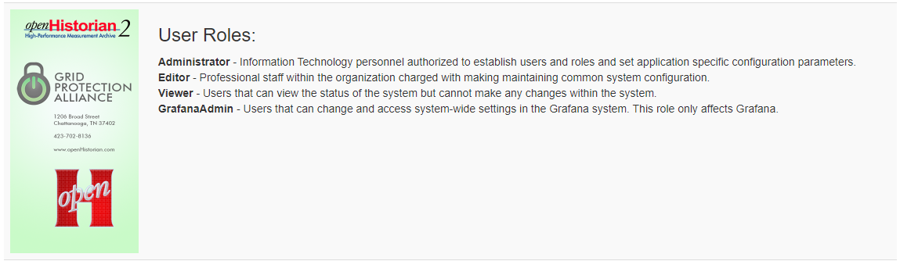
User/Access Management
Manage Users
  In OH, Settings > Users
User Roles
  Roles are the same as OH
  Special GrafanaAdmin role

Slide 24
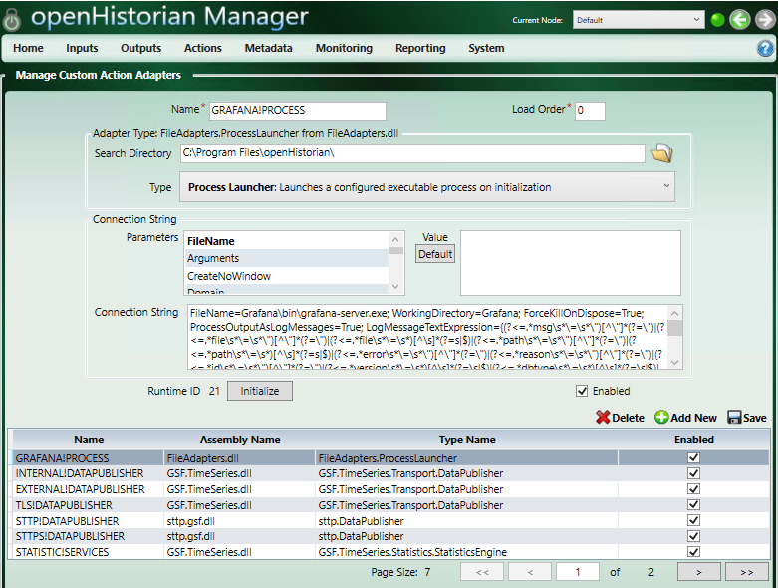
Reinitializing Grafana within OH
openHistorian Manager > Actions > Manage Custom Actions

