Slide 1

Grid Protection Alliance, Inc.
May 1

Slide 2

Who is GPA
GPA is a not-for-profit corporation established in 2010
Specialize in software and services for the electric utility industry
Most software is open-source, published under the permissive MIT license
Focus on a robust, reliable and resilient grid
Focus on collecting, managing, augmenting, and storing high fidelity power system data

Slide 3

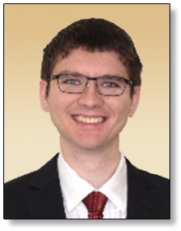
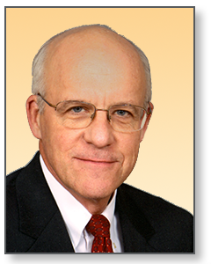
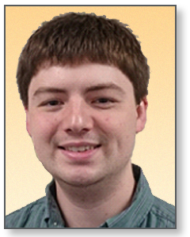
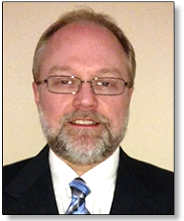
Introduction Key GPA Staff
Dr. Christoph Lackner
Operating Officer & Lead Engineer
ROLE: Operational & Engineering Leadership
Russell Robertson
VP of Grid Solutions
ROLE: Strategic Studies
Grid Protection Alliance, Inc. specializes in the development and support of innovative software solutions for the electric industry.
GPA has a track record of innovation and has led major software development projects with client utilities and the United States Federal Government.
In addition to custom application development, GPA offers services for installation, setup, integration, and ongoing maintenance of its open-source software.
GPA key personnel have a combined experience of over 120 years in the synchrophasor space and continue to be involved in industry-wide efforts including developing of new standards like IEEE 2664 and IEEE C37.118-2024.
Establishes new software development projects and ensures the successful completion of established projects.
Provides engineering oversight of GPA analytic applications.
15+ years’ experience with synchrophasor data analytics and use of synchrophasor data in various applications such as state estimation, predictive maintenance, and system parameter estimation.
Specializes in the development of real-time and offline data analytics for power systems.
Establishes collaborations within the utility industry to support the development and maintenance of open-source software.
Founded GPA’s open-source software and consulting service business.
Expertise in grid operations, IT/OT architecture, information management, and control systems.
Stephen Wills
Senior Systems Analyst
ROLE: Lead Software Development
Ritchie Carroll
Senior Solutions Architect
ROLE: Systems Architect & Lead Developer
Major contributor to GPA software solutions and provides system support and integration services to utilities.
15 years’ experience in developing .NET solutions, much of that time contributing significantly to GPA’s core code base – the Grid Solutions Framework.
Specializes in the management of data from substation devices – PMUs, DFRs, power quality meters, and relays.
Prior to joining GPA, extensive experience at the Tennessee Valley Authority in development of synchrophasor data software.
Oversees GPA software development and provides software system design and development services to utilities.
25+ years’ expertise in high-performance software system design, development, and delivery. Has led numerous large software development projects.
10 years at the Tennessee Valley Authority leading synchrophasor software development among other operational systems.
Active participant in NASPI and other industry efforts to improve synchrophasor data systems.

Slide 4


GPA Flagship Synchrophasor Products
The most widely used Phasor Data Concentrator
Supports 10,000+ PMUs
Support for 15+ common (and uncommon) data protocols
Designed for data and IT security
Most performant data augmentation in the industry
Support for synchrophasor, point on wave, and SCADA data
Historian for high fidelity timeseries data
Most performant read and write database for synchrophasor data in the industry
Designed for data and IT security
Support for 15+ common (and uncommon) data protocols
Support for 15,000+ PMUs
© 2025 Grid Protection Alliance

Slide 5


GPA Flagship Synchrophasor Products
New in 2025
Significant performance upgrades
Modern security features including SSO support
Support for modern data encryption
Modern web-based user interfaces
Simplified configuration
Event-based alarming
Significant performance upgrades
Modern security features including SSO support
Support for modern data encryption
Modern web-based user interfaces
Read speeds increased by over 30%
Customizable data retention policies
© 2025 Grid Protection Alliance

Slide 6
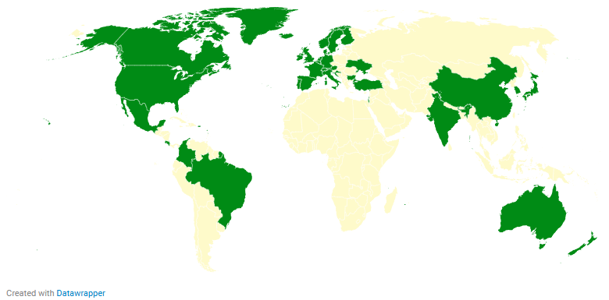
Open PDC and Open Historian Usage
* Based on GPA contracts, GPA forum engagement, and Github Repository Statistics
© 2025 Grid Protection Alliance

Slide 7




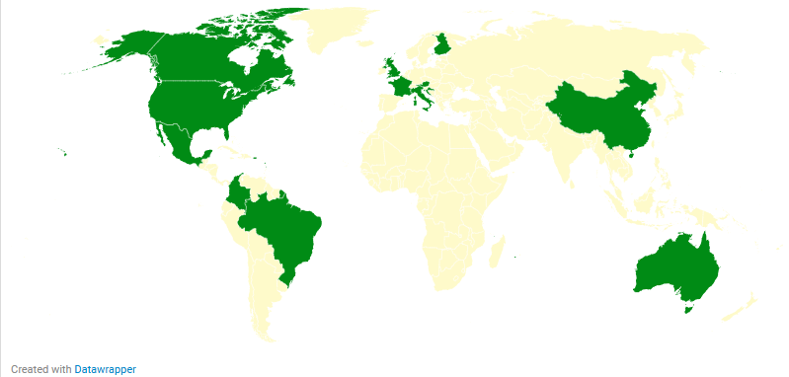













GPA Consulting and Support and Maintenance Clients
© 2025 Grid Protection Alliance

