Slide 1
EMCB Manager
Organization Administrators
Device and data management
EMCB
EMCB
Streaming data (JSON)
Webhook
EMCB
Eaton API and subsystems
Installers
EMCB Mobile App
Streaming data (PQDIF)
openXDA Database
EPRI Open
PQ Dashboard
openXDA

Slide 2
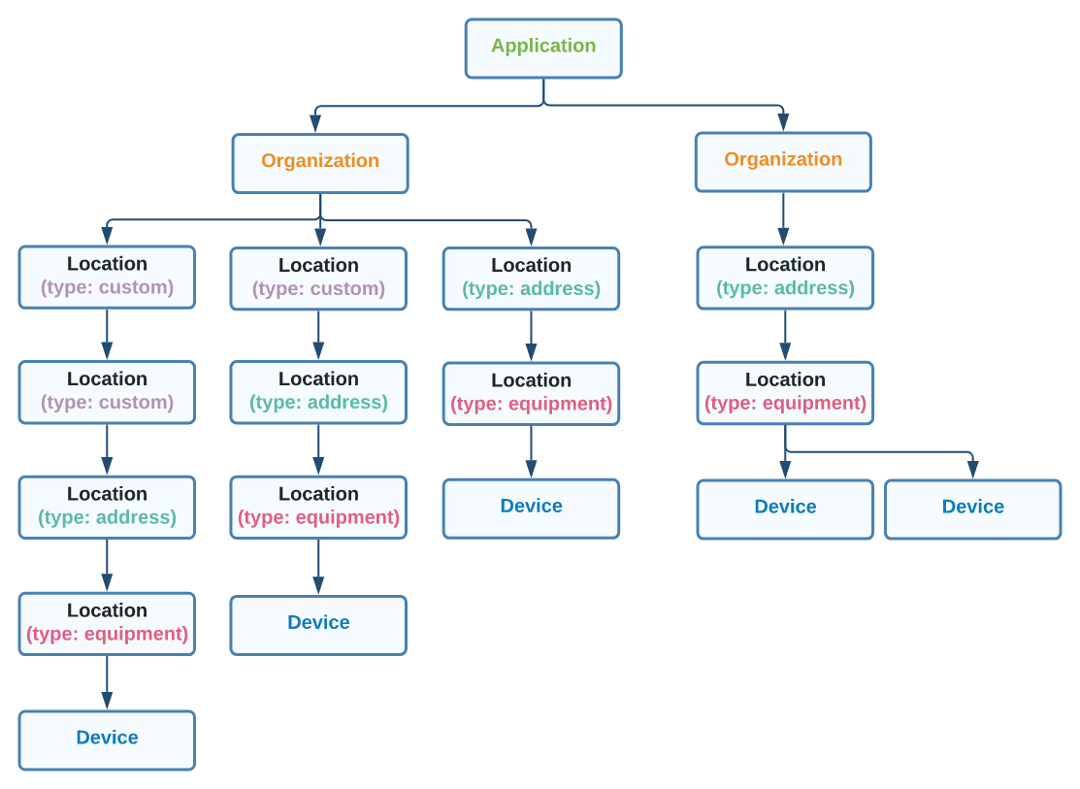
Eaton API Application Hierarchy
From the Eaton API docs:
Application: EMCB Manager
  Organizations page to manage organizations
  Locations page to view/edit the location hierarchy
  Installers page to manage who can use the EMCB mobile app to install devices
  Users page to manage who has access to each organization
  Settings page to manage EMCB Manager application settings

Slide 3
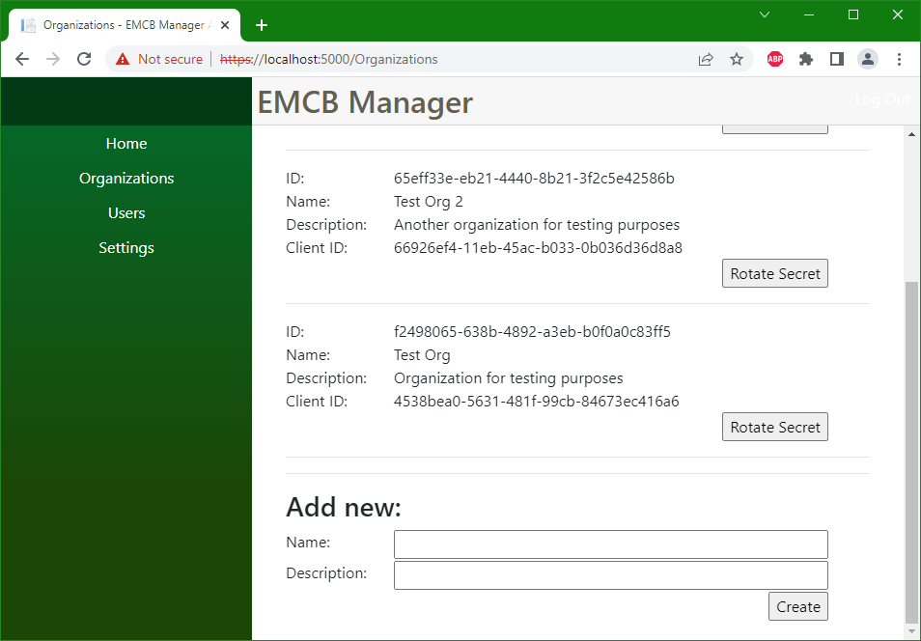
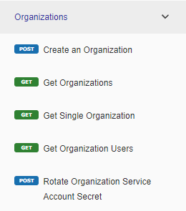
EMCB Manager – Organizations Page
From the Eaton API docs:
Note – the application is still under development

Slide 4
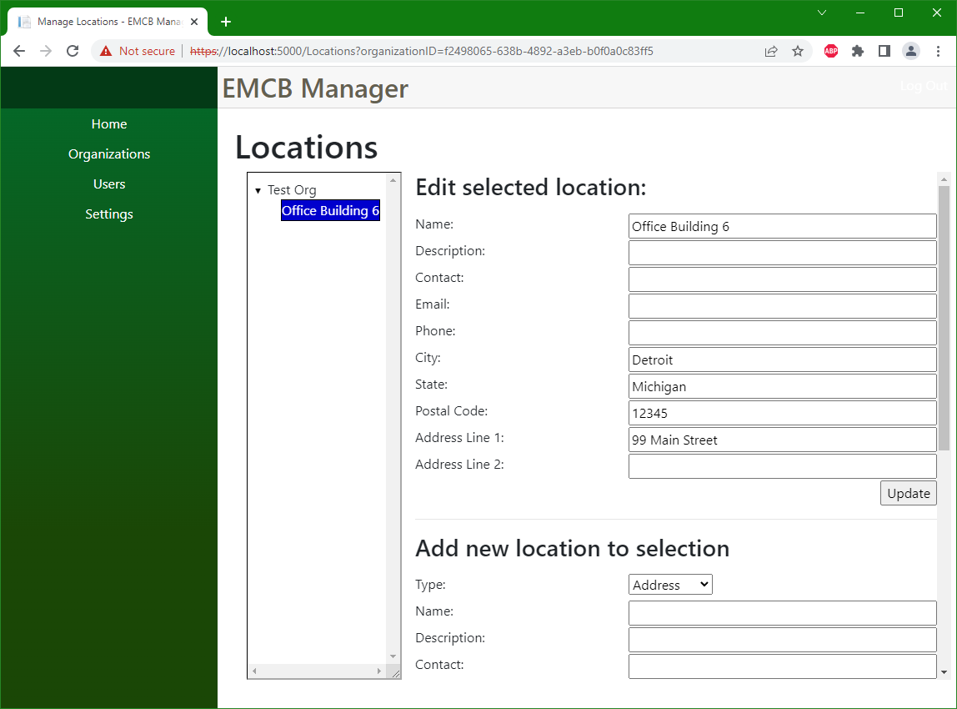
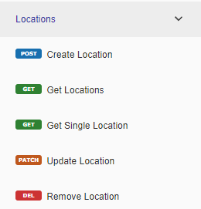
EMCB Manager – Locations Page
From the Eaton API docs:
Note – the application is still under development

Slide 5
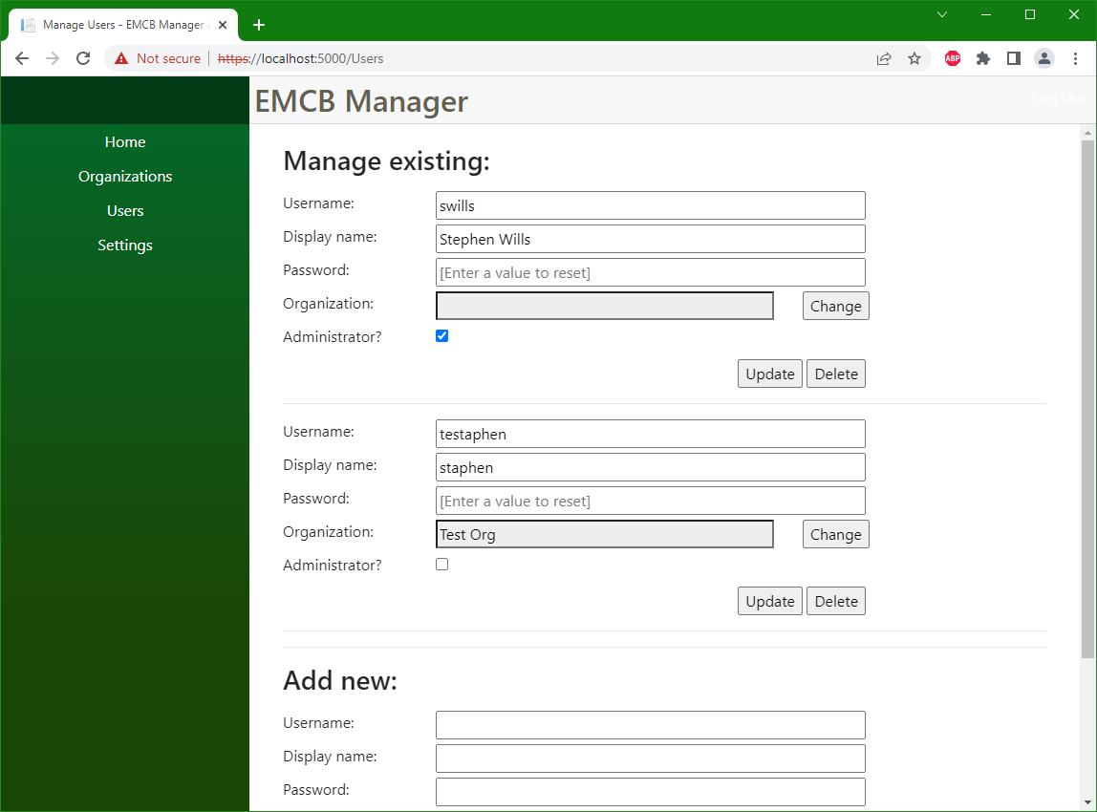
EMCB Manager – Users Page
Application administrators
  Manage any organization’s locations, installers and devices
  User management
    Invite new users and administrators
    Assign organizations
    Reset passwords
  Manage application settings
Organization administrators
  Assigned to a single organization
  Manage locations, installers, and devices for that organization
Note – the application is still under development

Slide 6
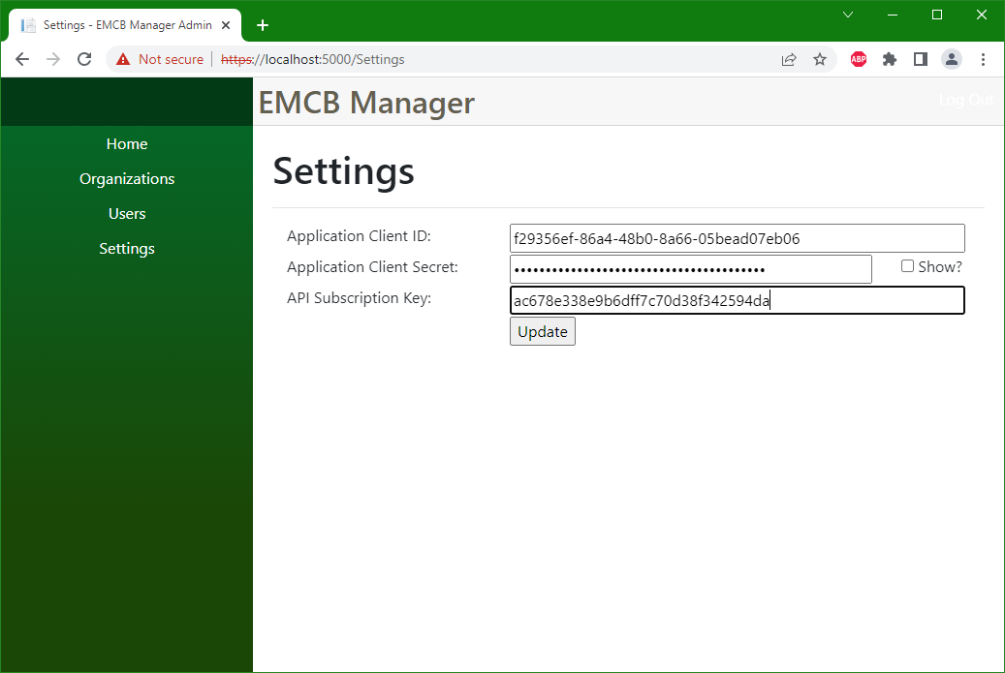
EMCB Manager – Settings Page
Manage settings for the application itself
Links the application to the Eaton API developer subscription
Note – the application is still under development

Slide 7
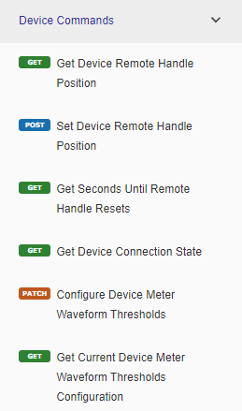
EMCB Manager – Still more to come…
From the Eaton API docs:
Organization administrators need to be able to invite installers who can use the EMCB mobile app to commission devices
Additional features to manage the devices themselves as well as their data
Webhook to receive streaming data and events from devices automatically
Integration with EPRI’s Open PQ Dashboard for data visualization

Slide 8
Grid Protection Alliance
Grid Protection Alliance (GPA) is developing the EMCB Manager as an option for users of EMCB devices to manage their data
Access to EMCB Manager will be provided as a service by GPA
Demo system to be available through February 2023 once development and testing has been completed
More information is available upon request (clackner@gridprotectionalliance.org)

Slide 9
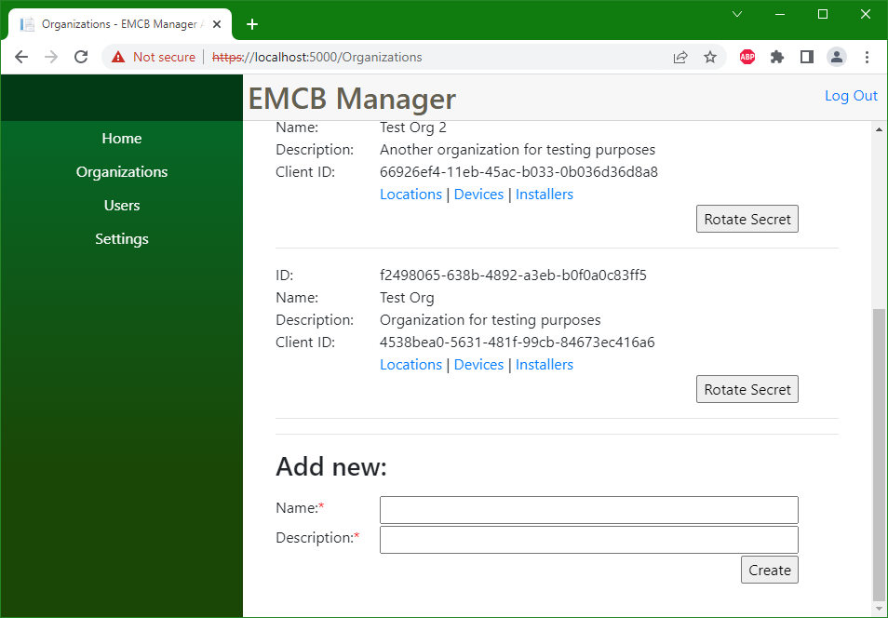

Slide 10
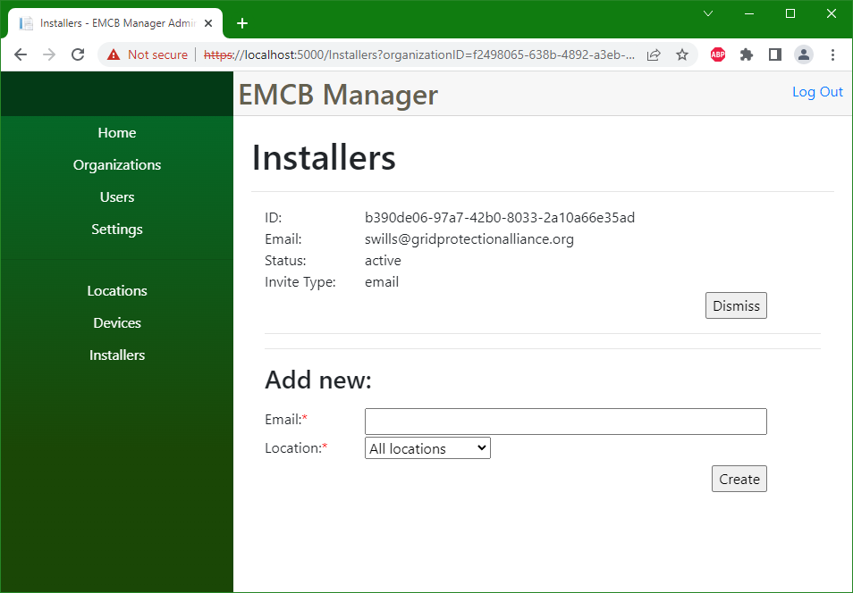

Slide 11
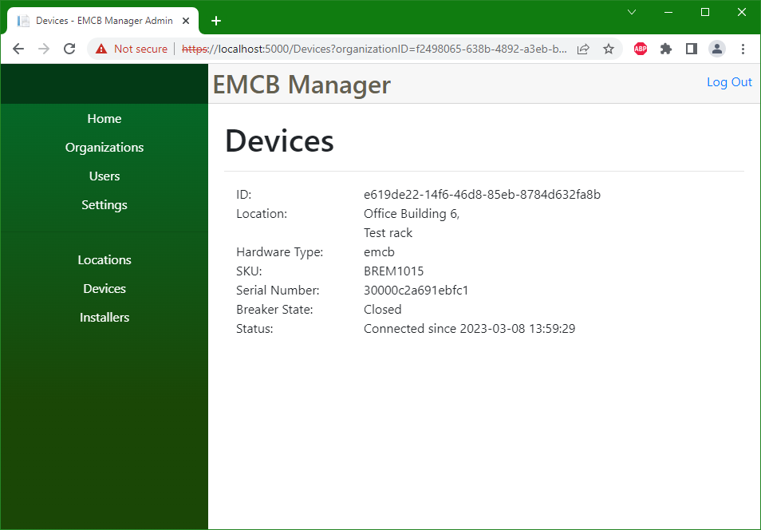

Slide 12
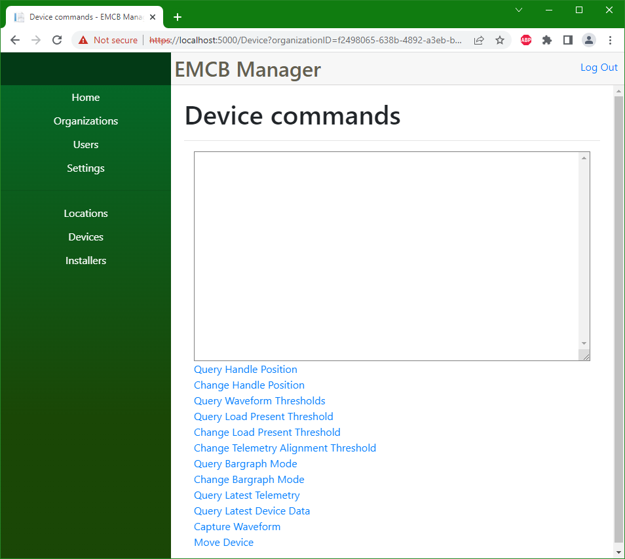

Slide 13
