Slide 1
Dominion
Grid Protection Alliance (GPA) Overview

Slide 2
GPA Upcoming I
Partnership with PingThings
  Joined support
  Improved integration
Corporate and Cyber Audits
  Working with Dominion to improve GPA corporate policies, etc.
  Working with Dominion to pass Cyber Security audit
GPA Personnel Growth
  Additional support staff (+2 since 2022)
  Additional developers (+2 since 2022)
  Continue hiring
Additio
Notes:
17 forked repositories

Slide 3
GPA Upcoming II
Changes to PQ/disturbance products
  Release of newest line of PQ products
    Improved performance (TVA tested at scale)
    Improved user experience
  Open-source with some closed-source additions
Changes to synchrophasor products
  Simplification of product line
  Enterprise Edition
    Open-source core based
  Annual User’s Group meetings starting 2024

Slide 4

openPDC Enterprise Edition
Improved User Experience
Simplify Common Workflows
Operator User Interfaces
Point by point Authentication
Compliance with EDs and FERC CIP Rules
Capability to support Audits
Data Encryption
User Interfaces
Security
Integration with MANTRA® (WSU)
Improved Integration with Predictive Grid® (PingThings)
Extended built-in analytics
Backwards compatible for open-source adapters
Event Management
Analysis
Core Technology Updates
Full integration with modern Protocols (STTP)
Tested for Substation Deployment with Hardware Vendors
Performance
Integration of Alarm Visualizations
Integration with Operator Fabric ® (RTE)
Extensive Report Generation Tools
Alarming
Reporting

Slide 5
Security
Working with Dominion Cyber Security to meet requirements for control room
Working with Dominion to get GPA infrastructure up to requirements
Several certifications in progress
  GPA practices and procedures
  Synchrophasor applications
  PQ/Disturbance applications
Compliance with upcoming FERC, NERC and DOE requirements (including ED)

Slide 6
Performance
Upcoming work with Dominion for substation deployments
Working with hardware vendors (SEL, APP) to test on substation devices
Working with Kevin’s team on improving performance on Dominion systems
Extensive testing with Predictive Grid

Slide 7
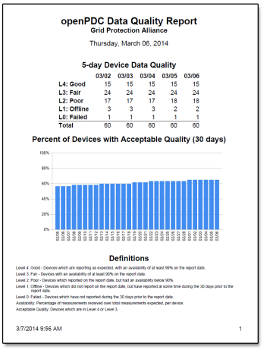
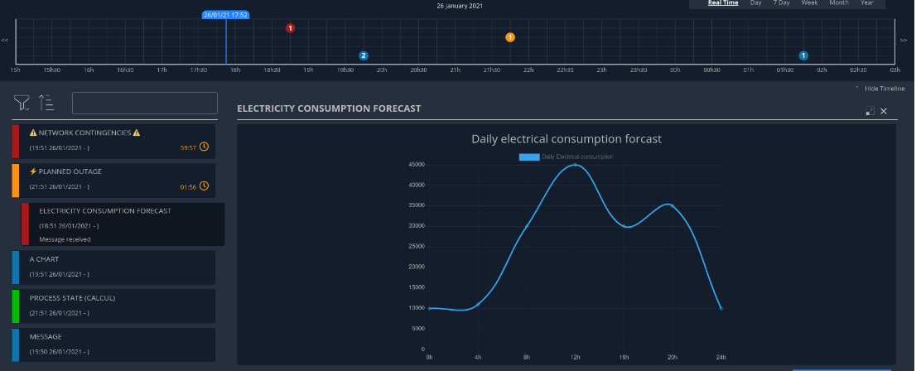
Alarm and Reporting
Worked with Dominion on extending data availability reports
Added reporting on other metrics
Alarm and event visualization for operators

Slide 8
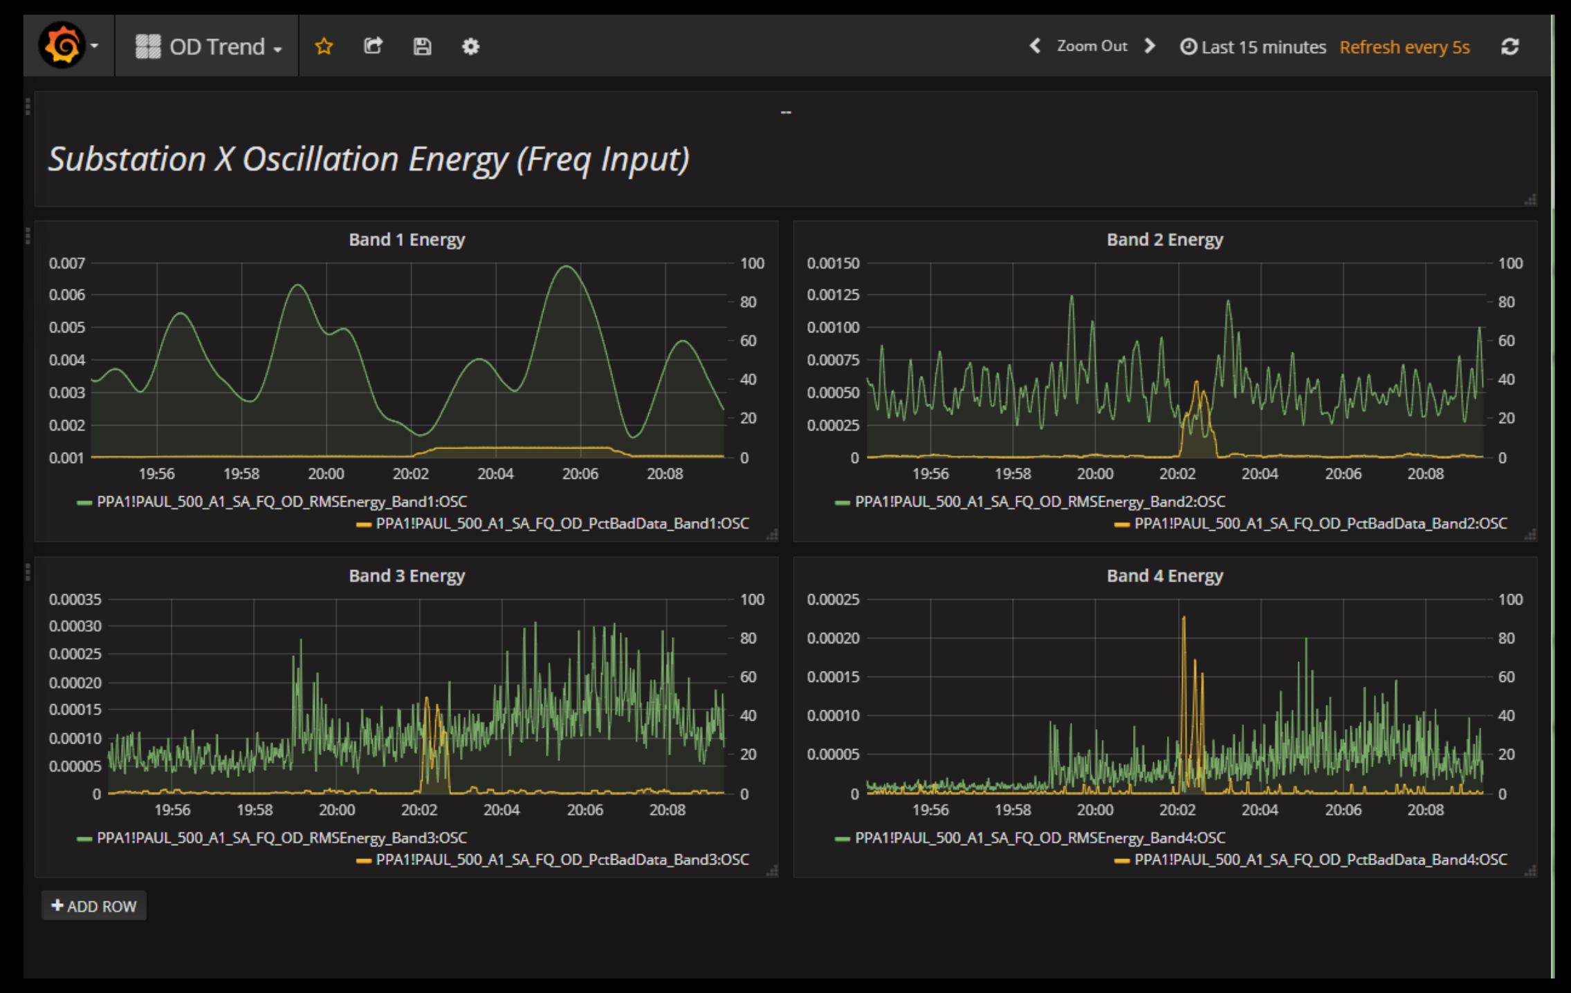
Analysis
Inclusion of MANTRA
  Modal ANalysis and Oscillation TRAcking
  Based on WSU’s tools
Build-in analysis
  Islanding detection, etc.
  Based on improvements to various open-source adapters
Backwards compatibility to open-source version

Slide 9
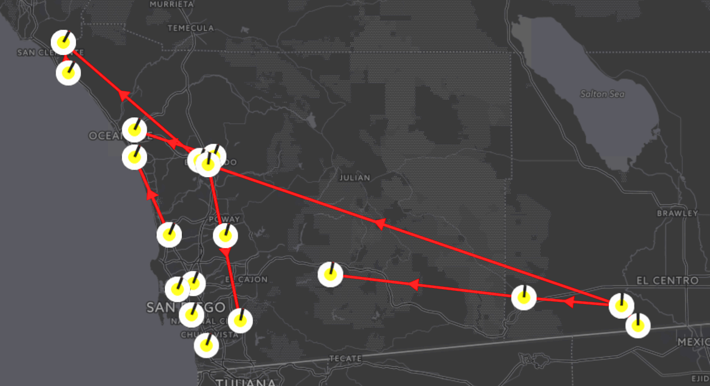
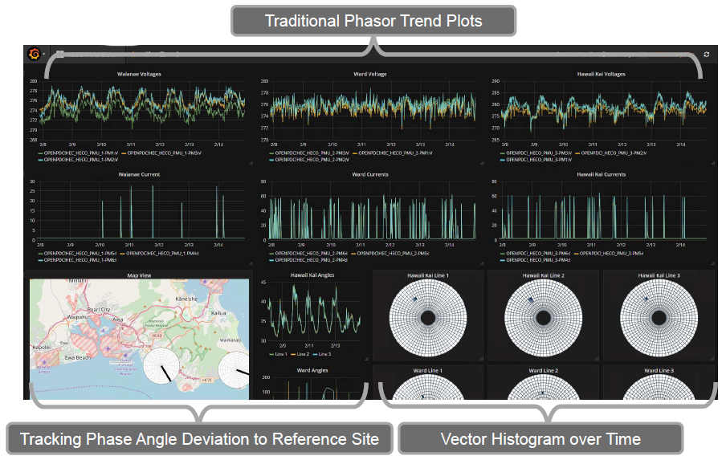
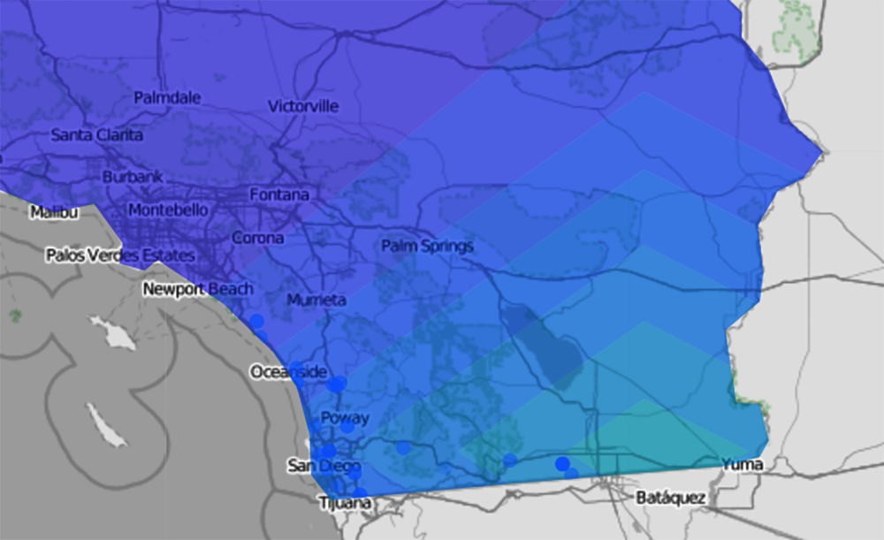
Improved User Experience
Redesign of common workflows
Update to newer technology – support for modern IT services
Updated documentation and training resources
A display to highlight frequency change.
A display to monitor angle differences.

Slide 10
Business-Related Changes
Improving support procedures
  24x7 availability
  In line with standards for 24x7 software support
Business policies and procedures
  GPA to be in line with Dominion Vendor requirements
Addition of more traditional pricing model
  Enterprise Edition will require a license
  Increased one-time cost, lower annual cost

Slide 11
Annual Synchrophasor User’s Group
Best options to maximize attendance
  NASPI meetings
  IEEE meetings
  Utility hosted
Keynote speaker
Participation from other vendors
  PingThings
  PMU Vendors

