Slide 1
GPA Synchrophasor Products Overview

Slide 2

Grid Protection Alliance
GPA is a not-for-profit corporation established in 2010.
Specializes in software and services for the electric utility industry
All software is open-source, published under the permissive MIT license
Focus is on a robust, reliable and resilient grid
https://gridprotectionalliance.org

Slide 3
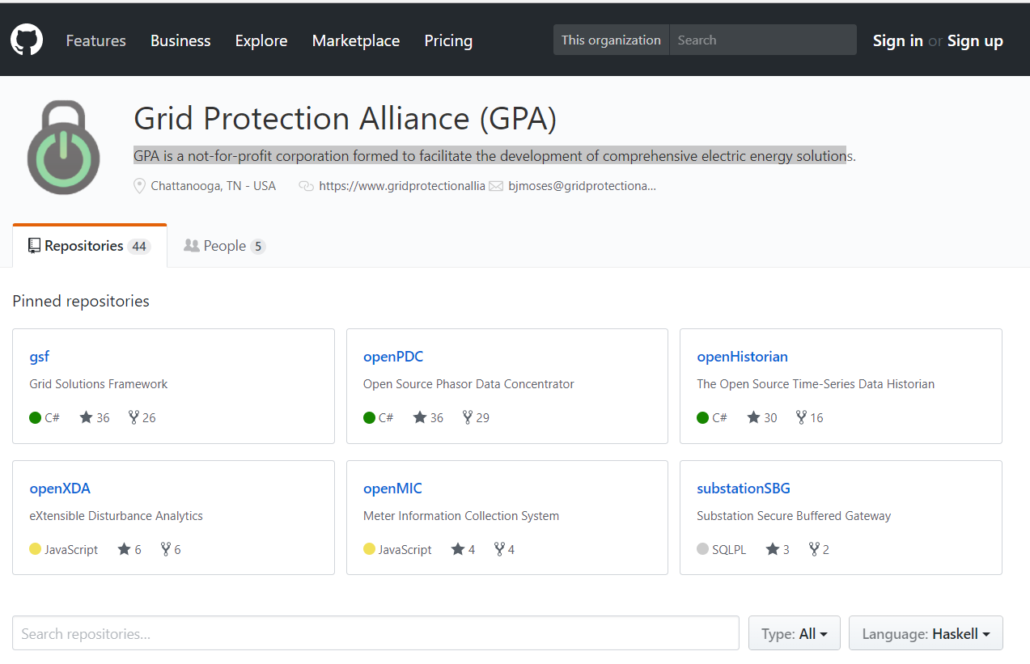
GPA Software is Open Source
Posted on GitHub
  51 Public Repositories
  11 Private Repositories
OSS has Permissive Licensing
Nightly builds available
online from GPA
GPA is an active open-source code steward
Code Security
  Checked at development time
  Checked nightly using SonarQube with OWASP
Notes:
17 forked repositories

Slide 4




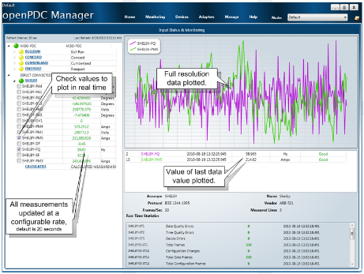
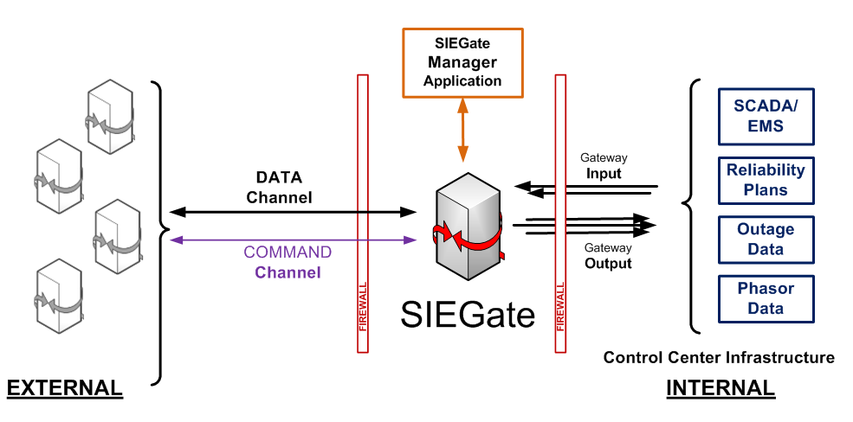






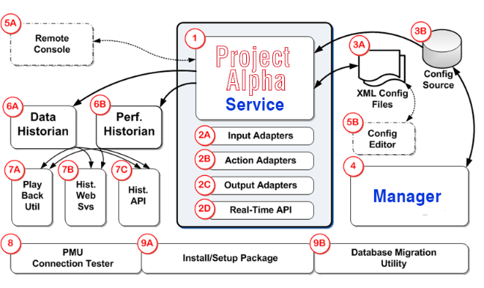
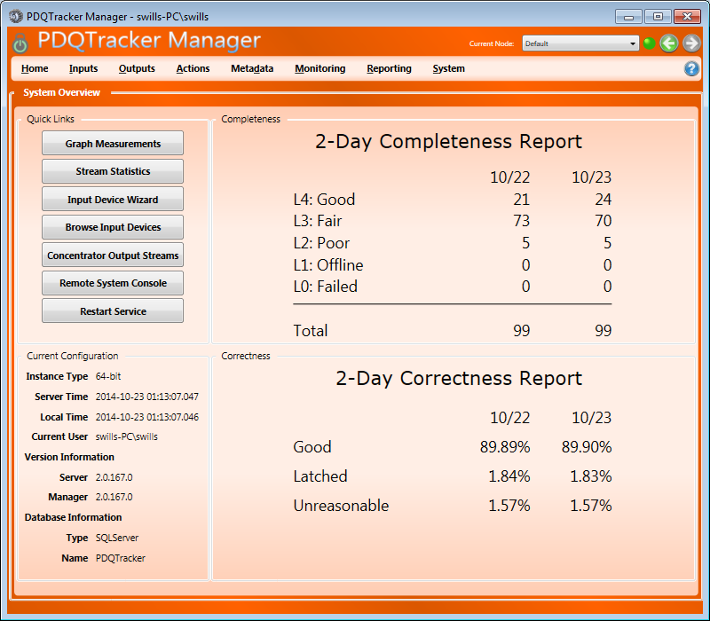
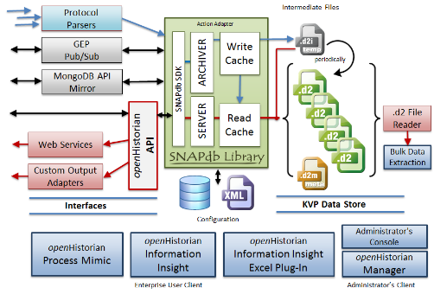


GPA Synchrophasor Products
Collect
Distribute
Analyze
Save
Display

Slide 5


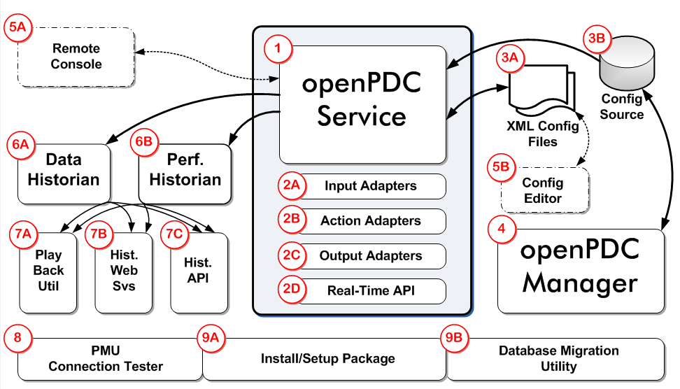


openPDC
Version 2.8
The electric industry’s
work-horse PDC supporting
the largest synchrophasor
data systems in North America
Massively threaded, distributed
multi-node architecture enables
high availability and throughput
Logs performance history
every 10 seconds – includes
latency, data completeness,
and connection errors, among
others
Supports Windows (including Server versions) - Linux & Apple OSX deployments supported via Mono
Easily extensible with the development of input, output or action adapters
Remote manager simplifies administration
Recent Improvements
IEEE C37.118-2011 with Config Frame 3 Support
Improved DNP3 Interface
https://github.com/GridProtectionAlliance/openPDC/releases

Slide 6

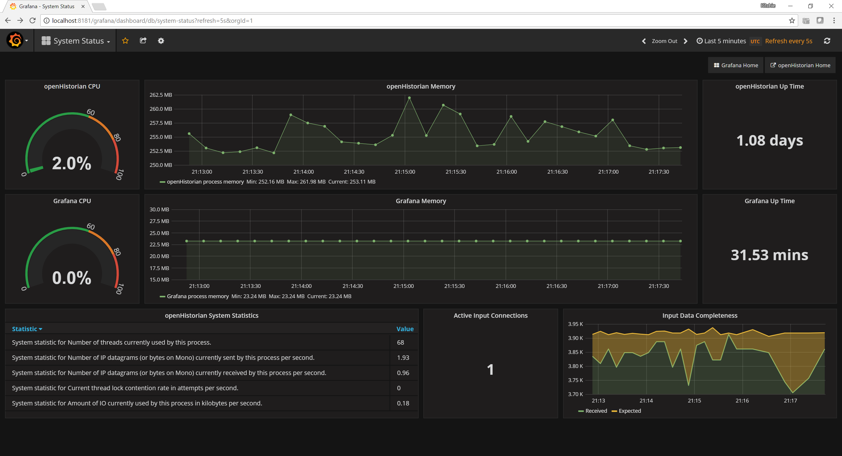
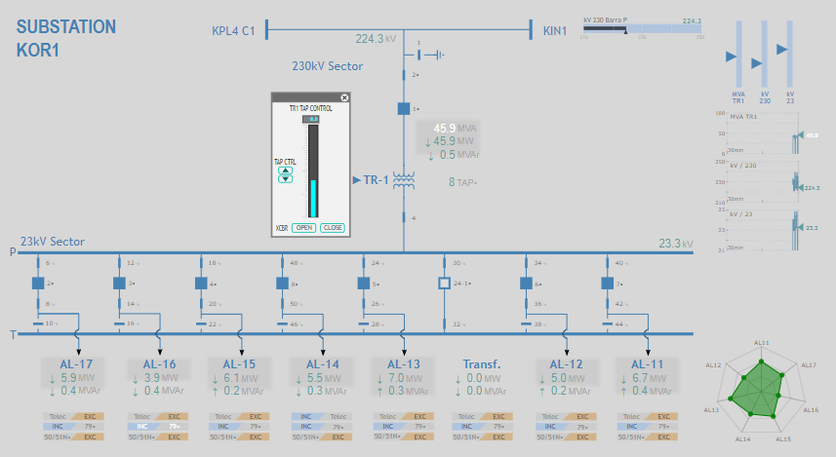
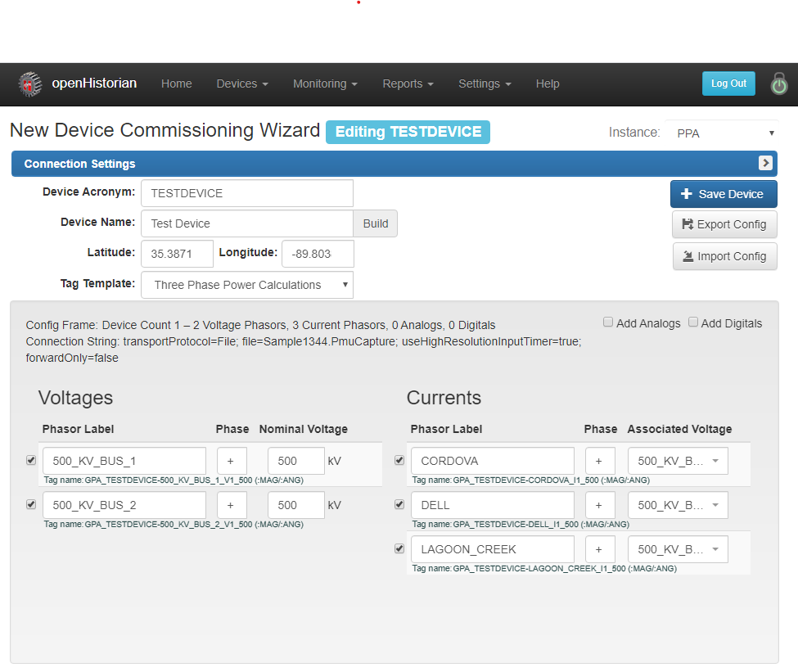

openHistorian
Version 2.7
High performance processing of
time-series data
  For both data
  archival and retrieval
  High frame rate
  application refresh
  Fast extraction of
  large data blocks
Support for multiple data
types
GPS precision timestamps
Can insert data out of sequence
Lossless data compression
Recent Improvements
Includes Grafana server Version 9.5.1
Includes new Geo Map and Data Export Panels as well as Device Filtering in Alarms
Improved WPF Synchrophasor Device Add/Update Wizards
https://github.com/GridProtectionAlliance/openHistorian/releases

Slide 7
Synchrophasor Data Applications
Phase Angle Visualization
Oscillation Detection
Oscillation Source Location
Islanding Detection
Wide Area Damping Control*
Asset Health Monitoring
  UnBalance Monitoring
  Signal-to-Noise Ratio Monitoring
Power Computations
Complex Alarming
System Event Management

Slide 8
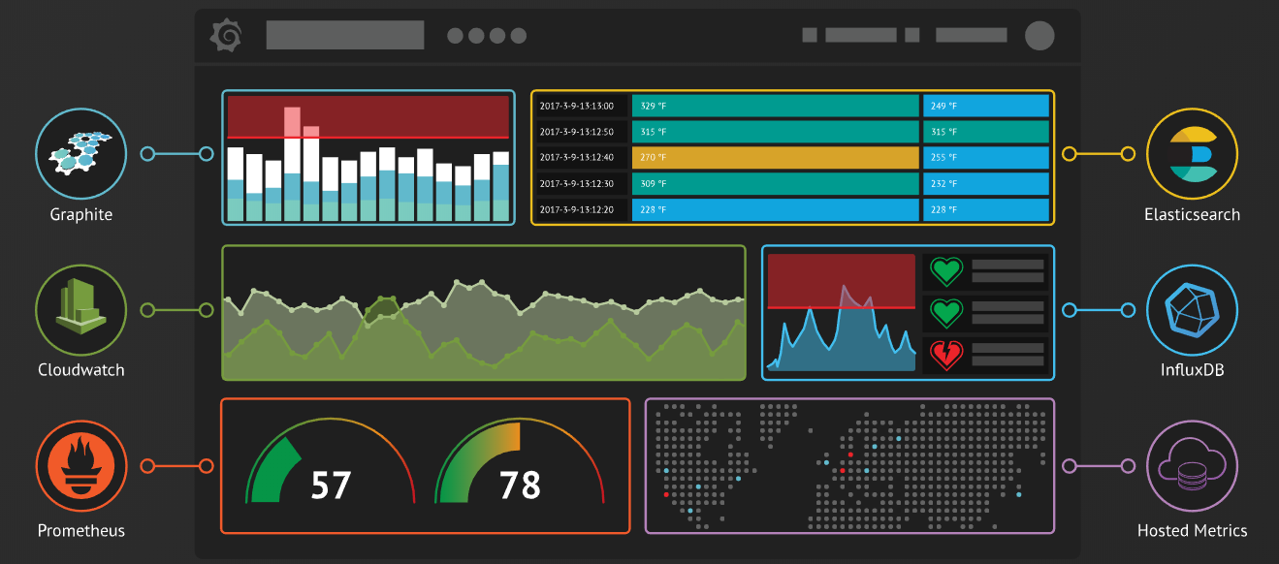

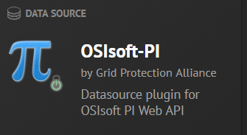
GPA Leveraged Technology
Open source
GPA published plug-ins for openHistorian, PI, and custom map and phasor widgets
Rapidly expanding library of graphical widgets
Displays easily shared
Extensible
https://grafana.com

Slide 9
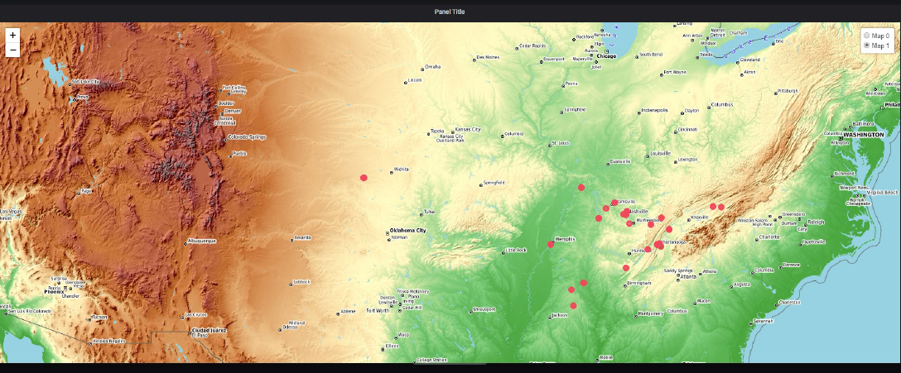
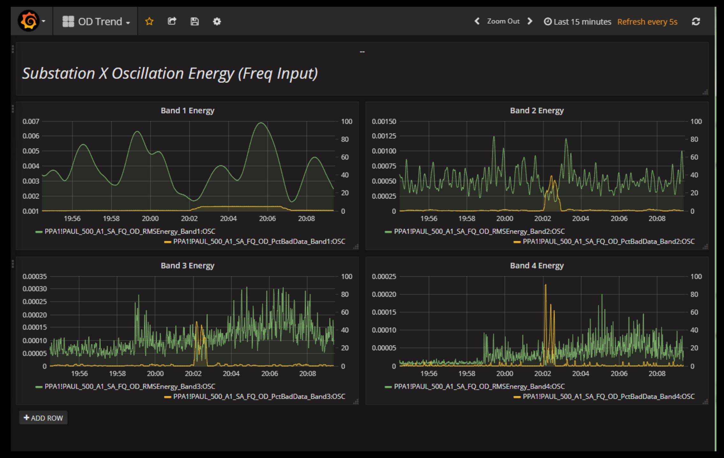
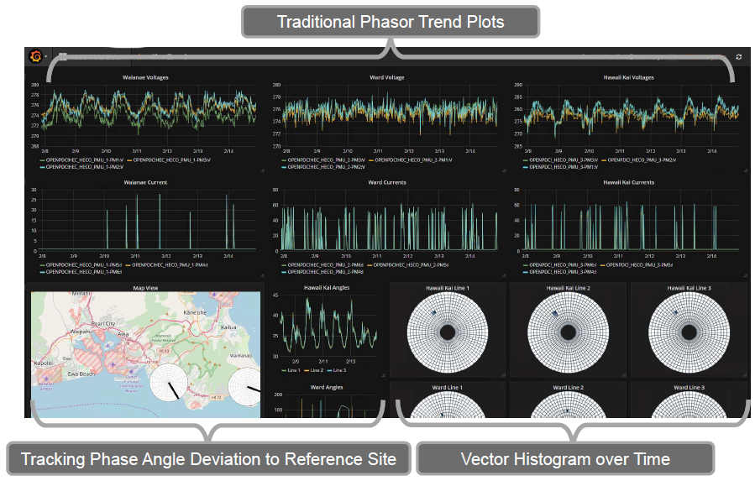
GPA Leveraged Technology

Slide 10
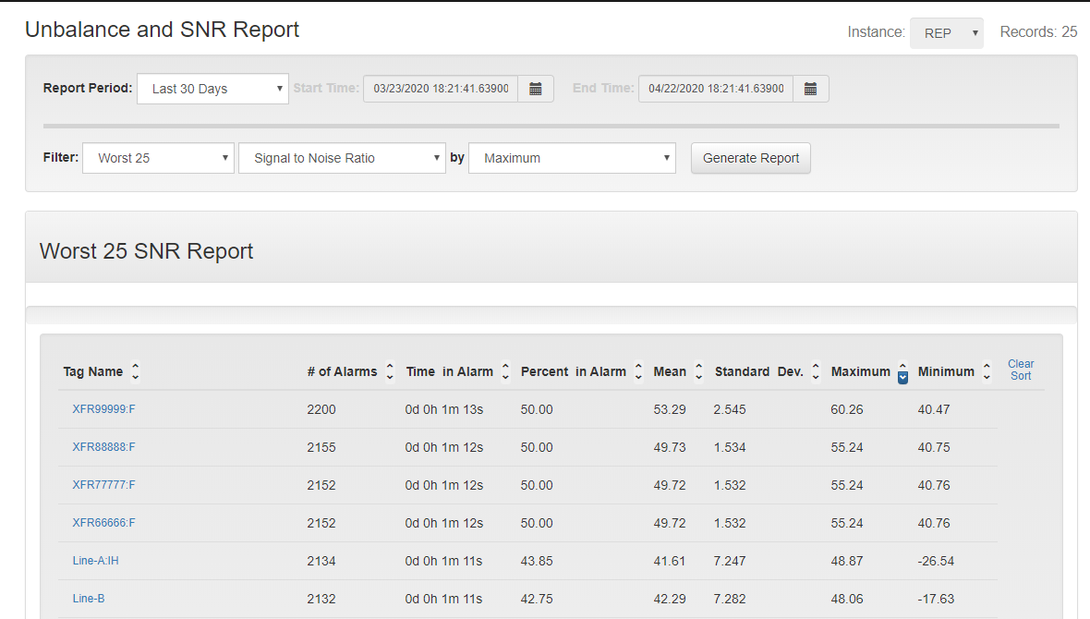
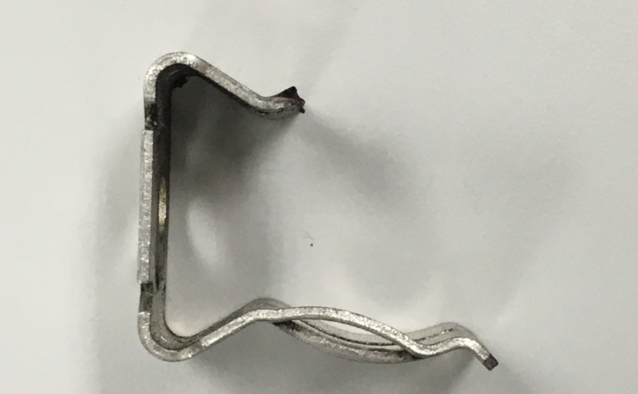
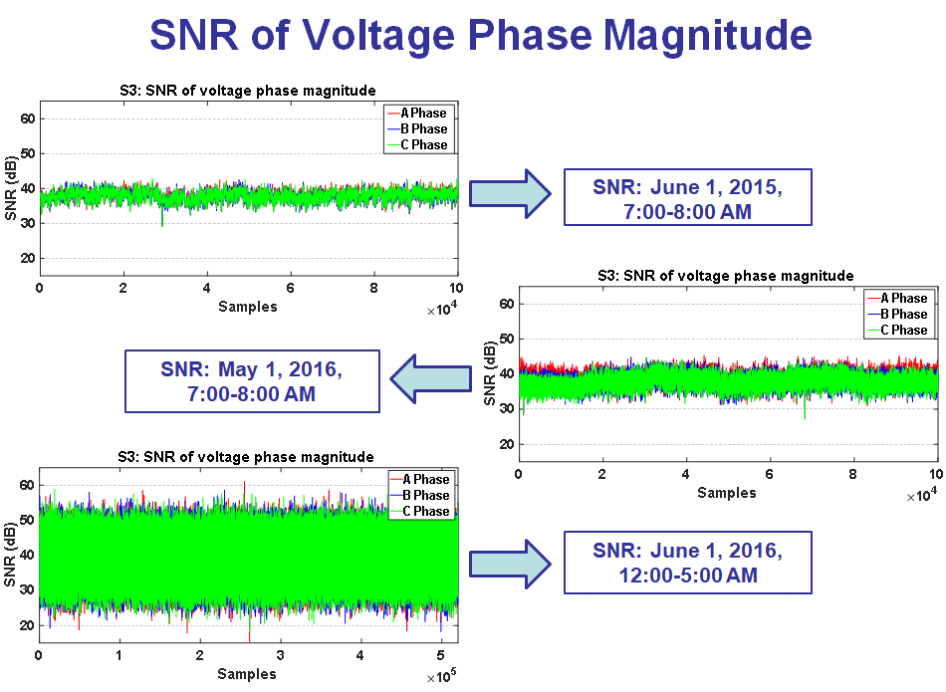
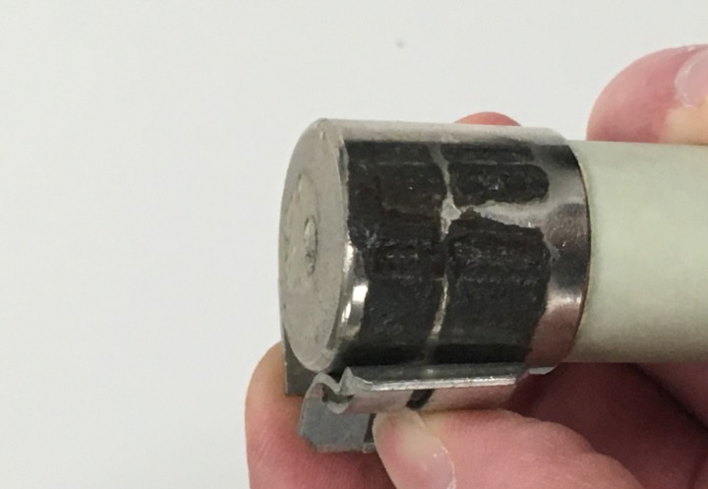
SNR Reports
Cause of growing noise – failed fuse clip

Slide 11
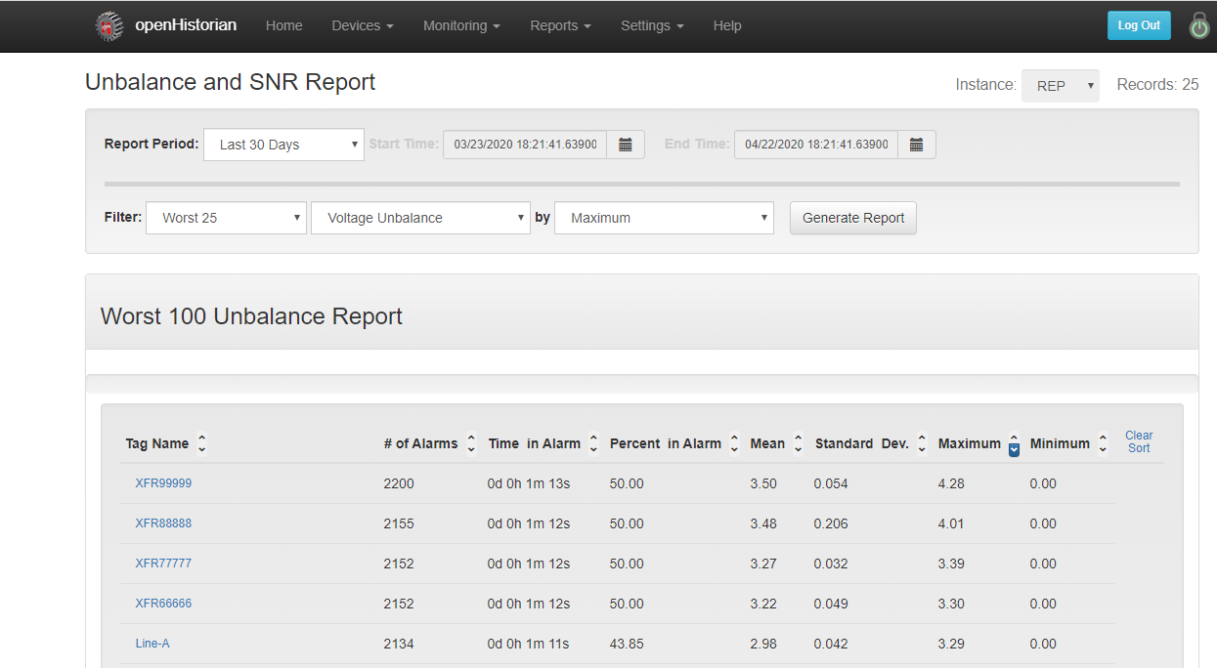
Unbalance Reports
Unbalanced Operation leads to
  Higher losses
  Stress on transformers and generators
Unbalance Reports
  Identify unbalanced lines
  Alert and notify
Notes:
Notes

Slide 12
Oscillation Detection
2-Axis
  Energy
  Bad Data
15 minute window
5 second refresh
Oscillation Bands
  Band 1 – 0.0 to 0.1 Hz
  Band 2 – 0.1 to 1 Hz
  Band 3 – 1 to 5 Hz
  Band 4 – 5 Hz and Up

Slide 13
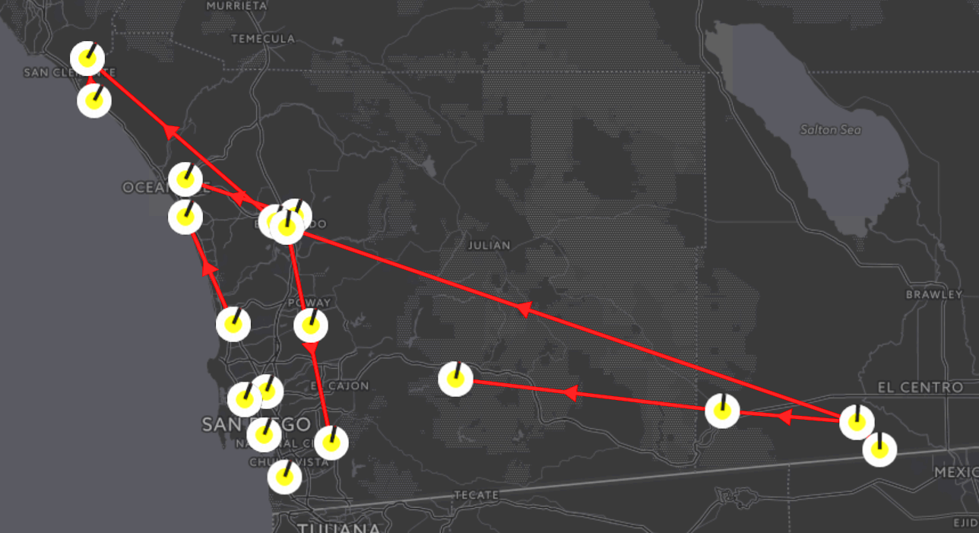
Phase Angle Difference Monitoring
A display to monitor angle differences.

Slide 14
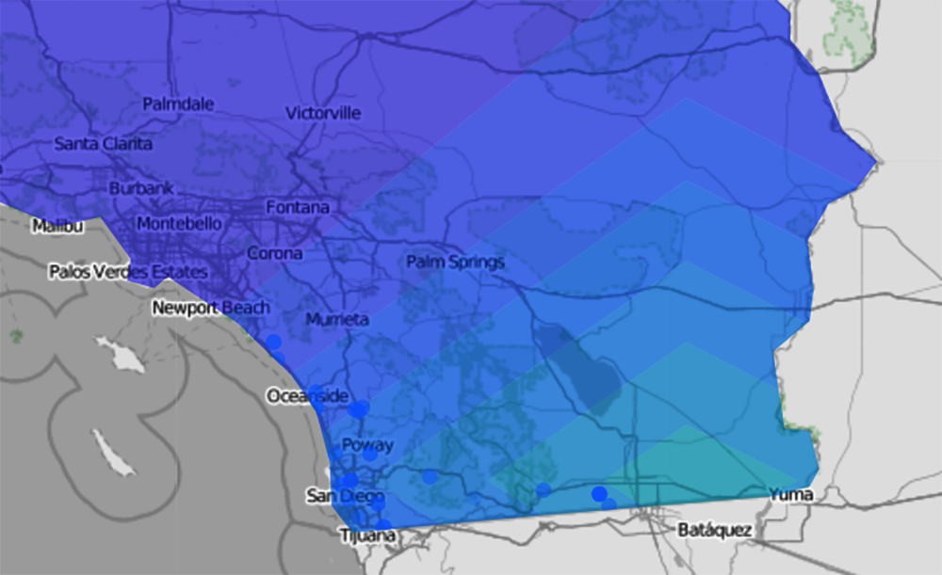
Map Overlays
A display to highlight frequency change.

Slide 15
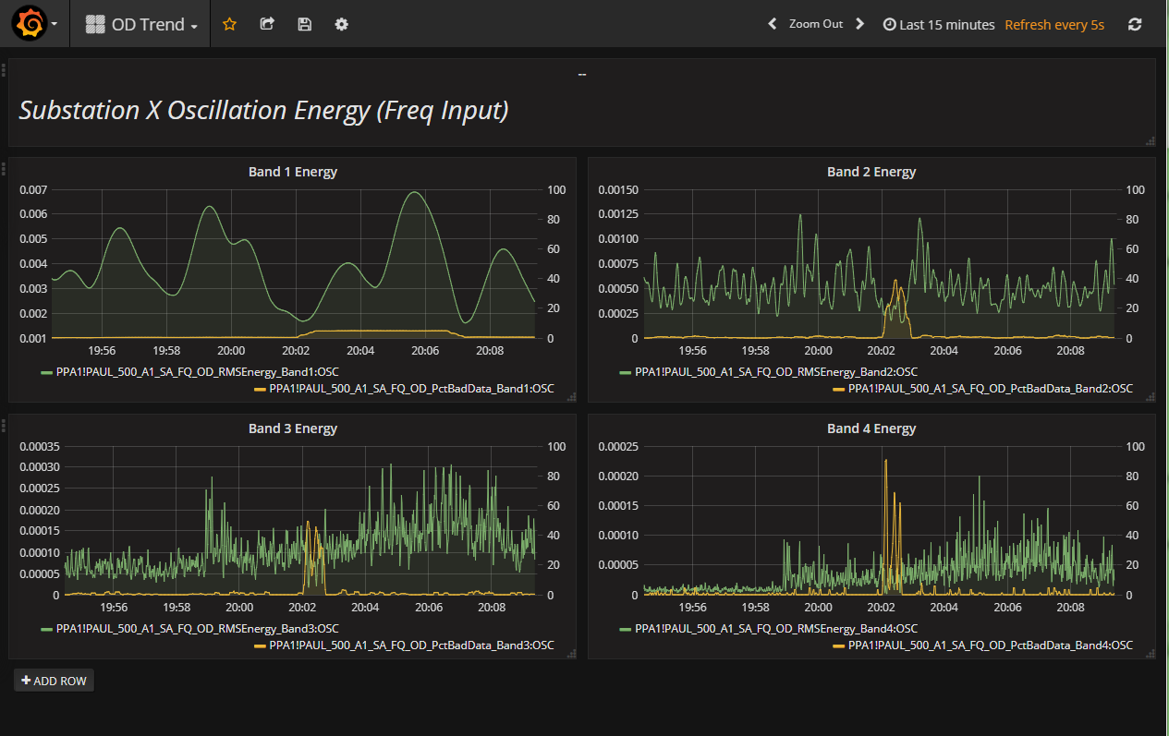
Oscillation Detector
Osc
Detctr
Outputs to OpenPDC
Band1 Energy (e.g., governor)
Band2 Energy (e.g., system mode)
Band3 Energy (e.g., local mode)
Band4 Energy (e.g., voltage controller)
Input, e.g., MW
from openPDC
One input at, for example, 30 samples per second
Four outputs at one sample per second
There are an additional four outputs to indicate trustworthiness of energy estimates

Slide 16
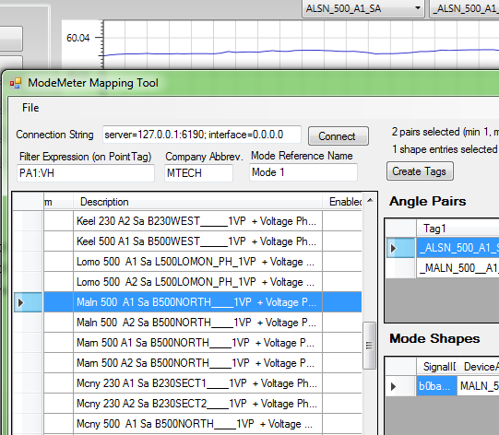
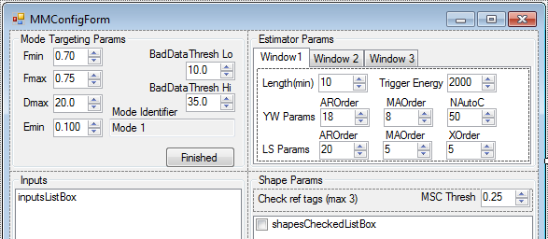
Mode Meter
Inputs from openPDC
Must be voltage angles
Up to 20 inputs
Selected to offer max
visibility of modal activity
Outputs to openPDC
Mode Frequency
Mode Damping
Energy captured by signal processing algorithms
Mode shape, consisting of up to 20 magnitudes and angles
Mode
Meter
Multiple inputs from openPDC
Each input is required to be a voltage angle
Extensive setup and configuration required – this analytic really
tested openPDC
configuration mechanism

Slide 17
Event Management
Events can be triggered by automatically by alarms
  Supports basic Expressions
Events can be triggered manually
  Supports additional information
Events can be triggered by analytics
  Oscillation Detection
  Islanding Detection
  Custom Developed Adapters

