Slide 1





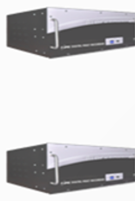





Application
Server 1
Application
Server 2
Users
Meters
Database Server/
File Share
IIS Server
Notification Pages
SQL Databases
File Share

